Slide 1


Slide 2
8. Resource Management
©Singapore Green Building Council 2014
Notes:
To focus on the health of buildings and consumption of resources in buildings. This lesson builds on Lesson 7 by looking at the indoor environmental quality of buildings and how this relates to health and wellbeing – green products play a role in building interiors. In addition, this lesson will look at the usage of water within buildings and the strategies to reduce the consumption.

Slide 3
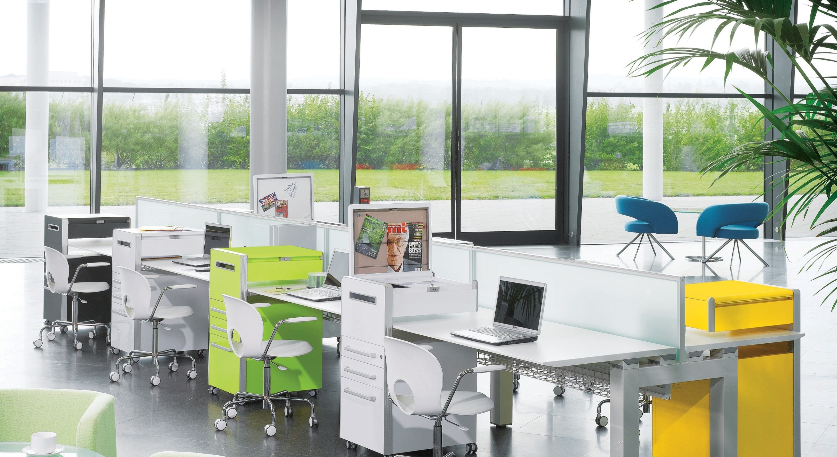
Indoor Environmental Quality
Indoor environmental quality (IEQ) refers to the quality of a building’s environment in relation to the health and wellbeing of those who occupy space within it. It depends on a number of factors.
©Singapore Green Building Council 2014
Notes:
When constructing cost-effective buildings, it is easy to forget that the success or failure of a project may rest on its indoor environmental quality (IEQ). Healthy, comfortable employees are often more satisfied and productive. Unfortunately, this simple truth is often lost, for it is easier to focus on the first-cost of a project than it is to determine the value of increased user productivity and health. Facilities should be constructed with an appreciation of the importance of providing high-quality, interior environments for all users.

Slide 4
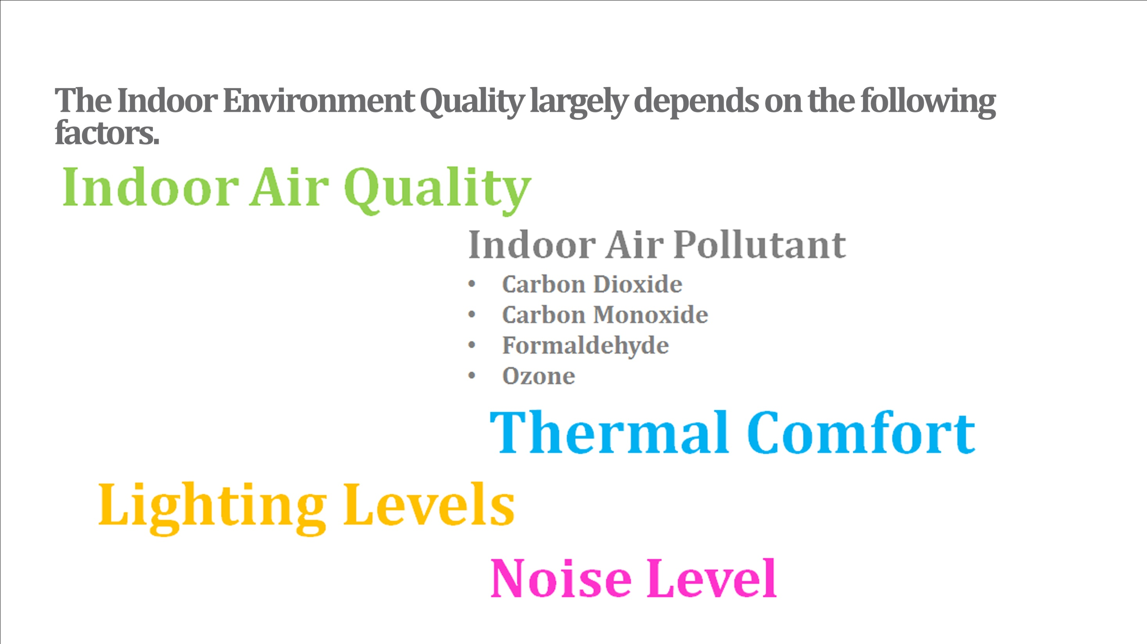
©Singapore Green Building Council 2014
Notes:
Green Buildings aim to provide a good healthy working environment for occupants so as to boost productivity levels.
Carbon dioxide Carbon dioxide is present in the unpolluted
atmosphere at a concentration of about 0.03% percent
but since about 5% of the air we breathe out is carbon
dioxide the level increases in inadequately ventilated
occupied rooms. The level of carbon dioxide is
therefore often used to assess the efficiency of
ventilation. Outside sources include vehicle exhaust
fumes or other exhausts.
Carbon monoxide Any process of combustion can produce carbon
monoxide, including cooking and tobacco smoking.
A major source of carbon monoxide is vehicle
exhaust.
Formaldehyde Formaldehyde is a colourless gas with a pungent
odour. It is found in hundreds of different products,
including insulation material, ceiling tiles, particle
board, plywood, office furniture, carpet glues, various
plastics, synthetic fibres in rugs, upholstery and other
textiles, pesticides, paint and paper. Levels of
emission increase with temperature.
Ozone Ozone is naturally present in the air since it is produced from oxygen by ultraviolet radiation. However, it can also be produced by electrical discharges and is emitted by some items of electrical equipment such as photocopiers and electrostatic precipitator devices used to clean the air by removing dust.

Slide 5
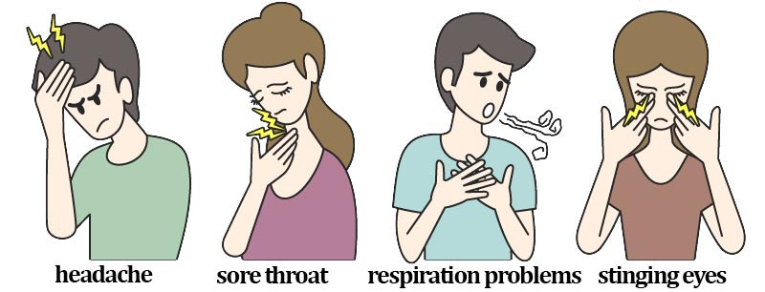
Sick Building Syndrome
Sick building syndrome refers to an excess of work-related irritations of the skin and mucous membranes and other symptoms (including headache and fatigue) reported by occupants in modern office buildings. [BCA]
This adversely affects the productivity of workers.
©Singapore Green Building Council 2014
Notes:
Personnel costs are critical
Studies show a 3 – 7% gain in productivity pays all energy bills
And a 10% gain in productivity pays for the entire building.
That is why green buildings are designed to improve the indoor environmental quality which improves productivity via reduction in absentism rate and better working environment.

Slide 6
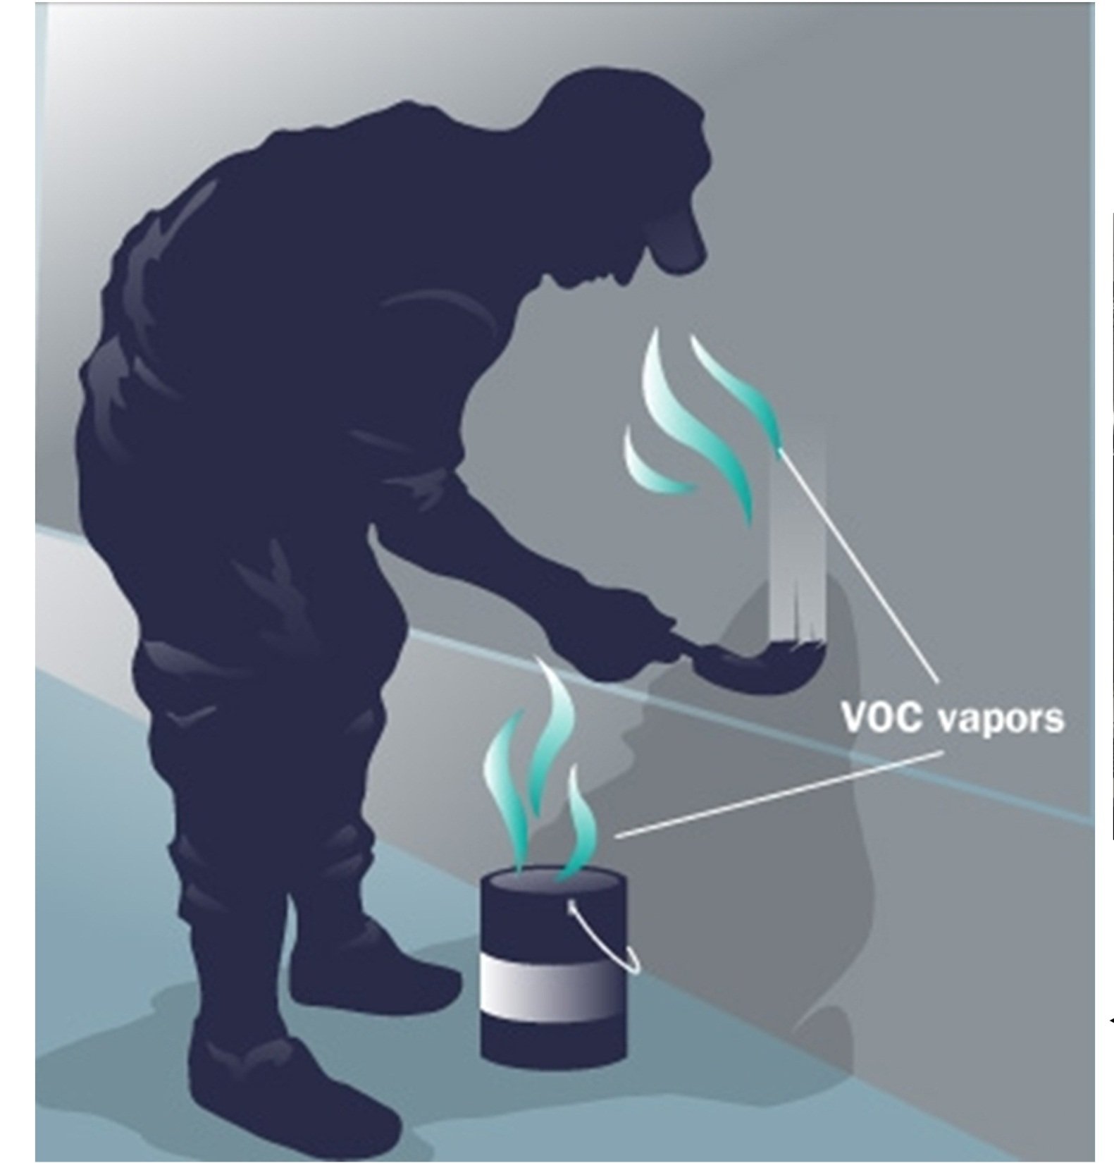
Sick Building Syndrome
How?
Sources of Indoor Air Pollutant
  Paints
  Adhesive that contain formaldehyde
Health Impacts
  Over exposure could result in eye, nose and throat irritation; wheezing and coughing; fatigue; skin rash or severe allergic reactions. High concentration may trigger attacks in asthma.
Solution
  Use zero or low VOC paint and use certified environmental friendly adhesive
©Singapore Green Building Council 2014
Notes:
Paints may have a major negative impact on the health of a building because they can contain VOCs and other toxic
components which evaporate into the air and are harmful to the occupants. The health effects of exposure to VOCs are
eye, nose and throat irritation, headache, nausea and more serious illnesses - heart, lung and kidney damage.
Formaldehyde is a gas at room temperature and is widely used as an adhesive in the manufacture of composite wood
such as MDF and particleboard. The health effects of exposure to formaldehyde could result in eye, nose and throat
irritation; wheezing and coughing; fatigue; skin rash or severe allergic reactions. High concentration may trigger attacks
in asthma. It may also increase risk of cancer.
Formaldehyde exposures of 0.1ppm or less are well below both the irritant and cancer thresholds, and no adverse health
effects would be expected in even the most sensitive individuals, including the young, the aged, and the ill.

Slide 7
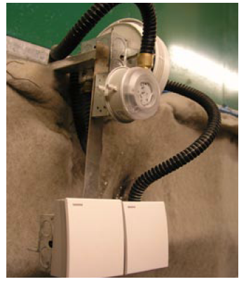
Design Considerations
Do you feel sleepy when you are in an air-conditioned space for prolonged hours?
Source: BCA
©Singapore Green Building Council 2014
Notes:
Air-conditioning space should be installed with CO sensors to modulate the amount of outdoor air introduced into the air conditioning system so that the CO2 level for the area served will always be below 1000ppm.
Higher than normal levels of CO2 can have substantial effect on the wellbeing and productivity of the occupants.
The installation of CO2 monitoring system can automatically adjust fresh air supply rates. This design can reduce the energy consumption without compromising the indoor air quality.

Slide 8
Design Considerations
Why do conventional ﬂuorescent lamps cause some people to experience headaches and eyestrain?
Why are lighting levels an important factor in determining occupant wellbeing and health in an ofﬁce?
Source: BCA
©Singapore Green Building Council 2014
Notes:
Conventional ﬂuorescent luminaries operate at a frequency of 50Hz .
This results in the light switching on and off 100 times per second and may cause headaches and eyestrain.
The use of high frequency ballasts in the range of 20kHz and higher will provide smoother, non-ﬂickering lamp operation. At this frequency, the ﬂicker is totally undetectable.
Lighting luminance levels are an important factor in determining occupant wellbeing and health in an ofﬁce. Lighting that is too weak or too strong can cause discomfort and strain for ofﬁce occupants.

Slide 9
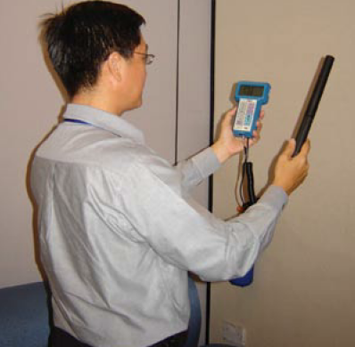
Design Considerations
Thermal comfort - Feeling too cold or too hot?
Source: BCA
©Singapore Green Building Council 2014
Notes:
Good indoor thermal comfort improves productivity at
workplace. Air-conditioning system should be designed
to take into consideration the ﬂuctuation in ambient air
temperature to ensure the following thermal comfort:
o Air temperature 22.5-25.5 Deg C
o Relative humidity < 70%
o Air movement <0.25m/s

Slide 10
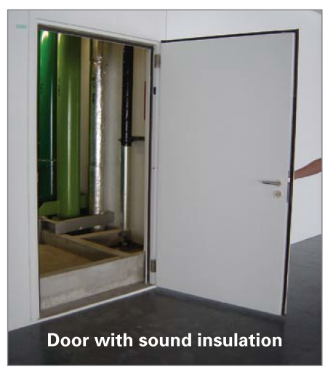
Design Considerations
Internal noise is a signiﬁcant factor in terms of occupant satisfaction and wellbeing. It can affect workplace productivity.
How about noise levels in schools?
Source: BCA
©Singapore Green Building Council 2014
Notes:
The following examples could be considered to ensure the design sound level of a building is within the limit:
• Site, orientate and layout the building such that external noise sources can be attenuated by distance or by
topographic features or walls.
• Layout of plant rooms and location of noise sources with respect to noise-sensitive areas. For example,
place acoustic buffers such as corridors, lobbies, stairways, storage rooms between noise-producing and noise-
sensitive spaces.

Slide 11
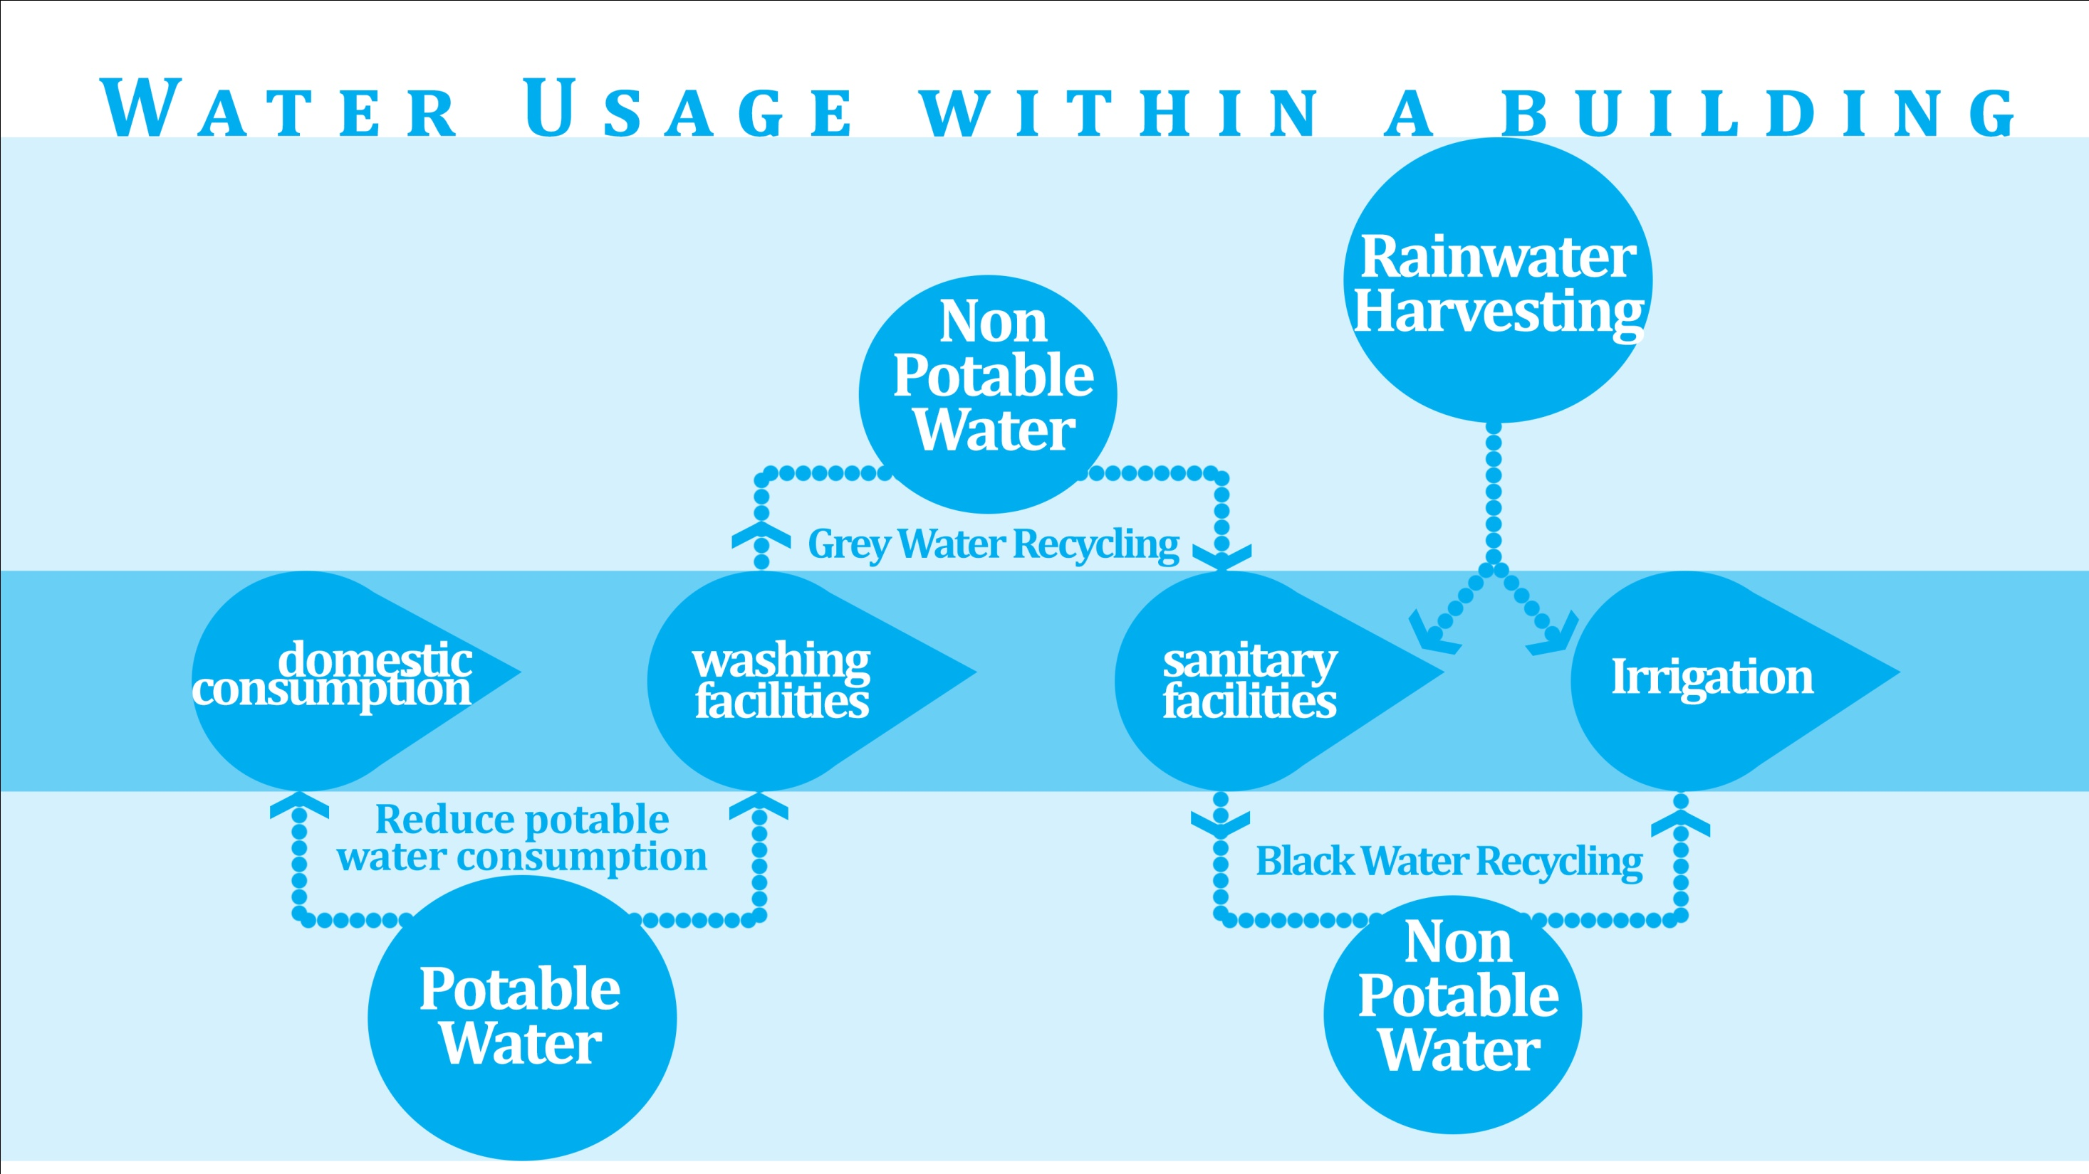
©Singapore Green Building Council 2014

Slide 12
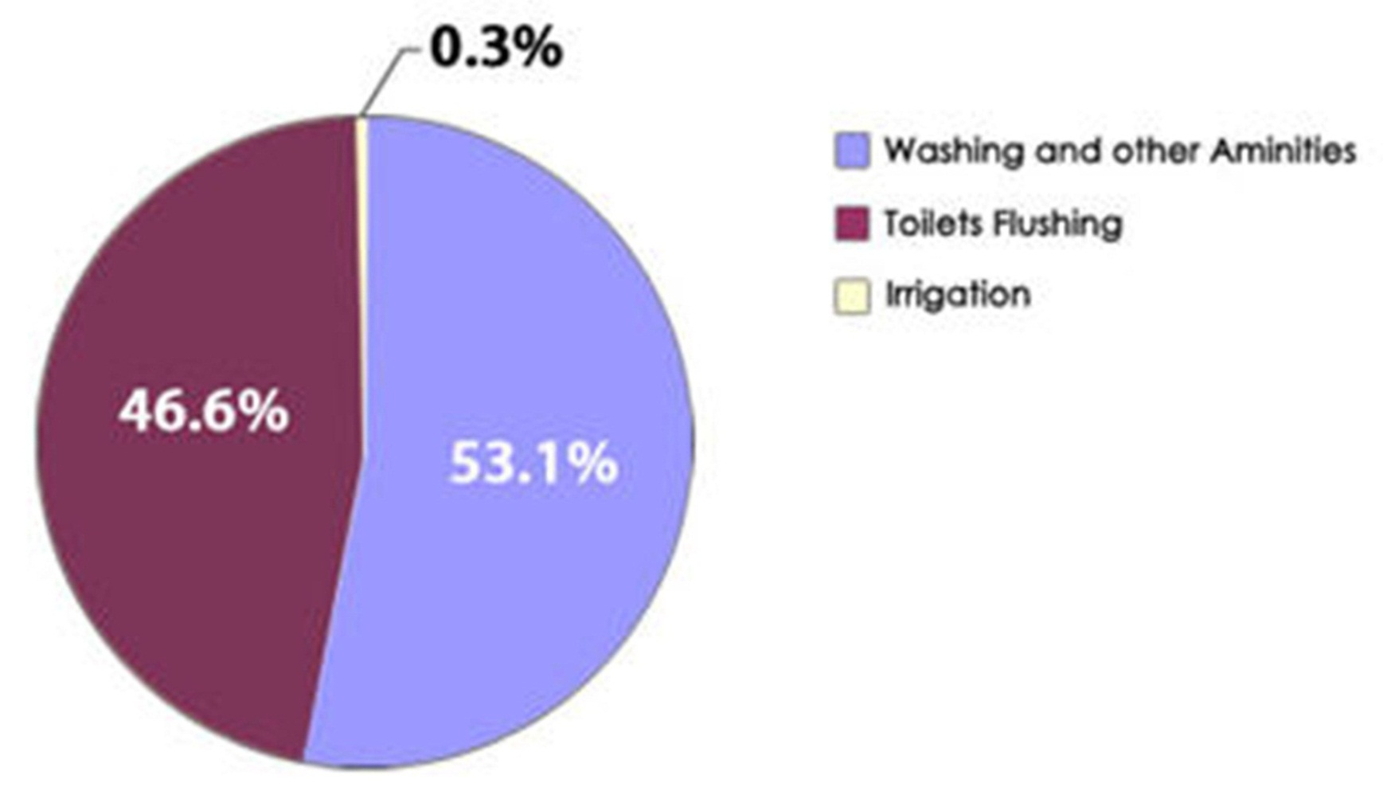
Water usage in Schools
Source: PUB
©Singapore Green Building Council 2014
Notes:
In most schools, the majority of water used is for toilet flushing and washing purposes. Cost-effective solutions offer the opportunity to lower a school's water consumption and operating costs.

Slide 13
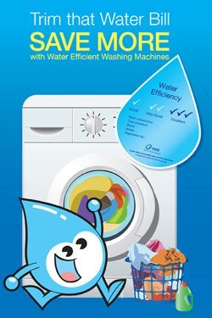
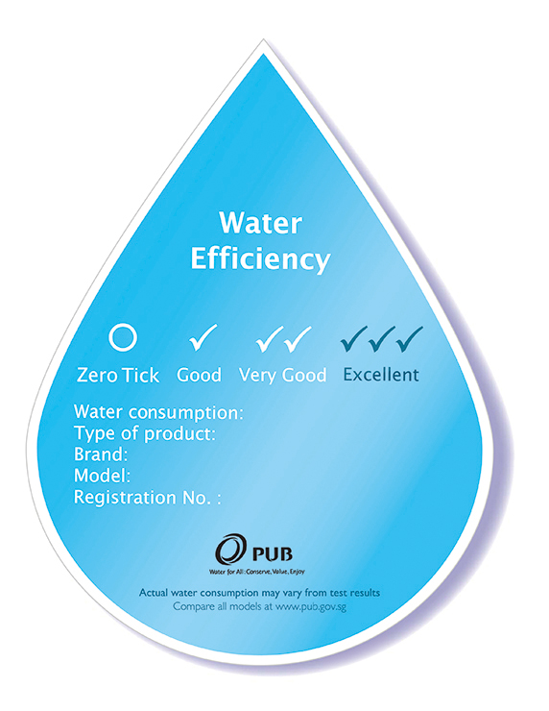
Water Efficient Fittings
Source: PUB
©Singapore Green Building Council 2014
Notes:
Having water fittings, such as flushing cisterns, washing machines, showers and taps, bearing the "Water Efficiency Label" can help to cut costs and save water.
Started in 2009, the Mandatory WELS is a grading system of 0/1/2/3 ticks to reflect the water efficiency level of a product. Currently, taps and mixers, dual-flush low capacity flushing cisterns (LCFCs), urinal flush valves and waterless urinals are labelled under this Scheme. The more ticks a product has, the more water-efficient it is. With this scheme, consumers can make informed choices when making purchases.

Slide 14
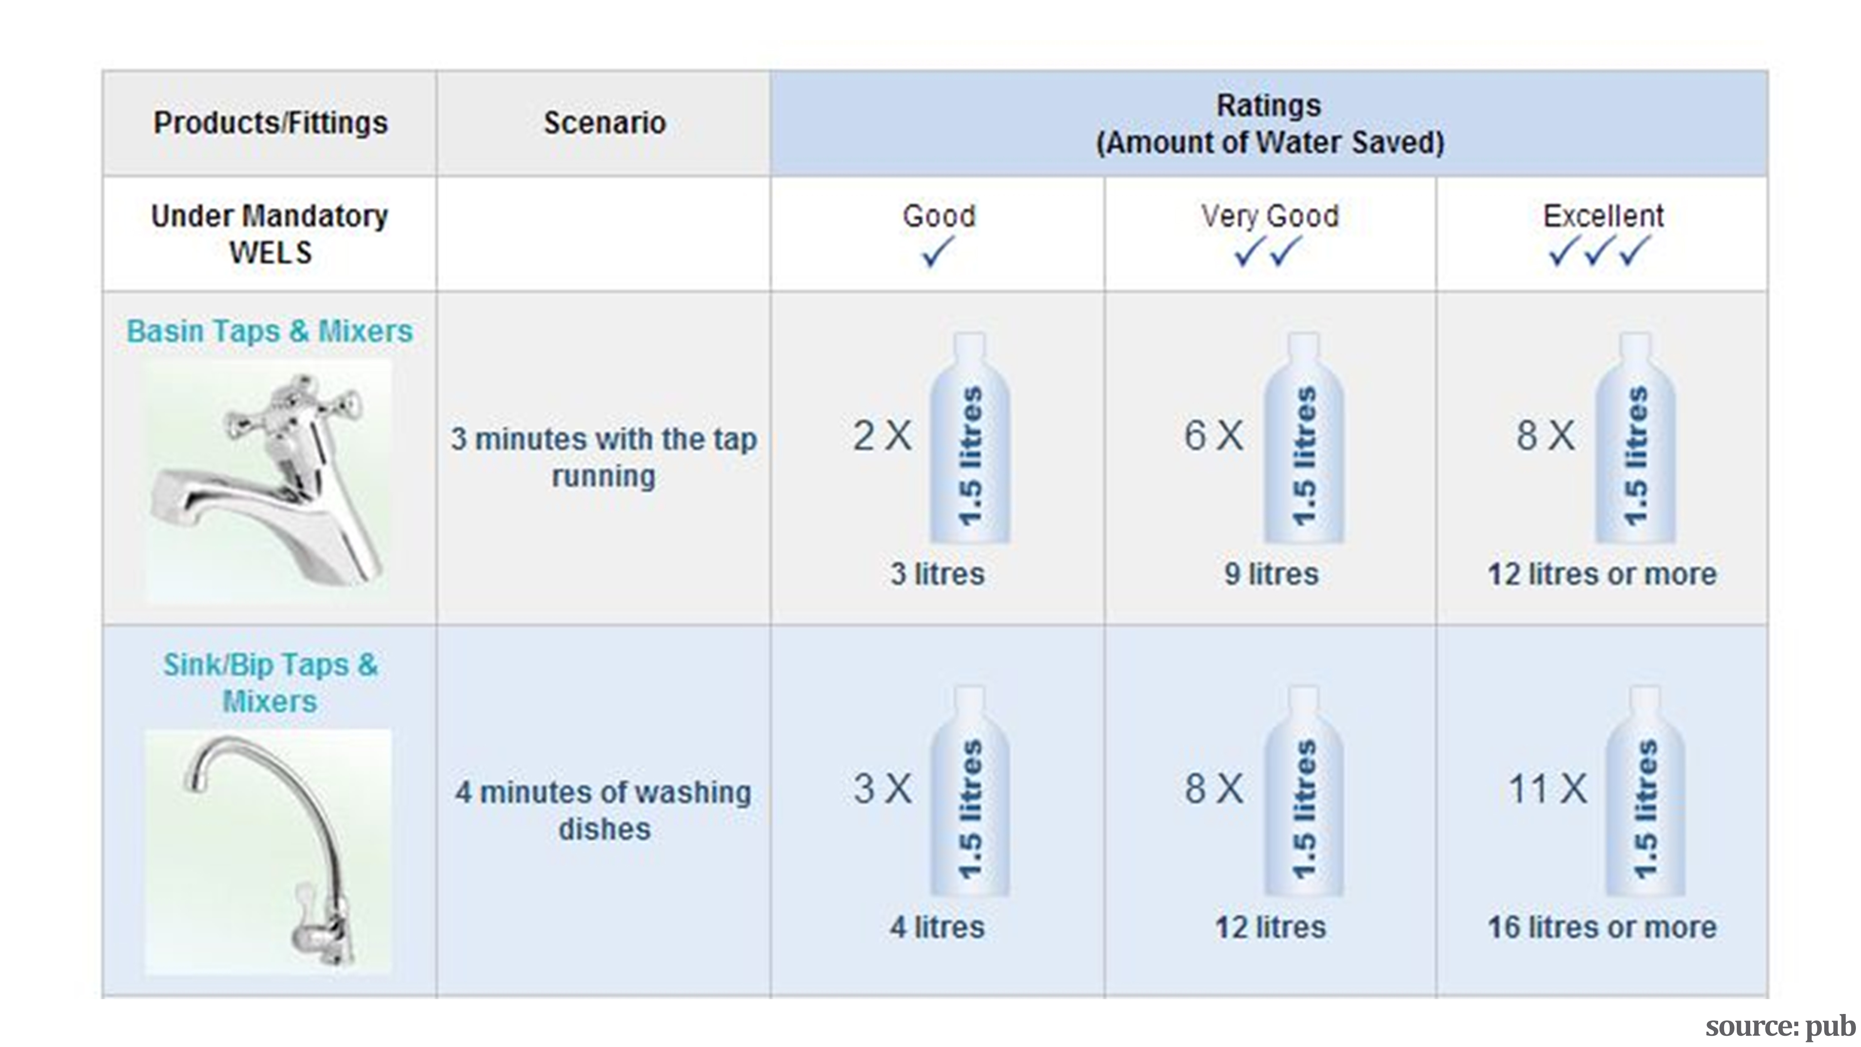
©Singapore Green Building Council 2014
Notes:
The table explains the amount of water that can be saved with the different WELS rated fixtures.
A basin tap which is rated Good, with one tick, as per the WELS can save 3 litres of water when running for 3 minutes as compared to a normal tap.
Likewise a basin tap rated excellent, with 3 ticks, would save about 12 litres of water as compared to a normal tap.
Similarly the amount of water savings that can be achieved with WELS rated Sink taps & mixers are also highlighted in the second row. The savings are estimated when the tap has been continuously running for 4 minutes as stated in the scenario in the table.

Slide 15
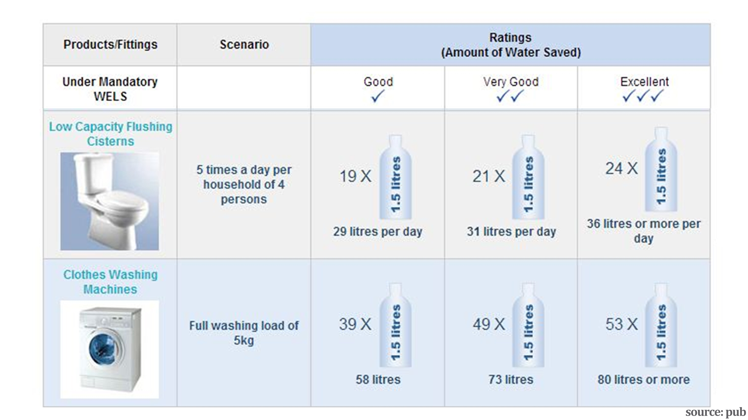
©Singapore Green Building Council 2014
Notes:
This part of the table describes the flow rates or the amount of water that could be saved in WELS rated Low capacity Flushing cisterns. The total water flushing usage of a four person household has been studied to come up with the values of water savings. An excellent rated flushing cistern can save up to 36 litres of water for a household per day.
Three tick rated washing machines can save upto 80 litres of water while washing a load of 5kg.

Slide 16
Water Usage and Monitoring
Metering BMS (Building management software)
©Singapore Green Building Council 2014
Notes:
If you cant measure then you will not be able to manage.
Any strategy aimed at reducing the water usage will essentially involve the water metering. Water meters gives us information about the water usage patterns. Careful monitoring of water meters can also help us to find water reduction strategies that can be implemented.
We can even detect leakage if we get to see an abnormal value in the meter.
Students can bring along their utility bills for analysis

Slide 17
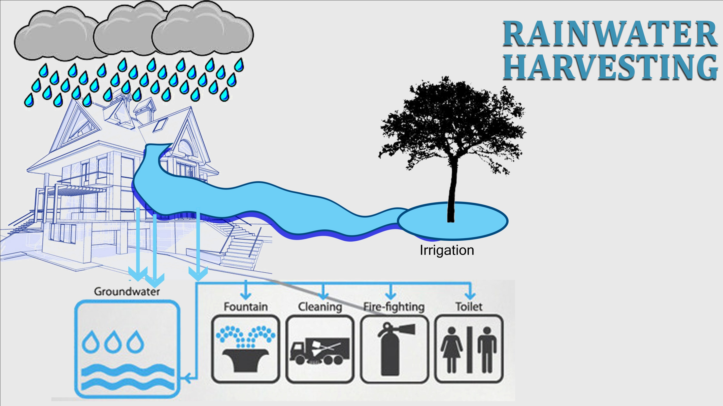
©Singapore Green Building Council 2014
Notes:
Rainwater harvesting is a technique used for collecting, storing, and using rainwater for landscape irrigation and other uses. The rainwater is collected from various hard surfaces such as roof tops and/or other types of manmade above ground hard surfaces.
Rainwater Harvesting Advantages
Makes use of a natural resource and reduces flooding, storm water runoff, erosion, and contamination of surface water with pesticides, sediment, metals, and fertilizers
Reduces the need of potable water for non potable uses.
Excellent source of water for landscape irrigation.
Reduce your water bill
Promotes both water and energy conservation
No filtration system required for landscape irrigation

Slide 18
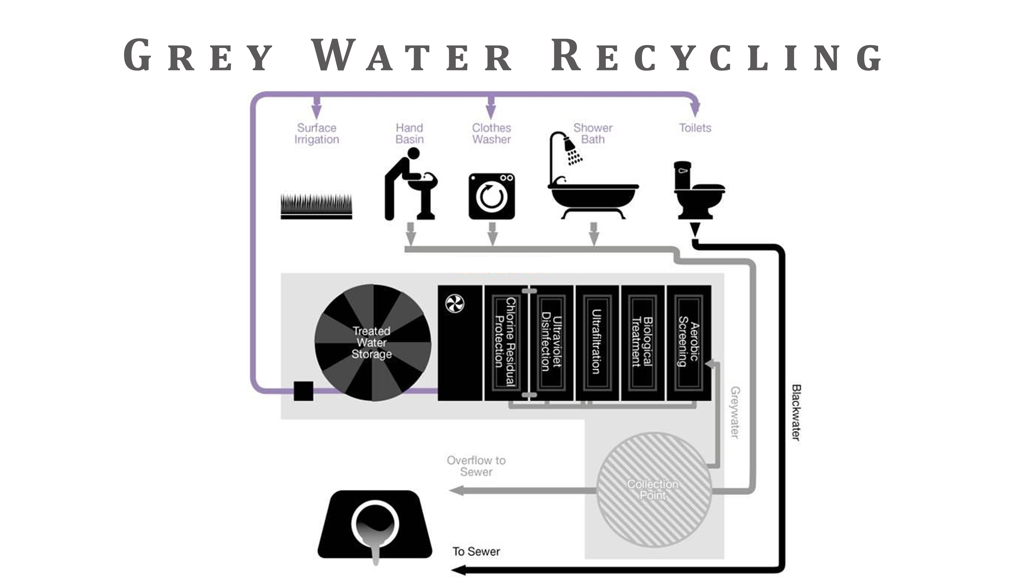
©Singapore Green Building Council 2014
Notes:
“Greywater” means untreated used water which has not come into contact with toilet waste. It includes used water from showers, bathtubs, wash basins and water from clothes-washing and laundry tubs. It excludes used water from urinals, toilet bowls (water closets), kitchen sinks or dishwashers.
Greywater recycling refers to reuse of treated greywater after the greywater has gone through treatment such as membrane filtration and disinfection to render the treated greywater safe for non-potable use. Treated greywater may be used for toilet flushing and as cooling tower make up water. However, treated greywater is not allowed for retail uses such as irrigation, washing floor including pressure washing, etc as there may be public health concerns.

