Slide 2
7. Infinite finite Resources
©Singapore Green Building Council 2014

Slide 3
©Singapore Green Building Council 2014

Slide 4
&
©Singapore Green Building Council 2014

Slide 5
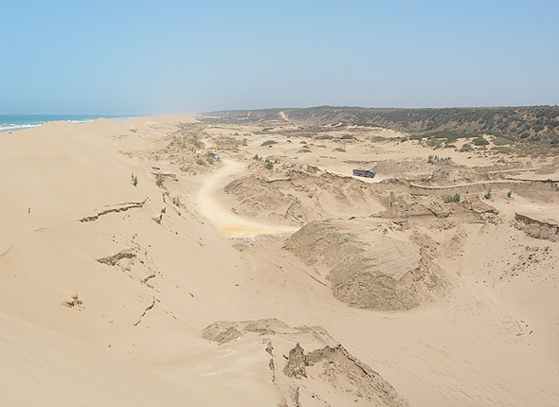
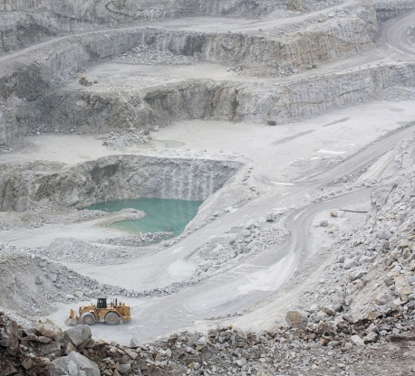
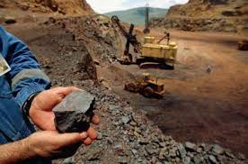
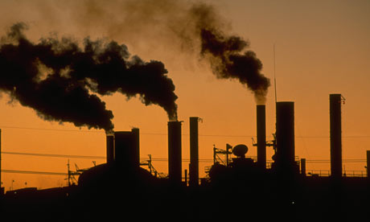
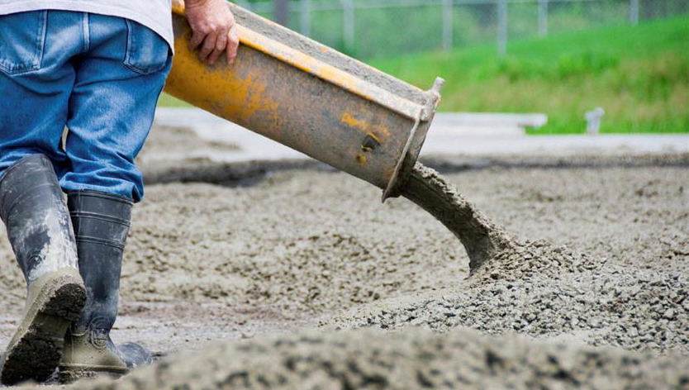
The Cement manufacturing process
Sand
Iron
Limestone
Raw Materials
Sand,
mined from earth
When processed through energy intensive and carbon emissive industrial process.
Energy intensive
110-120 kWh of electrical energy required per ton of cement produced.
Forms cement, a predominant construction material throughout the world
Cement concrete
©Singapore Green Building Council 2014

Slide 6
©Singapore Green Building Council 2014

Slide 7
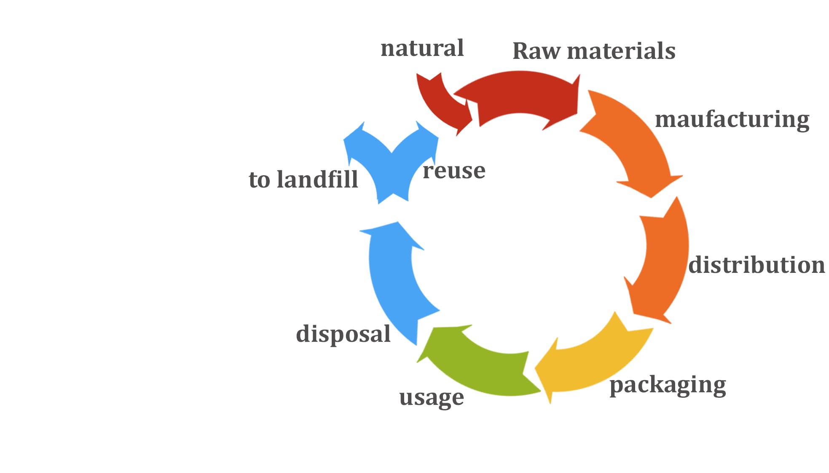
Embodied Energy
LIFE CYCLE ASSESSMENT
Embodied Energy is defined as the energy used during the entire life cycle of a product including the energy used for manufacturing, transporting, and disposing of the product.
©Singapore Green Building Council 2014
Notes:
Embodied energy is defined as the energy used during the entire life cycle of a product including the energy used for manufacturing, transporting, and disposing of the product.
Embodied energy, also called life cycle assessment (LCA), is a useful tool for evaluating the relative environmental impact of various building materials because it takes production, transportation and disposal into account, all things that can have a pronounced environmental impact but are not necessarily reflected in the price.
Due to the complexity of calculations and the wide range of production methods, transportation distances and other variables for some building products, exact figures for embodied energy vary from study to study. Fortunately, precise figures are not necessary. Builders, designers, purchasers and others can make informed decisions based on the embodied energy of a given product relative to its substitutes. It should be noted that when considering the embodied energy of an entire building, the energy embodied in the building materials is small relative to the energy it takes to operate that building over its lifetime.
Looking at the embodied energy of a typical home, for example, only 15 percent of that energy is embodied in the materials used to make the home; the other 85 percent is in the operation of the home over its lifetime. Thus, building for efficiency is the best way to lower the embodied energy of a building.
Embodied energy is defined as the energy used during the entire life cycle of a product including the energy used for manufacturing, transporting, and disposing of the product.
Embodied energy, also called life cycle assessment (LCA), is a useful tool for evaluating the relative environmental impact of various building materials because it takes production, transportation and disposal into account, all things that can have a pronounced environmental impact but are not necessarily reflected in the price.
Due to the complexity of calculations and the wide range of production methods, transportation distances and other variables for some building products, exact figures for embodied energy vary from study to study. Fortunately, precise figures are not necessary. Builders, designers, purchasers and others can make informed decisions based on the embodied energy of a given product relative to its substitutes. It should be noted that when considering the embodied energy of an entire building, the energy embodied in the building materials is small relative to the energy it takes to operate that building over its lifetime.
Looking at the embodied energy of a typical home, for example, only 15 percent of that energy is embodied in the materials used to make the home; the other 85 percent is in the operation of the home over its lifetime. Thus, building for efficiency is the best way to lower the embodied energy of a building.

Slide 8
©Singapore Green Building Council 2014

Slide 9
t
www.sarahjanemaki.com

Slide 10
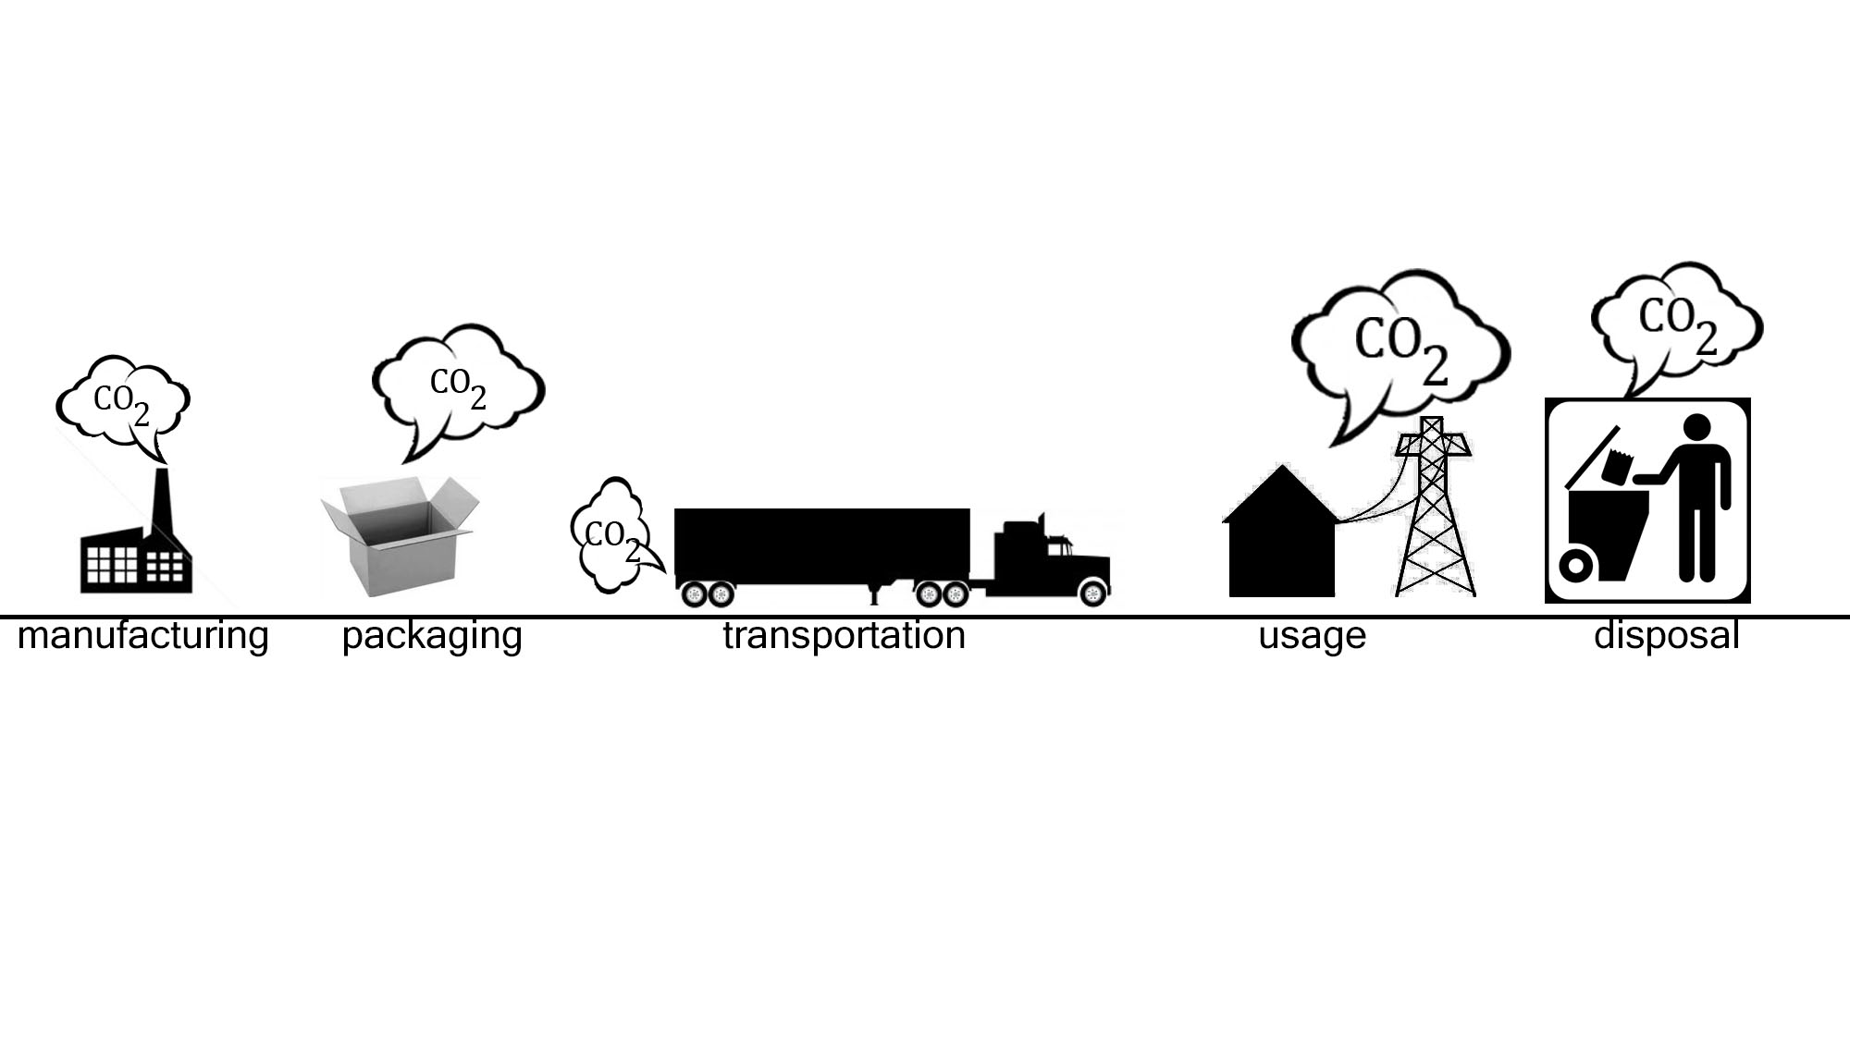
Carbon Footprint
All activities release carbon dioxide or other green house gases, during the various phases in its life cycle. Carbon footprint is the sum total of all the green house gases emitted into the atmosphere during the entire lifecycle of the product/material.
©Singapore Green Building Council 2014

Slide 11
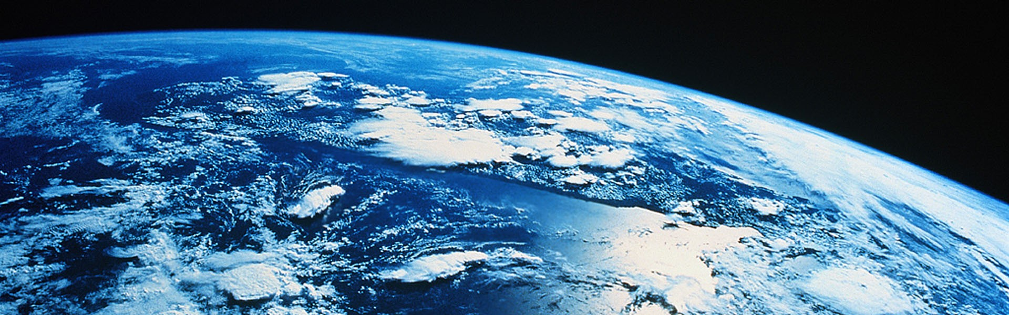
The current growth in global population and urbanization is creating intense pressure on our natural resource levels.
What shall we do now?
©Singapore Green Building Council 2014

Slide 12
©Singapore Green Building Council 2014

Slide 13
Reduce – to avoid waste generation
Reuse – to use again
Recycle – to convert unwanted things into useful and marketable recycled products.
In buildings, during construction and through occupancy, we have a number of opportunities to practice the 3Rs: Reduce, Reuse and Recycle.
©Singapore Green Building Council 2014

Slide 14
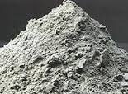
Alternative materials that can substitute main materials
Ground Granulated Blastfurnace Slag (Industrial Waste)
Substitute for Cement
Recycled Concrete Aggregate from Demolition Waste
Substitute for Granite
Pulverised Fuel Ash (PFA), aka ‘Fly ash’ (Thermal Power Plant waste)
Substitute for cement.
©Singapore Green Building Council 2014

Slide 15
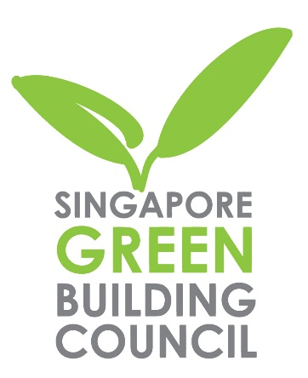
Singapore Green Building Council
SGBC is a committed advocate for green buildings and sustainable green building practices. Since its establishment in 2009, it has grown strength to strength with the aspiration to position Singapore as a leading sustainability hub in the tropics.
Through the Singapore Green Building Product (SGBP) Certification Scheme, building materials and services are evaluated for environmentally-friendly performance. Products bearing the SGBC logo can be assured of their commitment to a sustainable built environment.

Slide 16
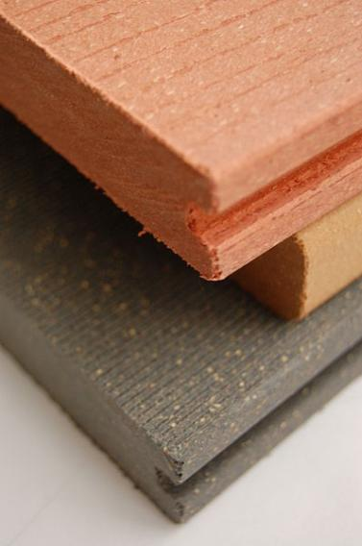
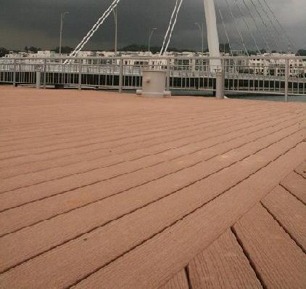
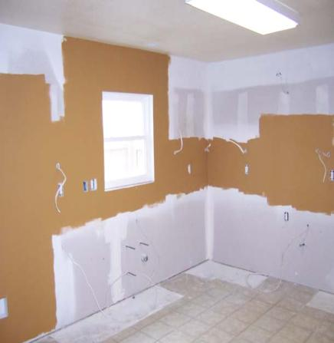
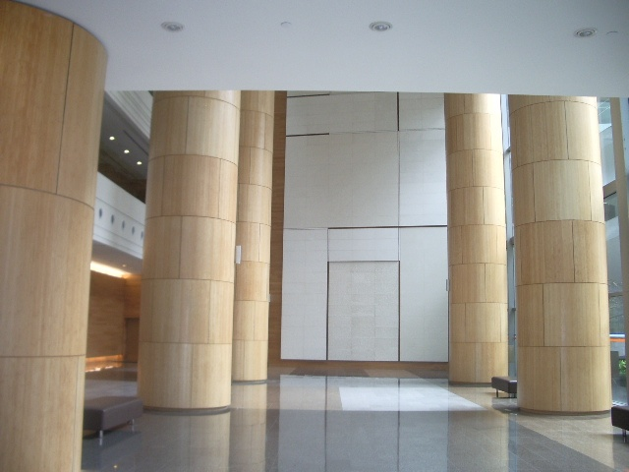
Alternative Green Products
Recycled
Composite
Wood.
Composite Timber Decking.
Dry Partition Walls.
Bamboo Finishes.
Waste recovery, conserving virgin resources
Prefabricated Units,
Reducing waste
Rapidly renewable material. Reducing the pressure on existing resources
Wood waste can be recovered and processed to these finished products.
©Singapore Green Building Council 2014
Notes:
There are a large array of green products in the market as seen in the slides ranging from internal finishes to external works.
In order to ensure that products are green as claimed by the companies, these green products can be certified and the Singapore Green Building Council is the body that does such certification.
The evaluation criteria used for assessment is based largely on a life cycle analysis approach which examines the entire product cycle.

Slide 17
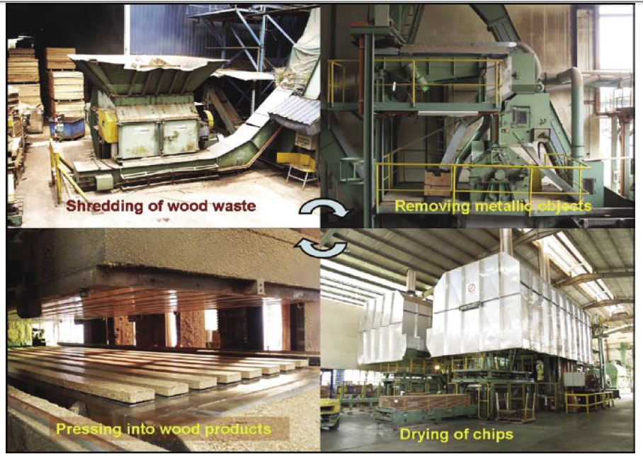
Wood Waste Processing
©Singapore Green Building Council 2014
Notes:
Wood waste constitutes about 3% to 30% of construction and demolition (C&D) waste. The quantity of waste generated per year is about 0.1 million tons. Better resource management and conservation can be achieved through innovative processing of timber as well as optimizing the use of wood waste.
With technological means, wood waste can be converted to wood-based products with enhanced properties. The process involves shredding the wood waste into chips, mixing the chips with binder to be compressed and moulded under high heat and pressure to become useful products. By having a controlled and consistent assembly process, products can be assured of better precision and quality. Compressed wood products have the added benefit of being pest-free, fire retardant, denser, stronger, more consistent in texture and color, and lower in moisture content as compared to natural wood.

Slide 18
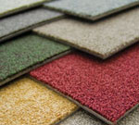
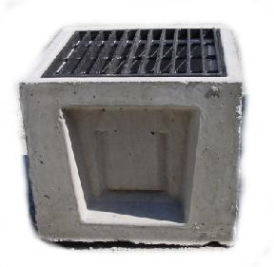
Recycled Carpet.
Precast Drain with RCA
Reusing waste and thereby extending the useful life of a product.
Prefabricated component, made to exact dimensions, so as to ensure no waste on site.
©Singapore Green Building Council 2014

Slide 19
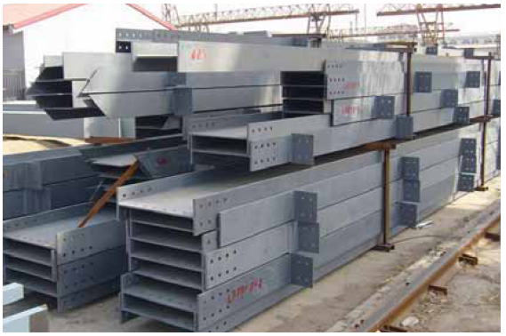
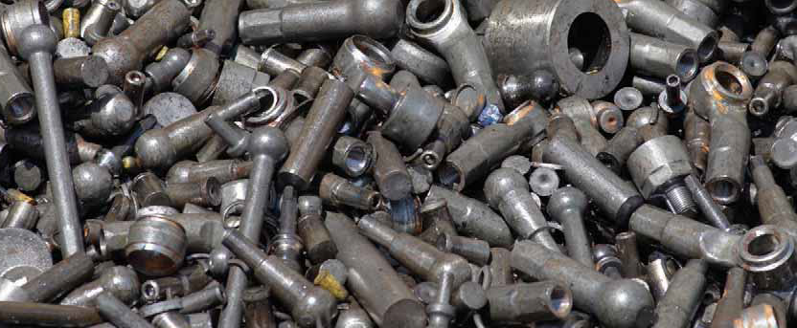
Scrap collection for recycling.
Prefabricated steel sections do not generate any waste at the site.
©Singapore Green Building Council 2014
Notes:
Steel can be recycled repeatedly without any degradation in terms of properties or performance in quality.
Steel construction has excellent low waste credentials during all phases of the building life cycle. It generates very little waste, with the byproducts of steel production widely reused by the construction industry. Any waste generated during manufacture is recycled. There is virtually no waste from steel products on the construction site.
Construction using sustainable materials offers many benefi ts throughout the various stages of a building’s life cycle.
Besides the main structural frame, the various components of a building can be constructed using the sustainable products and components. One very good example is the use of drywalls with plasterboards or fibre cement boards as internal walls, which is gaining popularity among the private residential projects.
The constant improvement in its performance means that it now meets high level specifications in the areas of acoustic insulation, thermal insulation and resistance to fire and damp conditions. Drywall is an ecological product, applied dry, generating no waste and pollution.

Slide 20
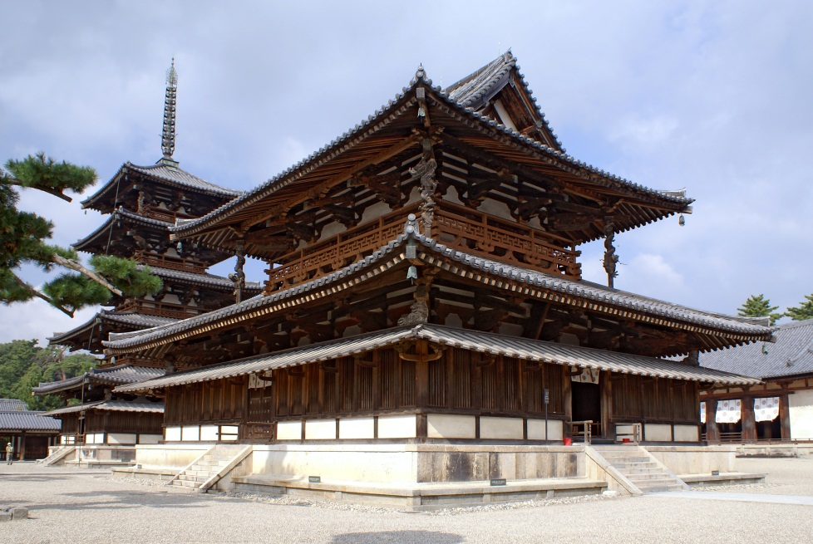
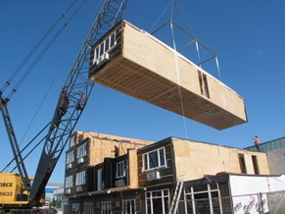
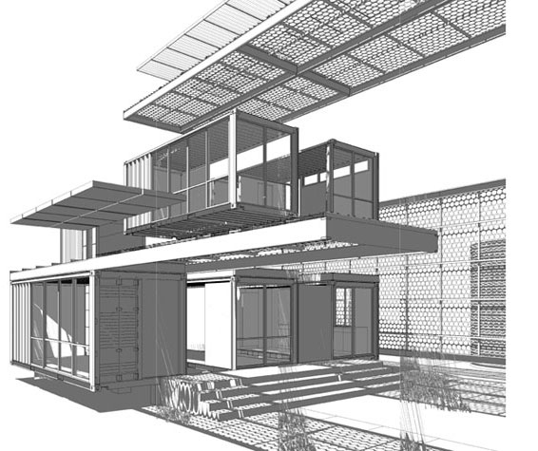
Modular Construction
Modular construction refers to prefabricated buildings that helps to design out waste through efficient planning and design.
The historic Japanese temples exhibited modular characteristics by which any part of the building could be replaced or maintained individually, which increased the useful life of the whole building as well as reducing wastage.
©Singapore Green Building Council 2014
Notes:
Modular construction is a process in which a building is constructed off-site, under controlled plant conditions, using the same materials and designing to the same codes and standards as conventionally built facilities – but in about half the time. Buildings are produced in “modules” that when put together on site, reflect the identical design intent and specifications of the most sophisticated site-built facility – without compromise.

Slide 21
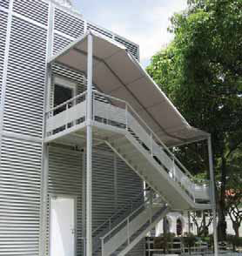
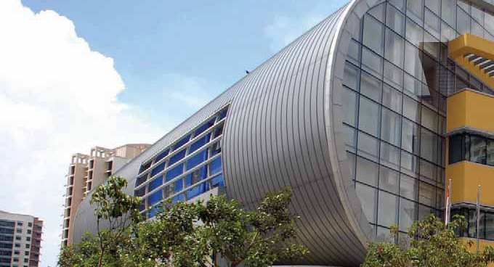
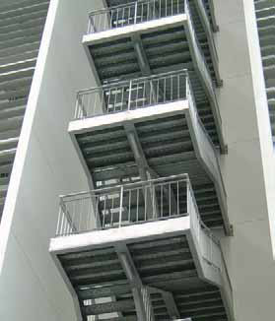
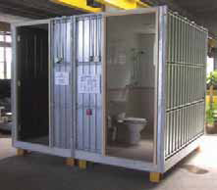
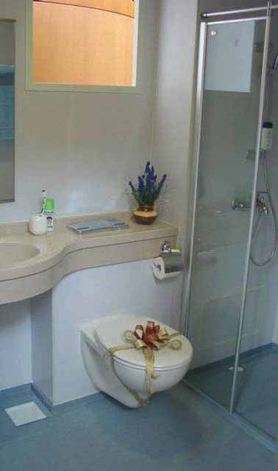
Prefabricated staircase
Prefabricated steel roof
Prefabricated bathroom unit
Notes:
Prefabrication is the practice of assembling components of a structure in a factory or other manufacturing site, and transporting complete assemblies or sub-assemblies to the construction site where the structure is to be located.
The components are fabricated at an external facility where it is fabricated to the exact dimensions, which reduces the waste. The use of prefabricated components also ensure faster construction and greater quality.

Slide 22
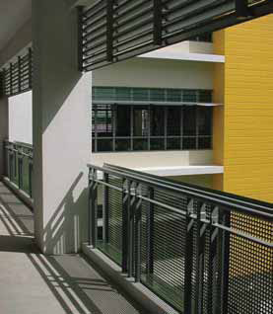
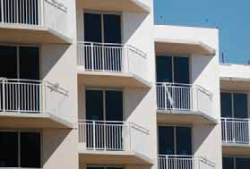
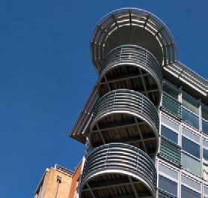
Prefabricated Parapets
Parapets and railings can be designed to facilitate ease of construction and to achieve higher quality finished products. The use of metal railings or glass parapets can achieve practical and environmentally friendly design as well as enable effective design and construction work onsite.
©Singapore Green Building Council 2014

Slide 23
©Singapore Green Building Council 2014

Slide 24
©Singapore Green Building Council 2014

