Slide 2
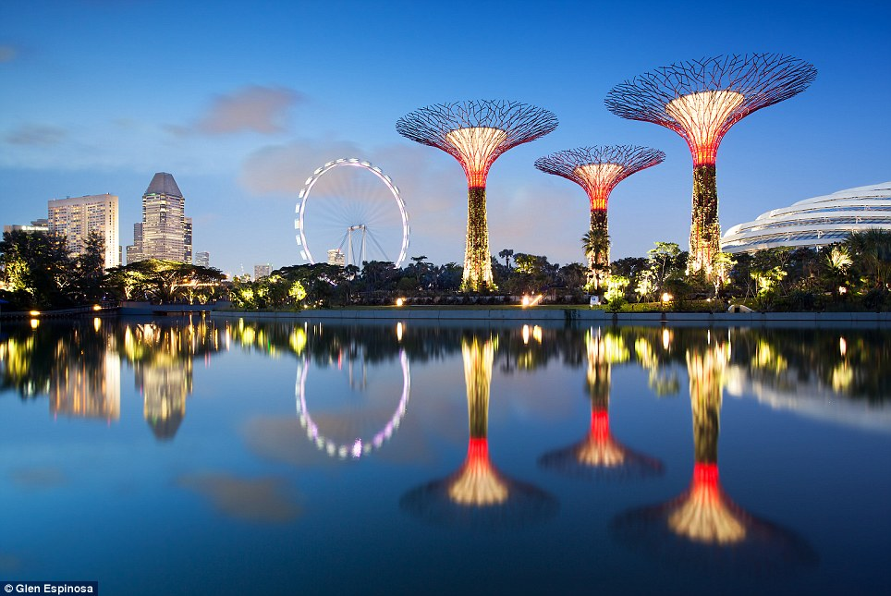
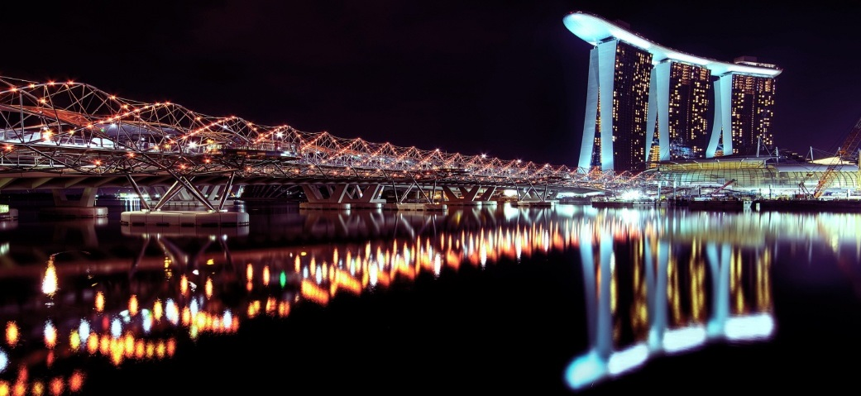
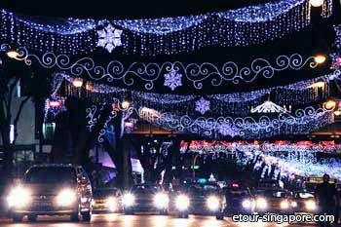
5. Lighting
Course outlines
Understand lighting
Understand school lighting
Understand lighting load & power density
Explore ways to save energy
Answer a Quiz
Get started, survey the lighting & suggest next moves.

Slide 3
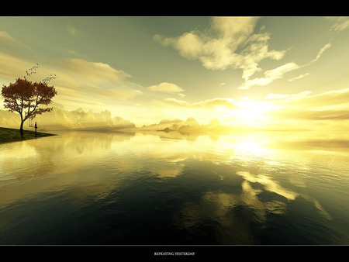
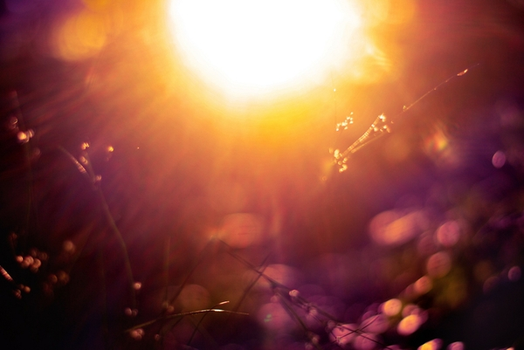
Understanding Lighting

Slide 4
Light is part of the Electromagnetic spectrum
Source: http://www.niehs.nih.gov
Notes:
The Sun radiates in all wavelengths of the Electromagnetic spectrum which has a vast range from Cosmic rays at one end and Radio and electrical waves at the other. When the wavelength of radiated energy is between 400 to 700 NM approximately, it impacts the human eye and creates our sense of ‘vision’. Q: What is a Nanometer?
A NM is 10⁻⁹ Metre. While 400NM gives the impression of Violet colour, 700NM will look red. But Infra-Red heat is a major part of sunlight and that is why we feel hot outdoor. When there are large windows, there is a possibility of heating up the building from the sun and it can increase the air-con load.

Slide 5
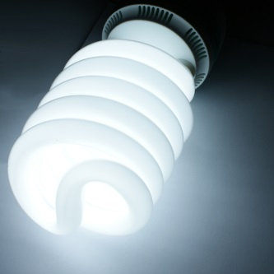
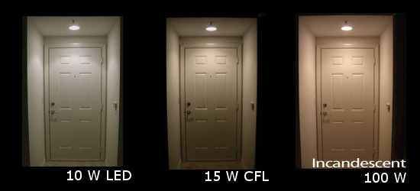
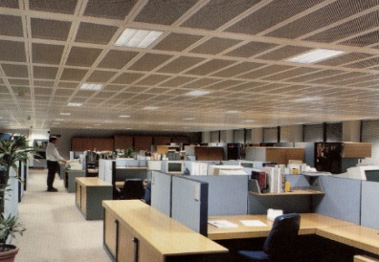
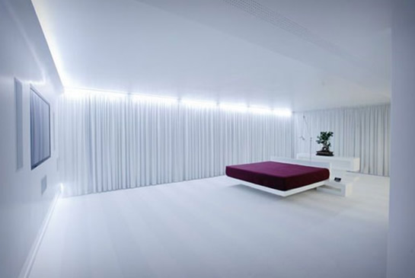
Key definitions & Units
Light Output (Lumens)
Efficacy (Lumens / Watt)
Illuminance (Lux)
Power Density (Watts / M²)
500 Lux
Notes:
Light output (in lumens) of each lamp is published by reputable manufacturers in their catalogue.
Efficacy is an indicator (at first glance) about how energy-efficient a lamp is. It is in Lumens / Watt
Illuminance in Lux is one of the final deliverables of a lighting system.
Power Density (in W / M²) is used by the Building & Construction Authority (BCA) to control the electrical loading of a given space for lighting, air-conditioning etc. Higher the efficacy of a lamp, higher the energy saving and less the power density. Watts/Sq.M is also used as a criterion to give Green Mark Awards for buildings.

Slide 6
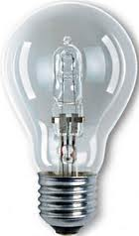
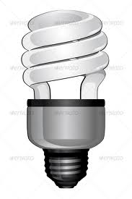
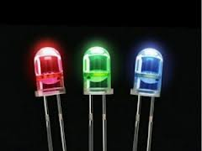
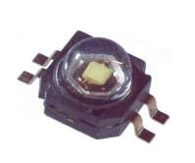
Light output & Efficacy
Lamp | Watts | Light output (Lumens) | Efficacy Lm / W
Incandescent Lamp | 75W | 900 | 12
Compact Fluorescent Lamp CFL. (Commonly called Energy-saver) | 15W | 900 | 60
Fluorescent tube Tri-Phosphor type 4ft with Electronic ballast | 32W | 3,200 | 100
LED (in stabilised condition) with Electronic Driver | 5W | 600 | 120
©Singapore Green Building Council 2014
Notes:
The Incandescent lamp (or common bulb) has a low efficacy of 12 lumens/W. Q: Who invented the electric bulb?
Compared to it, the CFL (or commonly called Energy-saver lamp used in households, hotels & public spaces) has 5 times higher Efficacy. So a CFL 15W can replace an incandescent 75W bulb, so long as there is no dimming involved as the latter cannot be dimmed.

Slide 7
Illuminance or Lighting level
‘Utilised’ output of all luminaires divided by total area receiving the light
Installed Lumens
Illuminance
= (Installed Lumens x UF x MF)* Area
Unit : Lux Symbol : E
Area( m² )
*UF is Utilisation Factor which depends on Room dimensions, Reflectances of Ceiling, Wall & floor, the Optics of luminaire used and its height above working plane. UF generally between 0.60 to 80
*MF is Maintenance Factor to account for gradual depreciation of lamp output and dust accumulation on luminaire and room surfaces. MF Varies from 0.65 to .90. For an AC interior, MF is usually taken at 0.85
Notes:
You can see a number of luminaires in an interior like our class room, each with one or more lamps inside. However, all the light output of lamps will not reach the working plane. For schools, offices and industries, the measuring plane for lighting level is at the table top (0.8 to 1.0 metre above floor).
UF is the Utilisation Factor of the total lumens installed. It depends on the room dimensions, type of luminaire used, Reflectances of walls, ceiling & floor, height of fitting suspension etc. UF is usually between 0.6 to 0.8. It was already calculated by the Building professional when installing our present school lighting. New luminaires produce what is called “Initial illuminance” while commissioning the lighting. It will gradually decline from the initial level.
MF Is the Maintenance Factor to account for gradual light depreciation of lamp and the dust accumulation on luminaires and room surfaces and lamp failures. MF varies from 0.65 to 0.90. A suitable MF has been reckoned by the original designer of our school lighting. For an air-conditioned interior, the MF is usually taken at 0.85.

Slide 8
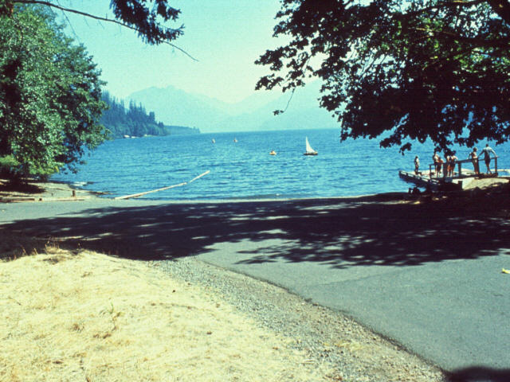
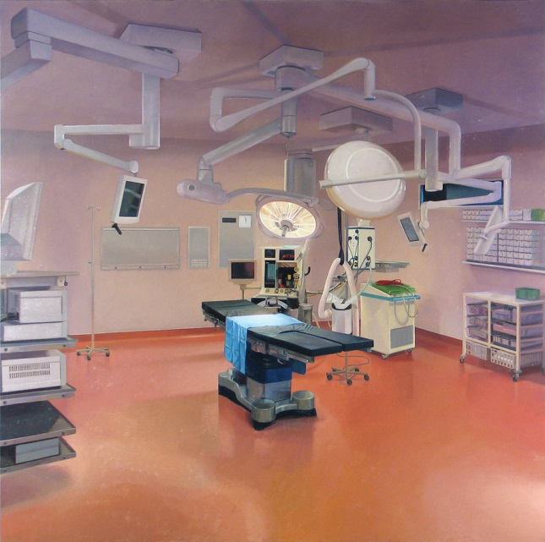
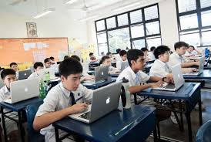
Examples of Illuminance (Lux)
100,000 Lux
20,000 Lux
500 Lux
300 Lux
Notes:
On clear or white-cloudy day, the illuminance under the shade of a tree is about 10,000 Lux. Directly under the sun is 100,000 Lux. Our forefathers for millions of years, used daytime and daylight for hunting, agriculture, herding animals, fight wars, create buildings from the great Pyramids to the Great wall of China. Even now, when we walk to a food court during lunch time or travel by road from place to place, we do so under varying lighting levels from 20,000-100,000 Lux. Even in the shade of a tree, it is normally 10,000 Lux. Human eyes are used to this level.
However, we cannot afford to have such high illuminance by electric lighting in building interiors as the energy-usage will be tremendous and the glare uncontrollable. So, SS 531 recommends just 300 Lux for class rooms and we cannot go below that level because it is based on Ophthalmologic (medical) and other investigations.

Slide 9
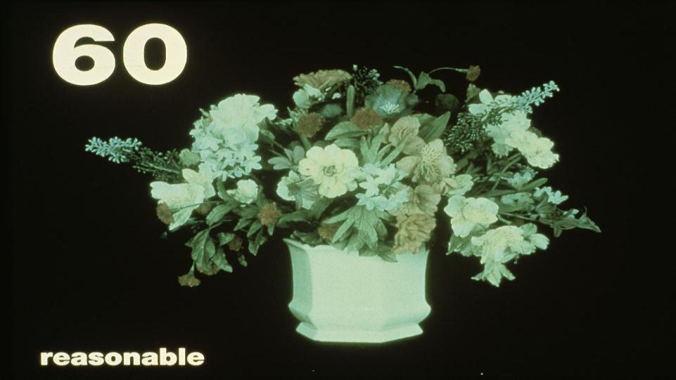
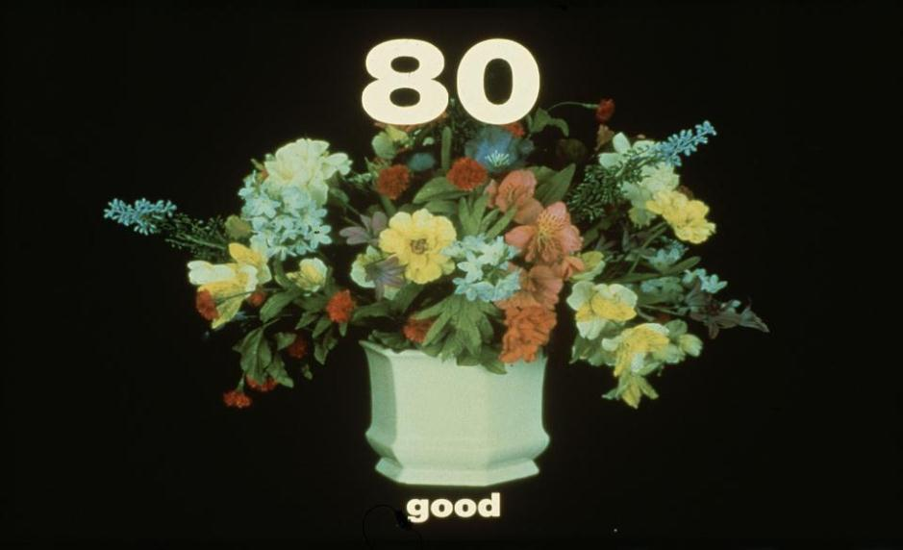
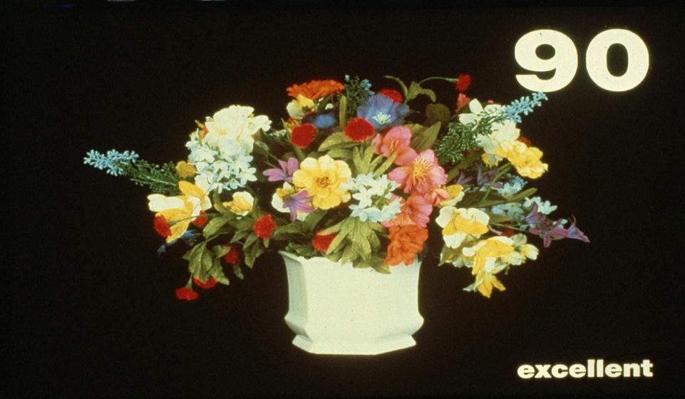
Colour Rendering index CRI
The Colors of objects and human skin-tone must be rendered well by the lamp used. This is important to appreciate true colors of objects and to feel well about one’s own health. Lamps that radiate in the 3 Primary colors of Red-Green-Blue generally have a high CRI.
©Singapore Green Building Council 2014
Notes:
Colour Rendering Index (CRI) is a measure how well you see colours while using electric light sources. The ability to bring out true colours of objects will depend on the spectral energy of the lamp and how much of energy it has in the wavelengths of 400-700 NM. Of these, Red-Green-Blue (RGB) are called Primary Colours.
The sun radiates in all the wavelengths and hence the CRI of daylight is 100 (Avoid calling it as 100%. The percentage should not be used because CRI is an Integer by definition). The Fluorescent tube or any other lamp in our class should have a CRI of >80 as per SS 531 because we should be seeing colours of text and other objects reasonably well. If LED or other sources are to be used, they should also be specified for this CRI > 80.

Slide 10
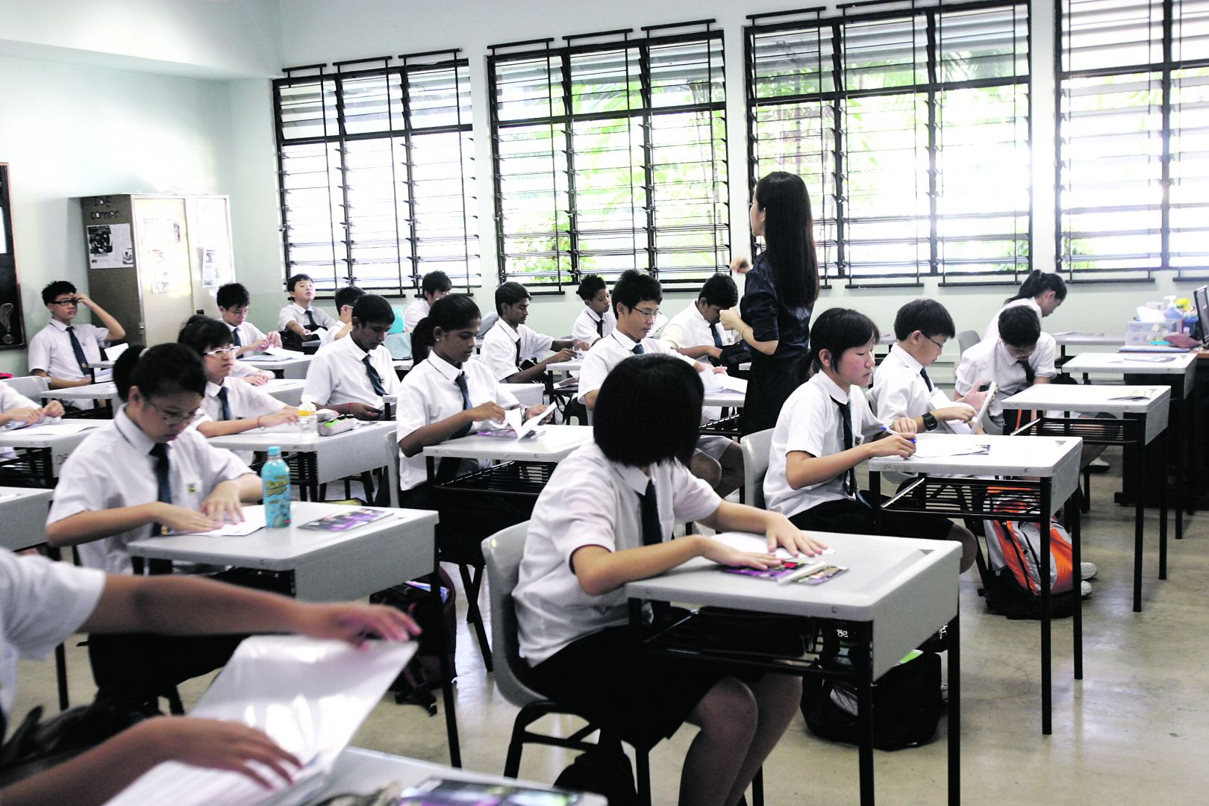
Understand School lighting

Slide 11
School Illuminance Levels
Minimum requirements (1) as per SS 531-1.
Area | Lux | CRI
Classrooms, tutorial rooms | 300 | 80
Classroom for adults | 500 | 80
Lecture hall | 500 | 80
Black board | 500 | 80
Demonstration table | 500 | 80
Art and craft rooms | 500 | 80
Technical drawing rooms | 750 | 80
Practical rooms and Labs | 500 | 80
Music practice rooms | 300 | 80
Computer practice rooms | 500 | 80
Language laboratory | 300 | 80
Preparation rooms & workshops | 500 | 80
Student assembly halls | 200 | 80
Teachers rooms | 300 | 80
Sports halls, gymnasiums | 300 | 80
Notes:
These are the school lighting recommendations of SS 531-1. We will avoid talking about the Glare Rating because it is too complex to teach at this stage.

Slide 12
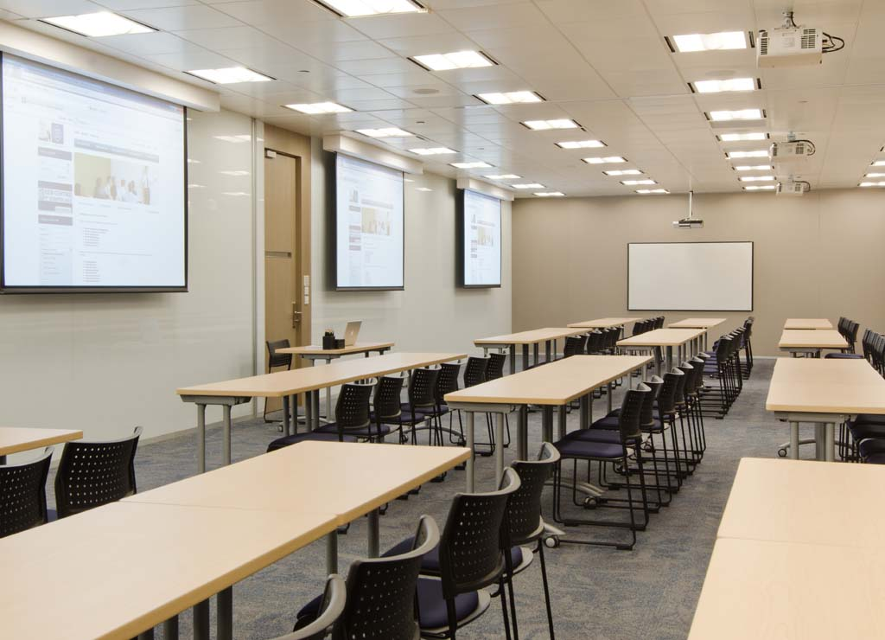
Lighting load and Power density

Slide 13
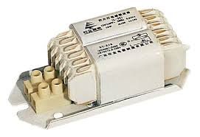
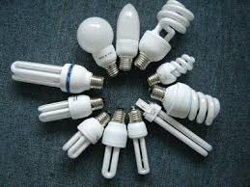
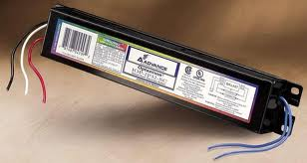
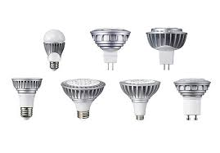
Some lighting products
Electro Magnetic (EM)Ballast
Fluorescent Lamp Family
CFLs
T12 1.5” Dia
Electronic (EL) ballast
T8 1.0” Dia
LED lamps
T5 5/8” Dia
Notes:
Fluorescent tubes come in 3 diameters called T12-T8-T5 shown above. Of these, T12 tube is hardly used in Singapore. We use T8 and T5 tubes.
The Electro Magnetic (EM) ballast is the old type which is mostly replaced by the Electronic (EL) ballast in schools. The EL ballast is more efficient, runs the tube at a lower wattage (but with same light output) and EL ballast loss is also less. CFLs may be used in some round-shaped luminaires in canteen, Meeting rooms etc as they look aesthetically more pleasing. Self-ballasted LED lamps are also increasing in the market. But right now, their prices may not allow long-term cost economics compared to Fluorescent or CFL.

Slide 14
The Common lamps and their loads
Tube & Length | Ballast type | Lamp W | Ballast loss | Total W / lamp
A.T8-18W 0.60 m | EM | 18W | 9W | 27W
B.T8- 36W 1.20 m | EM | 36W | 9W | 45W
C.T8-18W 0.60 m | EL | 16W | 4W | 20W
D.T8- 36W 1.20 m | EL | 32W | 4W | 36W
E.T5-14W 0.60 m | EL | 14W | 3W | 17W
F.T5- 28W 1.20 m | EL | 28W | 3W | 31W
The Ballast is a current-limiting device. Without it, the Fluorescent lamp will draw a high current and destroy itself in seconds.
EM = Electro Magnetic ballast EL = Electronic ballast.
Reg: the lamps in your class room, if in doubt, ask your Maintenance department about the lamp & ballast used. Then Calculate the Watts per lamp and the Watts of the luminaire based on no. of lamps used.
Notes:
Look at the luminaires installed in our class room and some other areas of our school. They are mostly 0.60m (square) or rectangular luminaires with 1.20m length. Ask our Maintenance department what type of ballast is used in these luminaires – most likely they will have Electronic (EL) ballast. Use this table to compute the load per luminaire. Then multiply it with the total number of luminaires to get total load (Watts) for lighting of our interior.

Slide 15
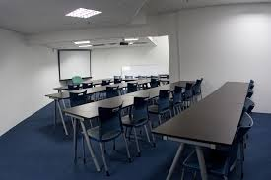
How to calculate Lighting Power density
of a room ?
Calculate the load (in Watts) per luminaire.
Multiply for total Watts of all luminaires installed
Measure the area of interior in M²
Power Density = Total W / Area (M²)
Compare it with Maximum Power density allowed as per Code of Practice SS 530: 2006
Class rooms | 15W / M²
Lecture theatres | 15W / M²
Notes:
The maximum Power density (in Watts per Sq.M allowed for different types of interiors) is specified in Singapore Code of Practice SS 530: 2006. For class rooms, it is 15W / Sq.M. You may later on calculate this density for some areas of our school in your project.

Slide 16
What
all can you do to
save energy?

Slide 17
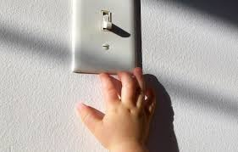
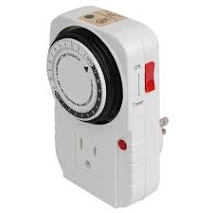
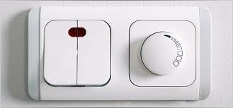
Switches-Timers & Dimmers .
Switch off when room is unoccupied
Timers are useful for specified duration of use
Dimmer: Ensure that Fluorescent Luminaires Have dimmable ballast
Notes:
Switching off any equipment when not required is an obvious choice to save energy. But in offices, schools etc, there is no specific ownership of this process and so it is difficult to cultivate it as a habit. Timer-switches will ensure that lighting will be switched on and off at specific times when its use is planned.
Lighting can also be dimmed when linked with daylight-sensors or Presence-detectors. But it is important that the ballast used in the luminaire is ‘dimmable’ type because every EL ballast is not made suitable for dimming.

Slide 18
Presence Detectors
Notes:
Presence (or Occupancy) Detectors can sense the presence of humans in a space either by passive Infra-Red or radio waves. They are very useful because of convenience and independence of human action to switch on and off. In bigger areas like class rooms or offices, these are less useful because it is used by many people. Presence detectors are often used in rooms occupied by individuals, reception desk etc

Slide 19
Light reduction control
Dimming all lamps or luminaires
Dual switching of alternate rows or alternate luminaires or alternate lamps
Switching middle lamp in luminaires independently from the outer lamps
Alternate Luminaires
Dimming
Alternate Lamps
S
D
S
S
S
Dimmer Switch
Notes:
The interior can be re-wired for switching off alternate luminaires, or dim or activate alternate lamp in the same luminaire.
Light reduction controls may require re-wiring of existing luminaires and / or install additional devices like dimmers.

Slide 20
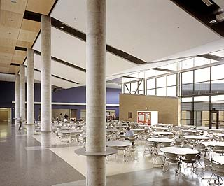
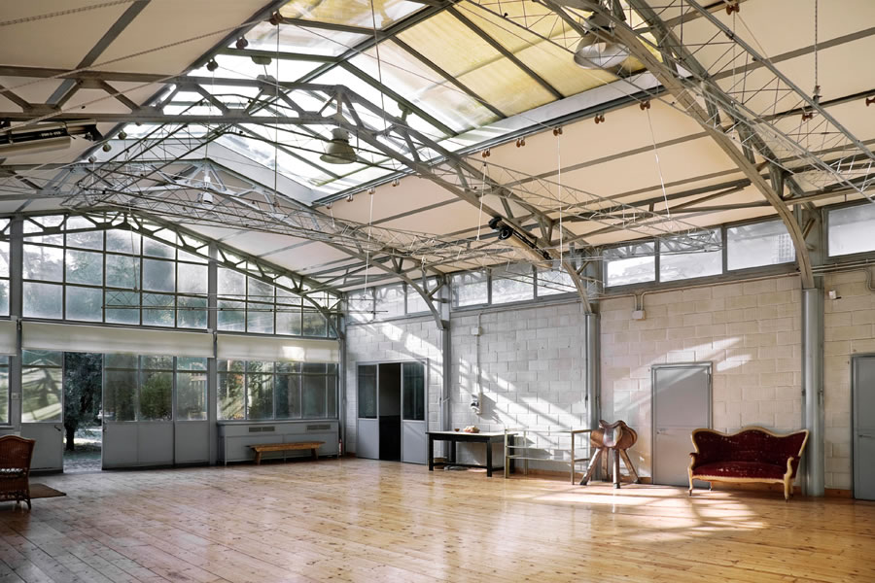
The daylight
Daylight can supplement electric lighting. However, daylight will vary with the time of the day, season of the year and orientation of building.
SS 531-1 calls for the recommended illuminances to be maintained whether by electric lighting or daylighting or both.
In Tropical climates like ours, daylight can allow substantial heat through windows. While it may save some lighting load, it may increase the Air-con load. Reckon with this, while recommending daylight.
Notes:
Above is a self-explanatory slide

Slide 21
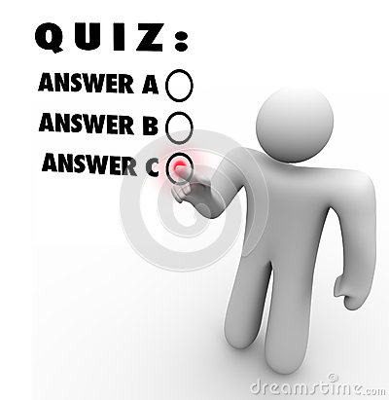
Quiz Time!
Notes:
A Quiz with 15 MCQs is supplied separately in Word form. Pls select any 10 per class. Print enough copies to issue to students and ask them to answer within 15 minutes. The teacher can show the correct answer on the Screen. Students can self-score based on the answers shown. At the end, the teacher once again shows all the right answers, as a kind of revision.

