Slide 1


Slide 2

Module 2 - Energy
What is meant by energy use in buildings?
Where does electricity come from and the differences between fossil fuels and renewable energy
How can buildings reduce their energy consumption / become more energy efficient
Energy Efficient Air Conditioning
Energy Efficient Lighting

Slide 3
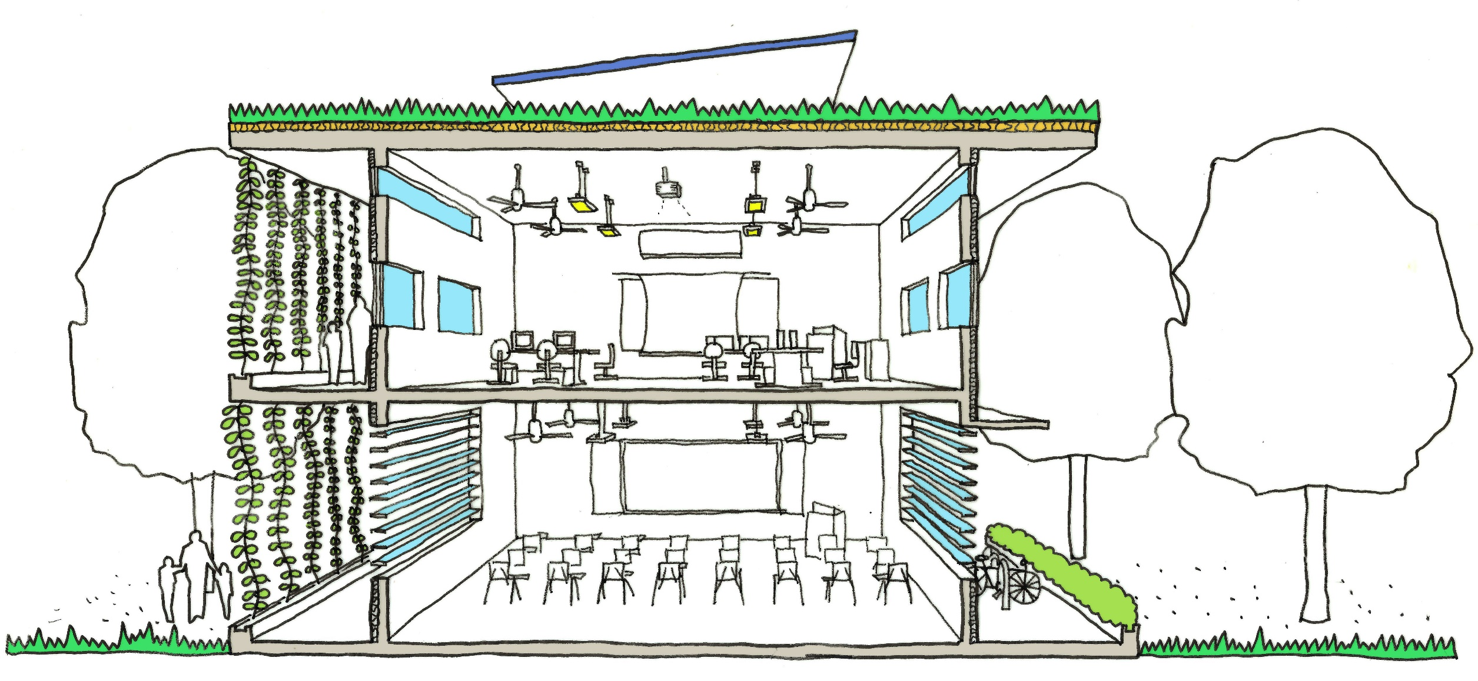
4. Energy Consumption
Benjamin Towell (2014)
Notes:
Teacher can insert a short re-cap about what was learnt from the previous lesson before or after this slide.

Slide 4
Aims & Objectives
Aim:
To give an overview of electricity use within buildings, where does the power we use come from currently and why is this environmentally damaging (the link between energy are climate change). To discuss the various critical elements of a building that contribute mostly to energy consumption and that these will be looked at in later lessons. Finally to introduce the use of renewable energy technology
Outcomes:
For you to relate energy consumption to climate change and to understand what consumes energy in a building thus what to aim to reduce reliance on. Understand that in building design the most important factor is to reduce the amount of energy used through designing passively (lessons 1-3) and where items need to use electricity to use efficient items. Finally to look at replacing the energy used with low carbon technologies which are applicable in Singapore’s context.

Slide 5
Where does Electricity Come from?
Most of the energy we use in buildings comes from fossil fuels:
Fossil fuels include coal, oil and natural gas.
These are fuels because they release energy when they are burned (combustion).
They are fossil fuels because they were formed from the remains of living organisms and take millions of years to form
These fuels are naturally occurring, however are considered non renewable due to the length of time to form.
Hydrocarbon + Oxygen
Water + Carbon Dioxide
Notes:
Fossil fuels are non-renewable energy resources. Their supply is limited and they will eventually run out. Fossil fuels do not renew themselves, while fuels such as wood can be renewed endlessly.
Fossil fuels release carbon dioxide when they burn, which adds to the greenhouse effect and increases global warming. Of the three fossil fuels, for a given amount of energy released, coal produces the most carbon dioxide and natural gas produces the least.
Coal and oil release sulphur dioxide gas when they burn, which causes breathing problems for living creatures and contributes to acid rain.
Crude oil is a mixture of compounds called hydrocarbons. Many useful materials can be produced from crude oil. It can be separated into different fractions using fractional distillation, and some of these can be used as fuels. Unfortunately, there are environmental consequences when fossil fuels such as crude oil and its products are used.
Complete combustion
Fuels burn when they react with oxygen in the air. The hydrogen in hydrocarbons is oxidised to water (remember that water, H₂O, is an oxide of hydrogen). If there is plenty of air, we get complete combustion and the carbon in hydrocarbons is oxidised to carbon dioxide:
hydrocarbon + oxygen → water + carbon dioxide
Incomplete combustion
If there is insufficient oxygen for complete combustion or where there are impurities in the fuel source, we get incomplete combustion. The hydrogen is still oxidised to water, but instead of carbon dioxide we get carbon monoxide. Particles of carbon, seen as soot or smoke, are also released.
The combustion of a fuel, especially with impurities may release several gases into the atmosphere, including:
water vapour
carbon dioxide
carbon monoxide
particles
sulphur dioxide
These products are harmful to the environment When sulphur dioxide dissolves in water droplets in clouds, it makes the rain more acidic than normal. This is called acid rain.

Slide 6
Where does Electricity Come from?
Nuclear Energy is not from fossil fuels but is still considered non renewable due to the availability of the fuels.
The main nuclear fuels are uranium and plutonium, which are radioactive metals.
Nuclear fuels are not burnt to release energy. Rather they are involved in nuclear reactions which leads to heat being released.
Unlike fossil fuels – nuclear fuels do not produce carbon dioxide or sulphur dioxide emissions. However nuclear waste is hazardous to health for thousands of years.
Notes:
The main nuclear fuels are uranium and plutonium. These are radioactive metals. Nuclear fuels are not burnt to release energy. Instead, the fuels are involved in nuclear reactions in the nuclear reactor, which leads to heat being released.
The rest of the process of generating electricity is then identical to the process using fossil fuels.
The heat energy is used to boil water. The kinetic energy in the expanding steam spins turbines, which then drive generators to produce electricity.
Unlike fossil fuels, nuclear fuels do not produce carbon dioxide or sulphur dioxide
Nuclear fuels are non-renewable energy resources. If there is an accident, large amounts of radioactive material could be released into the environment. In addition, nuclear waste remains radioactive and is hazardous to health for thousands of years. It must be stored safely.

Slide 7
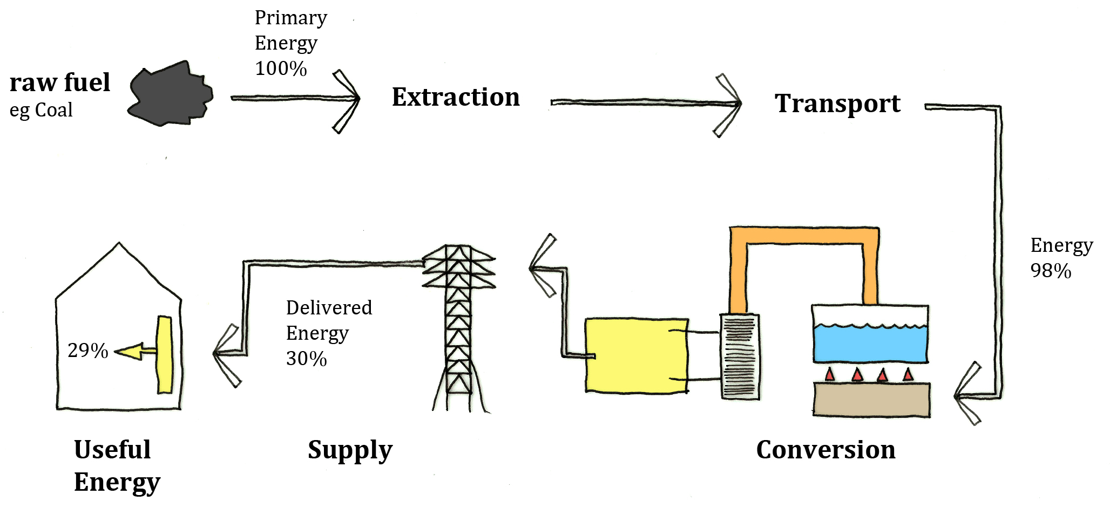
Where does Electricity Come from?
The combustion of fossil fuels provides stable energy for our use, however is an inefficient process with 70% of the fossil fuel’s potential energy lost before we can use it

Slide 8
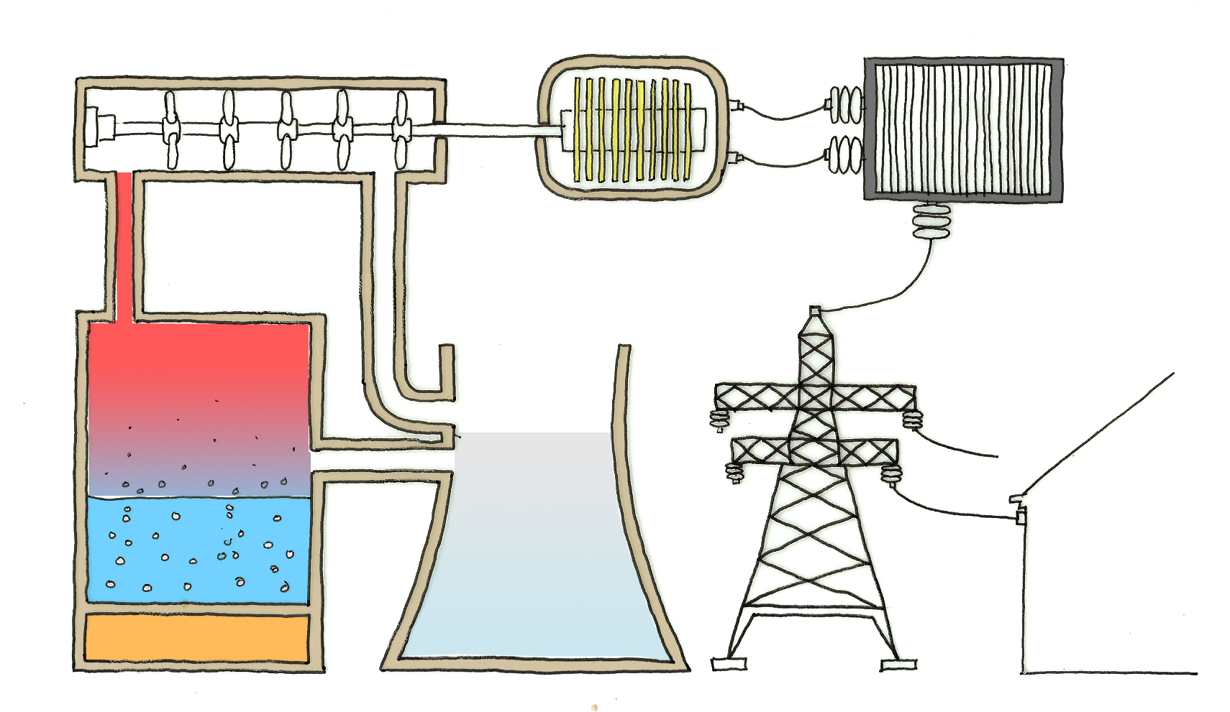
The spinning turbine turns a generator that produces electricity
Steam makes the turbine spin
The electricity goes to the transformers to produce the correct voltage.
The heat boils water to make steam.
Heat from the combustion of fossil fuels or nuclear reaction.
Steam Chimney
Notes:
Electricity is supplied to buildings through “the grid” at a very high voltage. This to reduce energy losses during transmission (remember Power = Voltage x Current), if the power is a constant a high voltage reduces the current, thus reduces the losses of a high current that would have some of its energy changed into heat due to the cable resistance. Transformers are used to increase or decrease the voltage of the supply. Electricity is charged in units. One unit is equivalent to one kilowatt of electricity used for one hour (kWh).
There are four main stages:
the fuel is burned to boil water to make steam
the steam makes a turbine spin
the spinning turbine turns a generator which produces electricity
the electricity goes to the transformers to produce the correct voltage
The energy needed to boil the water comes from fossil fuels or nuclear fuels. Renewable energy resources such as wind and wave power may drive the generators directly.
Transformers
A transformer is an electrical device that changes the voltage of an alternating current (ac) supply, such as the mains electrical supply. A transformer changes a high-voltage supply into a low-voltage one, or vice versa.
A transformer that increases the voltage is called a step-up transformer.
A transformer that decreases the voltage is called a step-down transformer.
Step-up transformers are used at power stations to produce the very high voltages needed to transmit electricity through the Grid power lines. These high voltages are too dangerous to use in the home, so step-down transformers are used locally to reduce the voltage to safe levels. The voltage of household electricity is about 230V.

Slide 9
Climate Change
Combusting fossil fuels in large quantities has contributed to climate change.
CO₂– A green house gas – absorbs heat energy and prevents this from escaping the earth into space. This is a natural effect, however with a greater volume of CO2, an enhanced green house effect occurs – leading to a steady increase in the earths temperature.
So_{x} – A by products of coal and other fossil fuels during combustion – causes acid rain that damages forests and aquatic ecosystems.
The more energy we consume, the greater the effects of climate change:
Change in weather patterns – rain, wind and temperature
Raise in sea levels – flooding of major cities and loss of land
Hydrocarbon + Oxygen
Water + Carbon Dioxide
Notes:
Carbon dioxide from burning fuels causes global warming, a process capable of changing the world’s climate significantly.
the amount of carbon dioxide in the atmosphere has increased steadily over the past 150 years, and so has the average global temperature.
Carbon dioxide is a greenhouse gas. It absorbs heat energy and prevents it escaping from the Earth’s surface into space. The greater the amount of carbon dioxide in the atmosphere, the more heat energy is absorbed and the hotter the Earth becomes.
Results of global warming
A rise of just a few degrees in world temperatures will have a dramatic impact on the climate:
Global weather patterns will change, causing drought in some places and flooding in others.
Melting of polar ice caps will raise sea levels, causing increased coastal erosion and flooding of low-lying land – including land where major cities lie.
Global dimming
Tiny particles that are released when fuels are burned cause global dimming. Like global warming, this process may change rainfall patterns around the world.
The amount of sunlight reaching the Earth’s surface has decreased by about 2 per cent every ten years, because more sunlight is being reflected back into space. The particles from burning fuels reflect sunlight, and they also cause more water droplets to form in the clouds. This makes the clouds better at reflecting sunlight back into space. It is likely that global dimming has hidden some of the effects of global warming, by stopping some of the Sun’s energy reaching the Earth’s surface in the first place. Governments around the world are introducing controls on pollution. There is the possibility that as the air becomes less polluted by smoke and soot, global dimming will decrease, causing the effects of global warming to become more obvious.
Effects of acid rain
Acid rain reacts with metals and rocks such as limestone. Buildings and statues are damaged as a result. Acid rain damages the waxy layer on the leaves of trees and makes it more difficult for trees to absorb the minerals they need for healthy growth. They may die as a result. Acid rain also makes rivers and lakes too acidic for some aquatic life to survive.

Slide 10
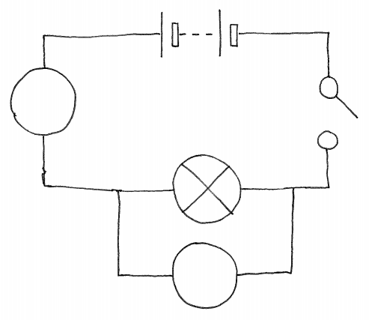
Power, Energy and Cost:
Power is a measure of how quickly energy is transferred
power (watt, W) = voltage (volt, V) × current (ampere, A)
The kilowatt-hour (kWh) is not a unit of power. It is a unit of energy
power = energy / time
energy transferred (kWh) = power (kW) × time (h)
The kW is a unit of power. It is 1000 W or 1000 J/s
The amount of electrical energy transferred to an appliance depends on its power and the length of time it is switched on. The amount of mains electrical energy transferred is measured in kilowatt-hours, kWh. One unit is 1kWh A 40W light bulb transfers more electrical energy each second than a 20W light bulb.
A
V

Slide 11
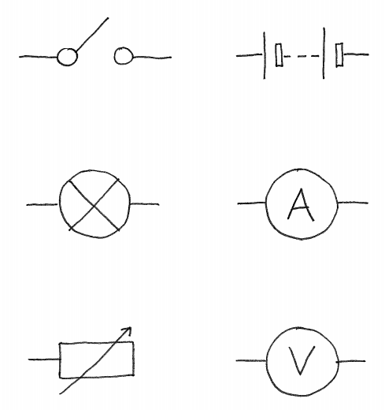
Power, Energy and Cost:
The cost of the electricity used is calculated based on the electrical device’s energy consumption. This is dependant on the power rating of the device and the time the device is used for.
energy (kWh) = power (kW) × time (h)
Cost ($) = power × time × cost of 1 kWh
QUESTION:
A TV needs 250 W. It is switched on for 30 minutes. If each kWh costs $0.26, how much does it cost to watch the TV for that period?

Slide 12

Power, Energy and Cost:
QUESTION:
A TV needs 250 W. It is switched on for 30 minutes. If each kWh costs $0.26, how much does it cost to watch the TV for that period?
ANSWER:
Cost = Power x Time x Unit Cost (1kWh)
= 0.250kW x 0.5 h x $0.26
= $0.325 ( 3 cents)

Slide 13
Energy Usage Breakdown
Buildings consume a large proportion of electricity in Singapore :
Buildings (excl Households) = 31%
Households = 18%
Total = 49%
The remaining electricity produced is used in industrial processes and transportation and infrastructure
3%
18%
43%
31%
5%

Slide 14
Where is Energy used in a Building?
What are the parts of the school / classroom you are in or even your house that uses electricity?
Which of these consumes the most do you think?

Slide 15
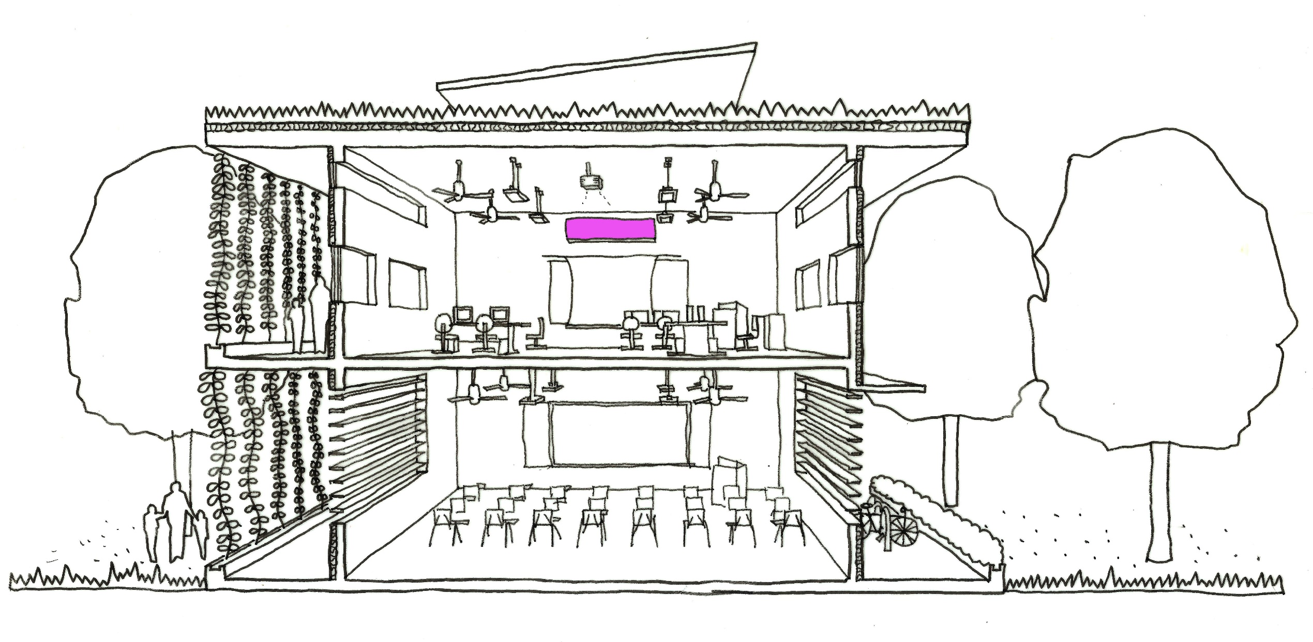
Benjamin Towell (2014)
Notes:
Air conditioning systems

Slide 16
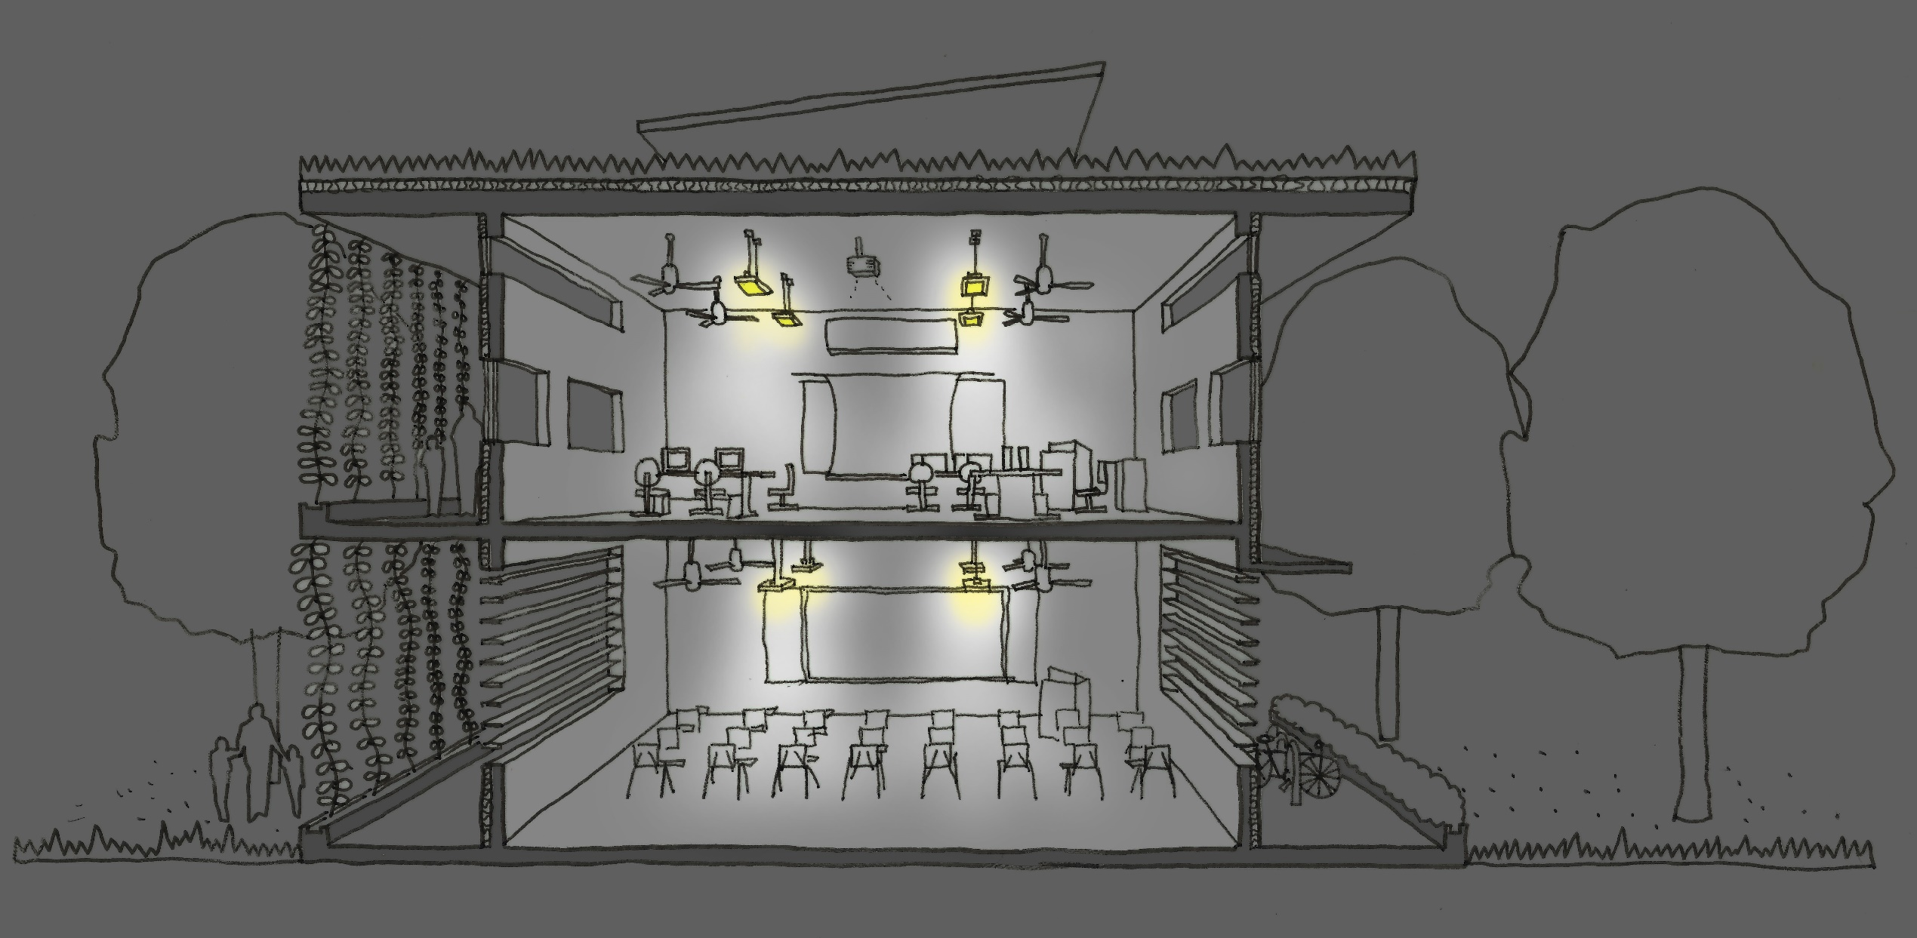
Benjamin Towell (2014)
Notes:
Artificial Lighting systems

Slide 17
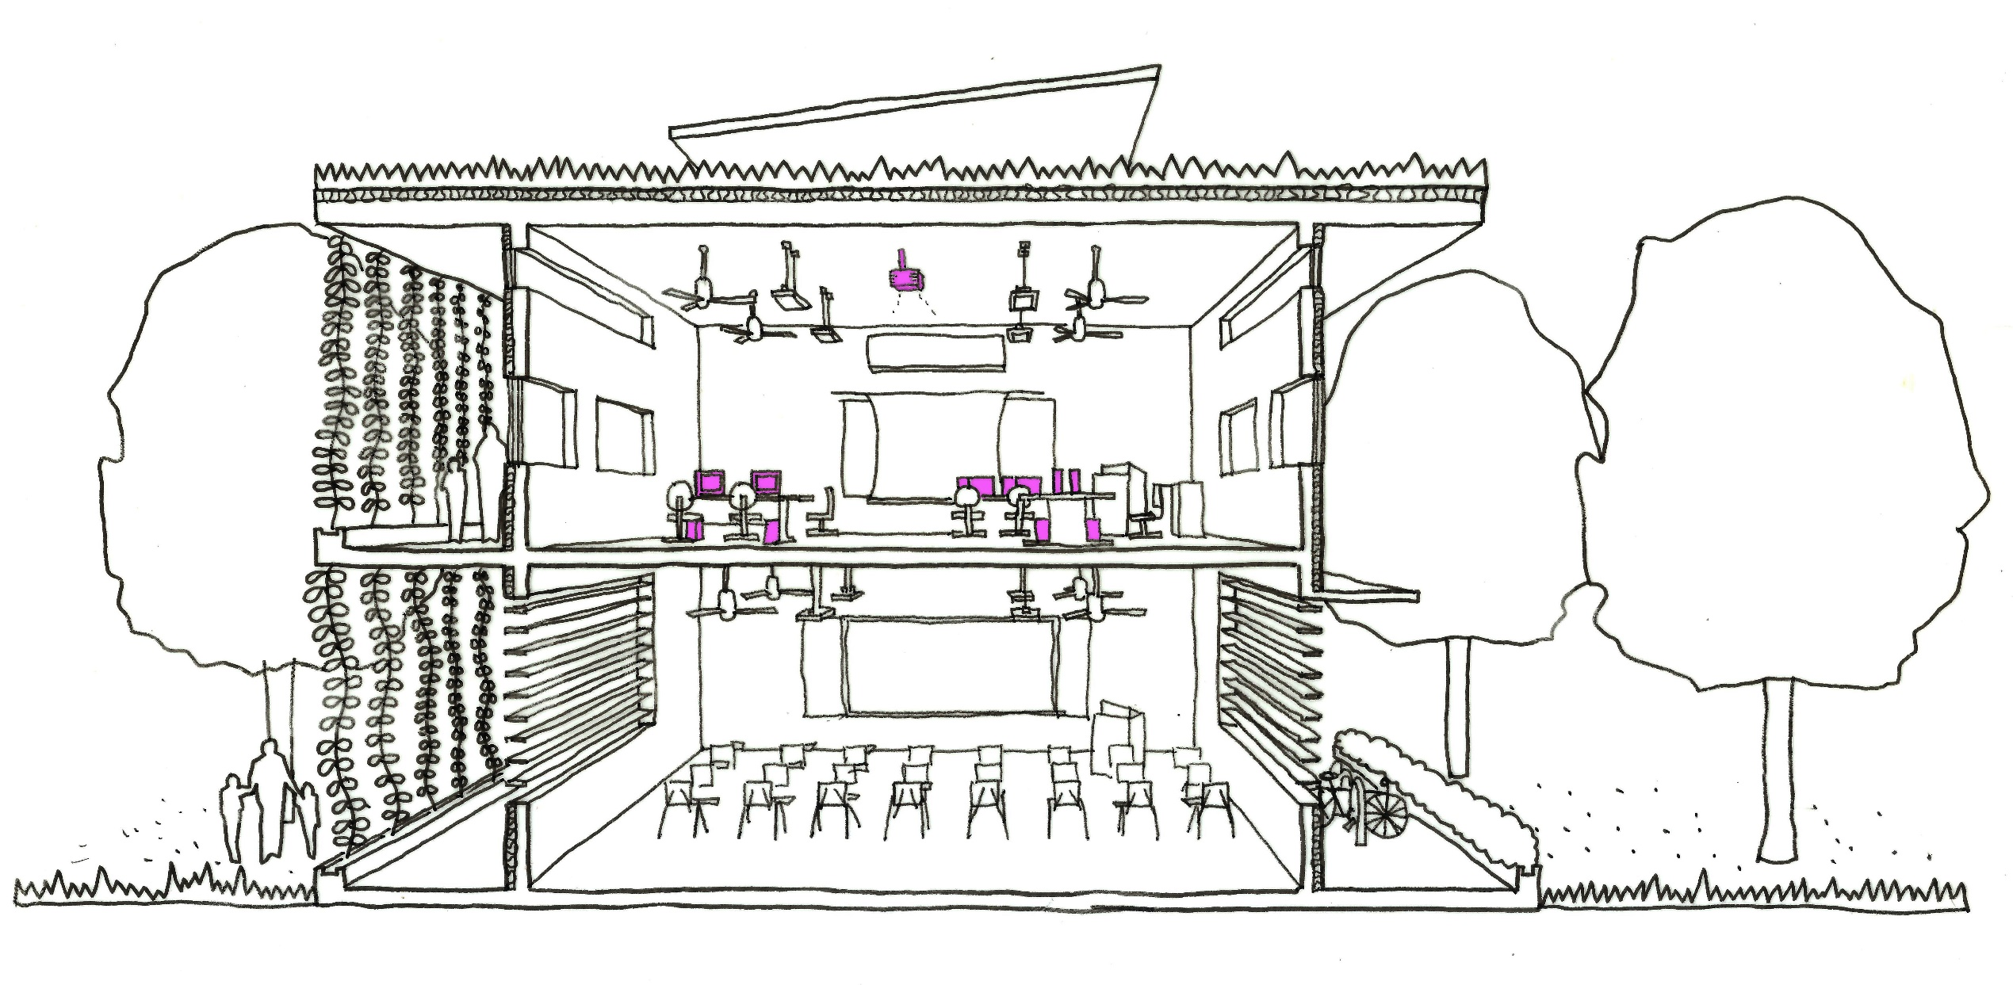
Benjamin Towell (2014)
Notes:
Plug (receptacle) load. This covers the television, computer’s, wifi routers, electric ovens, projectors, mobile phone chargers etc…

Slide 18
Where is Energy used in a Building?
Simplifying a general building we note the following
Air conditioning– is the single biggest consumer of energy!
Lighting is the second largest consumer of energy
The energy we use for our IT, TV’s and other systems is the next largest.
So how can we reduce our energy consumption? Less AC, more daylight and turn our appliances off when not in use!
20%
50%
30%

Slide 19
Where is Energy used in a School?
What about a typical Singapore School
Classrooms – Less than 15% of total school energy – naturally ventilated spaces with ceiling fans – less energy consumed
Teachers Offices, Library and Computer rooms and the ICT infrastructure (LAN) rooms consume 25% each (75% total) of schools energy
Other facilities and spaces consume the remaining 10%
What do the office, library + computer rooms and LAN rooms have in common?
10%
25%
25%
15%
25%
Notes:
Answer is Air Conditioning. Also mention that these have higher plug loads due to the numbers of computers and such.
Also note that the classrooms although larger in area than any of these other spaces still consume less energy in total than these other spaces. Thus we can see that Air Conditioning, although nor used in many spaces in schools consumes a vast quantity of energy

Slide 20
Where is Energy used in a School?

Slide 21
Where is Energy used in a School?
What about a typical Singapore School
Air Conditioning 60% electrical energy
Lighting 20% electrical energy
Plug loads 10% (Computers, TV’s, ICT [information communication technology] infrastructure
Fans 5% electrical energy
Each school will vary, but this is an average breakdown based upon Singapore Schools
5%
5%
10%
60%
15-20%
Notes:
With this in mind the students should have an idea on what can be optimised:
For example new AC units that are more efficient with higher temperature set points and to only be used when required
Improve lighting by replacing the old lights with energy efficient fittings such as LEDs and high efficiency fluorescent lights (the next two lessons will focus on these).

Slide 22
Energy Hierarchy
To reduce the electrical energy used in buildings
“Passive Design”– This refers to Module 1’s lessons – thus opening windows for ventilation rather than using air conditioning, using day light rather than artificial light, and designing the building to minimise heat gains.
“Active Systems” – Where electricity has to be used for equipment, get the most efficient equipment possible –this means things that require less electrical emery input to it for the same desired output – for example efficient lighting.
“Control Systems” – Timers, temperature settings switches to turn equipment off to name a few
“Renewable Energy” – the use of non polluting sources of energy such as solar power to offset any electrical usage of the building

Slide 23
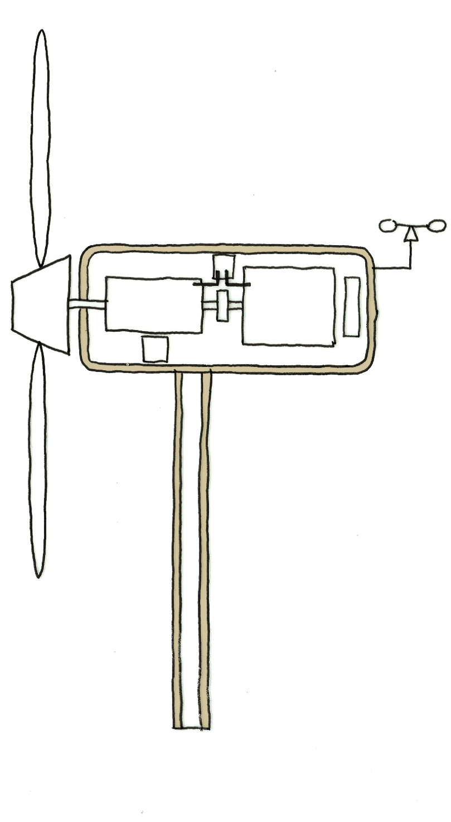
Renewable Sources
Rotor Blades
High Speed Shaft
Renewable energy refers to harvesting energy from natural sources that are non exhaustible:
Wind Energy– Wind can be used to power turbines to generate electricity. The turbine converts the kinetic energy of the wind into motion which is converted into electricity.
Wind power is popular in areas where there are constant winds and off shore wind farms (away from land). In Singapore our wind is not very strong thus wind power is currently not a viable option.
Geothermal – This uses heat from the ground present in various locations around the world to heat water to power turbines for electricity or for water / space heating in cooler countries. In Singapore there is no access to high heat below ground
Gear Box
Low Speed Shaft
Electric Generator
Wind Turbine
Notes:
Renewable resources
Renewable resources of fuel do not cost anything, but the equipment used to generate the power may be expensive to build. Certain resources are reliable, including tidal barrages and hydroelectric power. Others are less reliable, including wind and solar energy.
Wind energy
The wind is produced as a result of giant convection currents in the Earth's atmosphere, which are driven by heat energy from the sun. This means that the kinetic energy in wind is a renewable energy resource: as long as the sun exists, the wind will too.
Wind turbines have huge blades mounted on a tall tower. As the wind blows, it transfers some of its kinetic energy to the blades, which turn and drive the generator. Several wind turbines may be grouped together in windy locations to form wind farms.

Slide 24
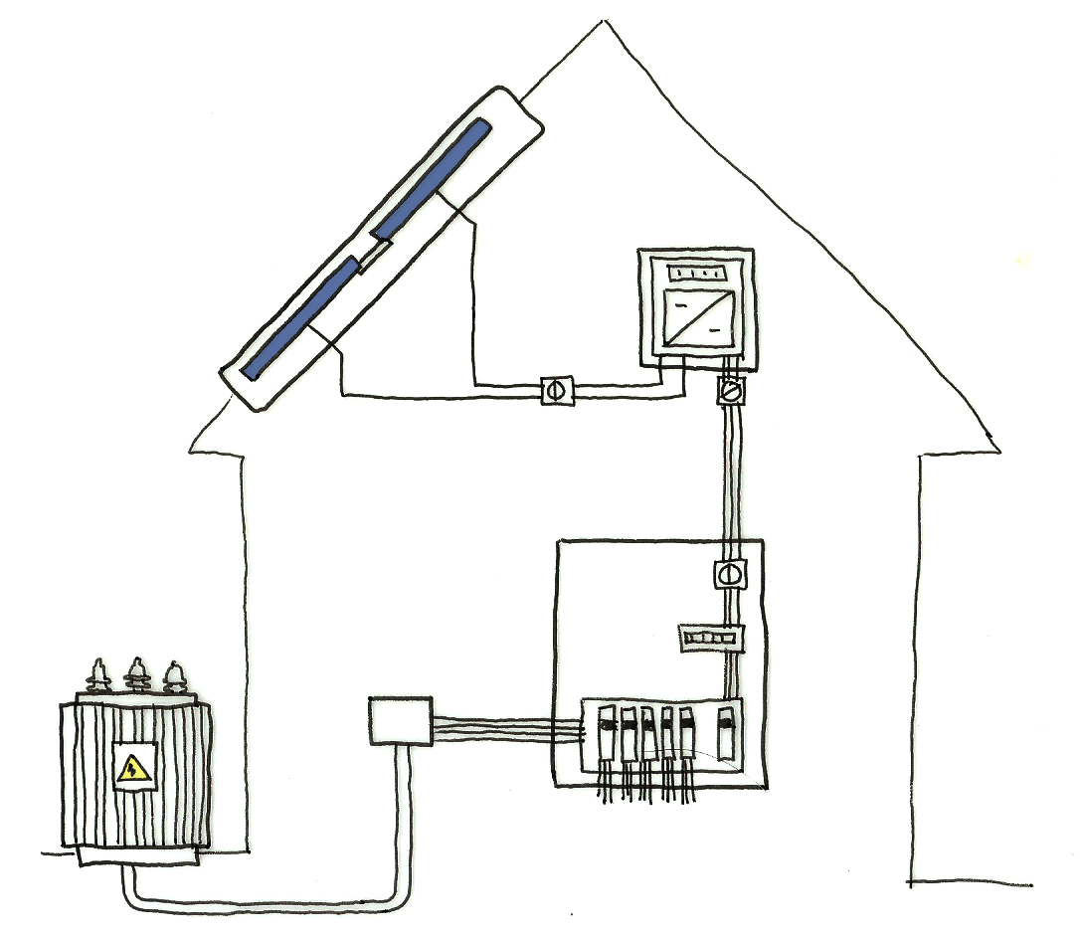
Renewable Sources
Hydro Electric– Water can be used with through the use of waterfalls or dams. These use gravity and the flow of water to turn turbines to generate electrical power. There are environmental issues with these including destruction of aquatic habitats through blocking rivers.
Tidal Power – Using the waves to generate power is being developed for areas with strong tides. In Singapore our seas are calm thus this too is not applicable
Solar Power– This uses sunlight to either produce electricity directly (photons of light exciting electrons) or to heat water. In Singapore our sunny weather, sun angle and daylight hours is perfect for the use of solar power.
Notes:
Solar cells (Photovoltaic Panels)
Solar cells convert light energy directly into electrical energy. These are not new technology, small solar cells have been used in calculators for a very long time. Larger arrays of solar cells are used to power road signs, and used to power satellites in orbit around Earth. More recently photovoltaics have been used in buildings as a viable way of offsetting their energy. BCA’s zero energy building in Singapore is an example of the extensive use of photvoltaics which produces as much energy as the building consumes in a year. – Could Schools also achieve this?
Solar panels
Solar panels do not generate electricity, but rather they heat up water. They are often located on the roofs of buildings where they can receive heat energy from the sun. The water heated by the panels is often stored in an insulated storage tank to keep the water hot for use in the evening or early morning. This technology again is not new and has been widely adopted globally.
Advantages
Solar energy is a renewable energy resource and there are no fuel costs. No harmful polluting gases are produced.
Disadvantages
Solar panels may only produce energy or hot water in sunny climates. Although warm water can be produced on cloudy days, neither solar cells nor solar panels work at night.

Slide 25
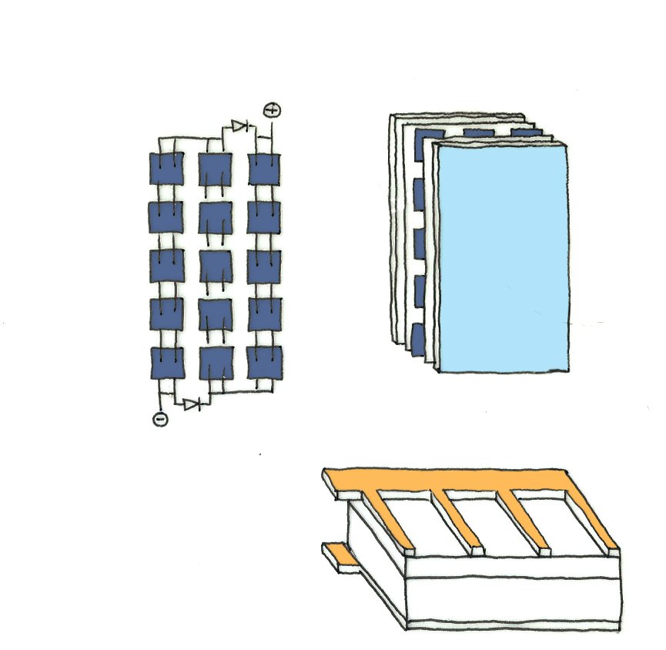
Photovoltaic Panels
Inverter
Non-reflective glass covering
DC Circuit
Supply from Grid
Positive contact
N - layer
Mains &
Fuse board
Negative
contact
P-layer
Silicon diode
Notes:
Photovoltaics (PV)
Photovoltaic energy is the conversion of sunlight into electricity through a photovoltaic (PVs) cell, commonly called a solar cell. In contrast to solar thermal systems, photovoltaic systems convert sunlight directly into electrical energy. This is a solid state electronic process involving no moving parts and the systems are therefore reliable and durable. The pv cell was discovered in 1954 by Bell Telephone researchers examining the sensitivity of a properly prepared silicon wafer to sunlight.
The simplest photovoltaic systems power many of the small calculators and wrist watches used everyday.
A photovoltaic cell is a semi-conductor device, usually a silicon p-n junction diode. Light incident on the surface of the cell frees electrons from their positions in the crystal lattice. Electrons which drift to the p-n junction are accelerated into the n-type region by the electric field innately present across the junction. The excess of electrons (negative charge carriers) thus produced in the n-type region sets up a potential difference from the n-type to the p-type side of the cell. This potential difference (or voltage) will then cause a current to flow in the external circuit

Slide 26
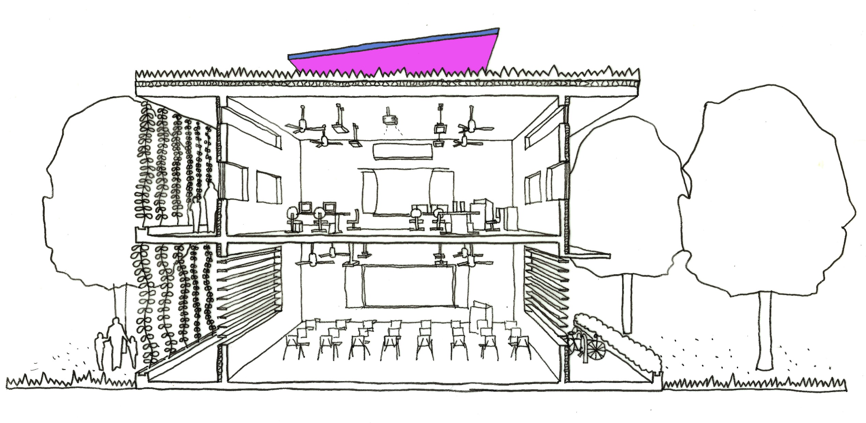
Benjamin Towell (2014)
Notes:
PV installation sketch for a Green School, ask if students think their school can be zero energy!

Slide 27
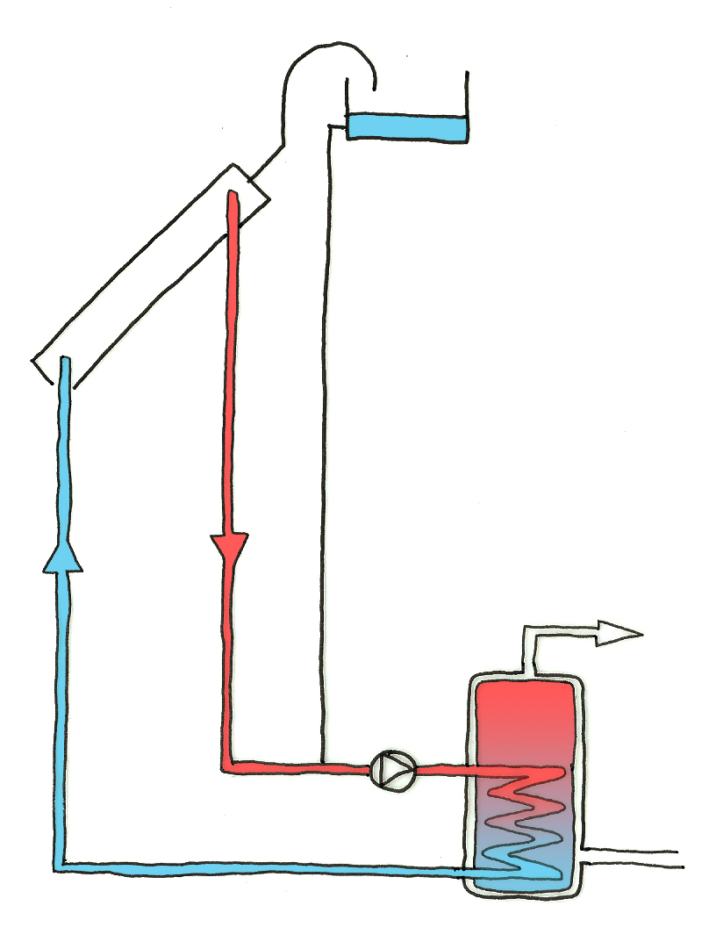
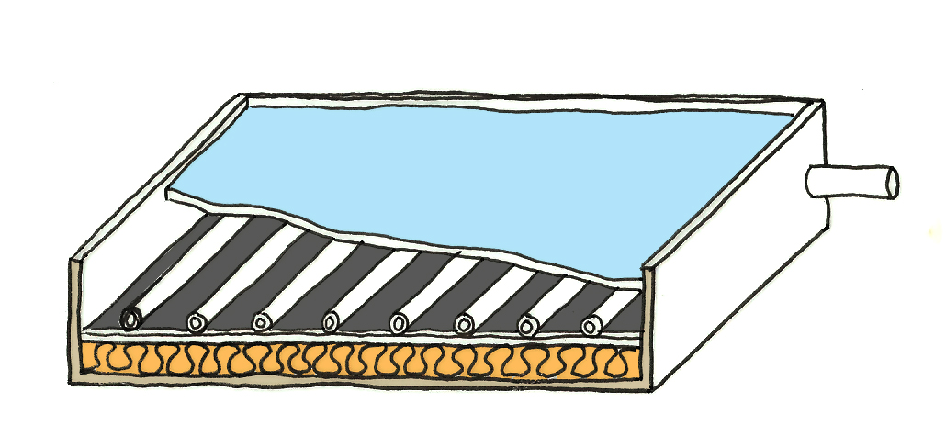
Solar Water Heater
Overflow Tank
Solar Water heating (Solar Panels):
The solar panel transfers heat energy to a liquid heat transfer medium (usually water). This medium then transfers heat to water for use. When the medium transfers its heat to the water it cools and is pumped back to the solar panel to collect more heat to transfer to the water. This cycle continues while there is sun light or until the water in the tank reaches its desired temperature.
Solar Panel (Collector)
Hot water supply
Heat Transfer Pipes
Glass Cover
Inlet / Outlet Pipe
Pump
Blackened Absorber Plate
Hot supply
Insulation to underside of panel
Cold Return
Cold water inlet
Notes:
Solar water-heating systems typically are roof-mounted panels that absorb the sun's heat into water or some other fluid, then deliver it to the buildings water heating system through a heat exchanger. Solar systems can also provide indoor space heating by running the heated water though radiant floor-heating pipes or through a heat exchanger in warm air applications. These systems can provide heat and hot water with very little energy use. "Active" solar systems rely on pumps to move the fluid through the collectors to where the heat is exchanged into the fluid. A pump increases system efficiency, but also cost, maintenance, and the need for outside power. "Passive" systems are designed so that the heated fluid moves through the collector naturally (heat rises, while cold tends to sink), without requiring a pump or outside power.

Slide 28
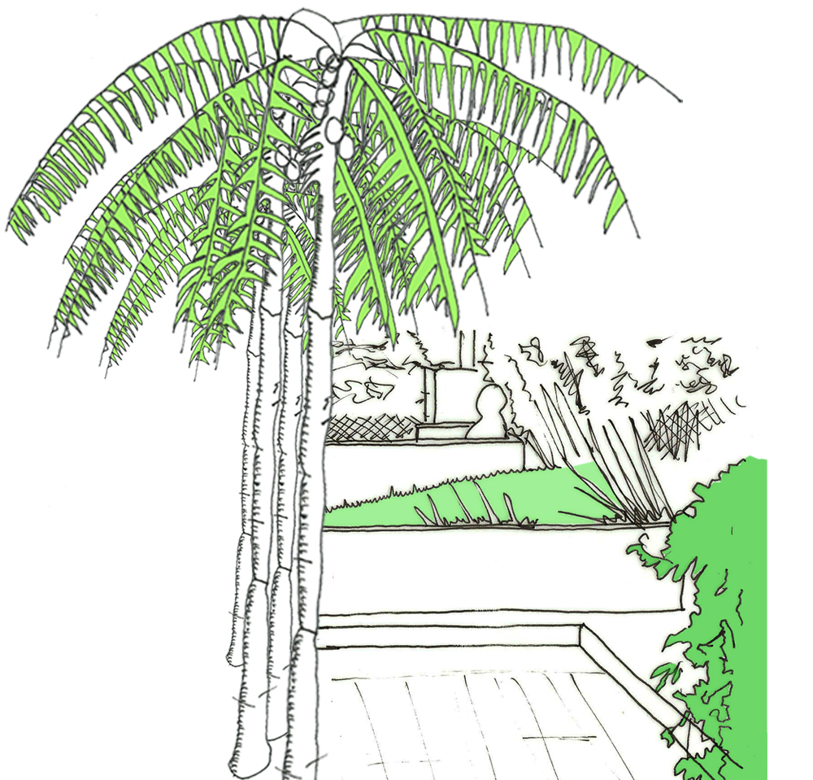
Energy Benchmarks & Schools
The energy utility index (EUI):
This is a measure to understand the total consumption of the building (kWh in a year) divided by the total gross floor area.
This can be done by looking at the SP Power bill for the school and adding up the total amount of electricity consumed over a year.
The gross floor area is the area of each floor of the building added up.
For a school - all of the classrooms, the hall, corridors, canteen computer room, teachers offices and other spaces (make sure you minus off the playground, car park and other spaces such as outdoor landscape / fields)
Notes:
The following lessons will help you identify areas where the school can improve its energy performance, to reduce its consumption

Slide 29
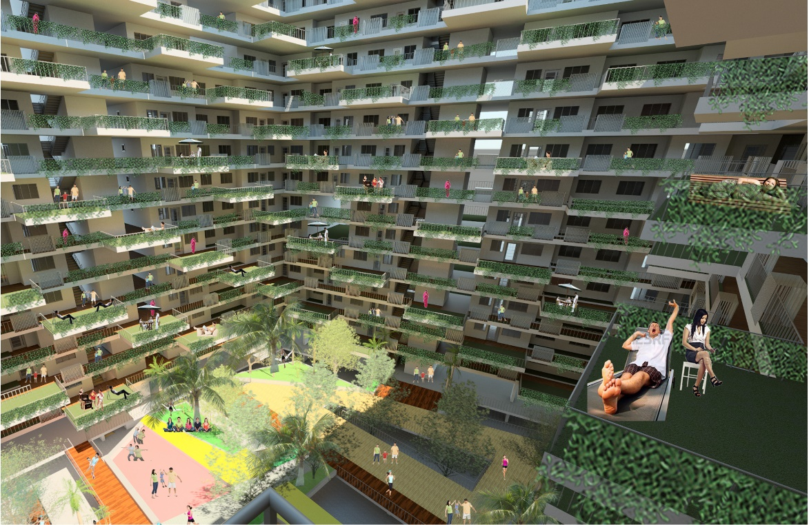
Energy Benchmarks & Schools
The energy efficiency index (EEI):
This is a measure to understand the total consumption of a building (kWh in a year) divided by the total gross floor area and based on standard operational hours.
This is used to compare a variety of different building types where the operational hours may differ thus so will the actual consumption
Hence when you look at the BCA Green Mark Projects you will often see the EEI figure of a building.
The LOWER the number, the less energy it consumes per m2 of development
Notes:
The following lessons will help you identify areas where the school can improve its energy performance, to reduce its consumption

Slide 30
Energy Benchmarks & Schools
The energy utility index (EUI) EXERCISE:
Calculate your EUI and compare your school with other MOE secondary schools:
Get the SP power bill, if the full 12 months are not available use 3 months data and average it, then multiply this by 12 months. Do note the difference in consumption between term time and holidays!
Calculate the GFA (Gross Floor Area) of the school, this is the total floor area of all the classrooms, corridors, office space, WC’s, canteen, library and computer rooms etc…. i.e. all spaces except for the outdoor areas such as the playground, tennis courts, football fields and car park.
Compare this with the graph to see which percentile you fall in, the higher the percentile the better! (The LOWER your EUI the better)
50th Percentile for secondary schools = 36.5kWh/m2/yr (are you better than this?)

Slide 31
Energy Benchmarks & Schools
Percentile
EUI Value
Notes:
The following lessons will help you identify areas where the school can improve its energy performance, to reduce its consumption

