Slide 2
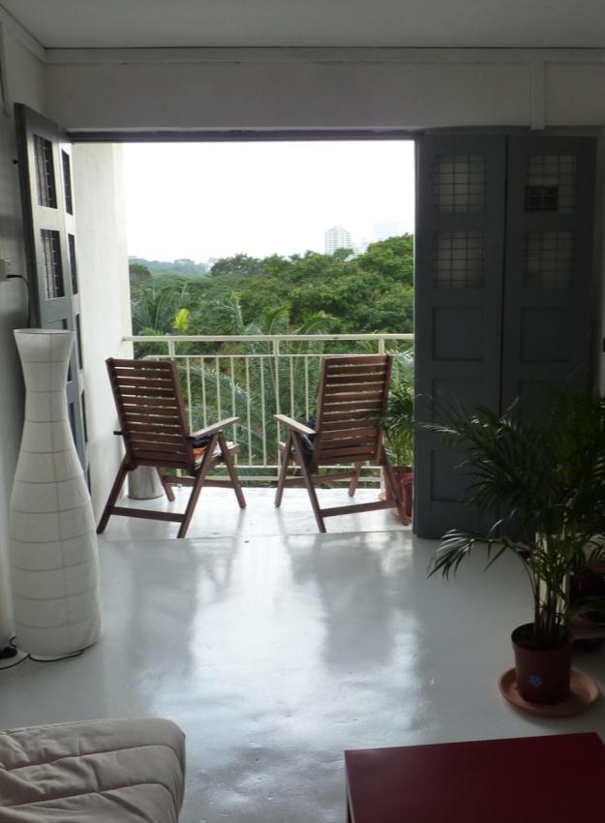
Lessons 2 & 3 - Outcomes
To know what is meant by building orientation and what works best for Singapore and the tropical region, based on the sun path and how this relates to building shading and design.
For students to understand the concept of thermal comfort in terms of what makes one comfortable and how the human body achieves this. This would be related to building use and design.
Benjamin Towell (2011)

Slide 3
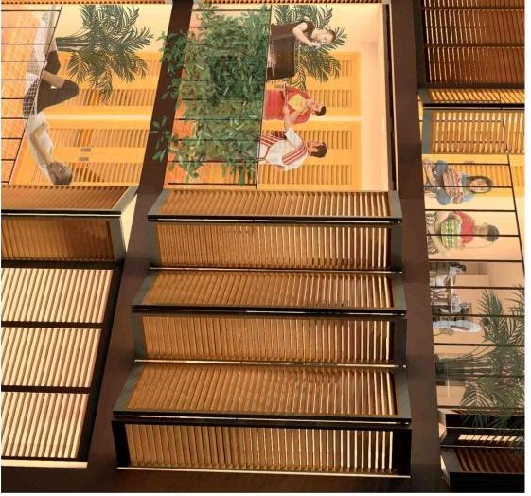
Re-Cap
Tropical climate:
High temperatures throughout the year, high humidity and high rainfall.
Why sustainability:
The effects of Climate change will lead to:
adverse effects on ecosystems and particularly agriculture
changing patterns of weather and increased storminess
increased demand for water
more extreme climatic conditions, drought and floods
rising sea levels and flooding of low lying regions
huge population displacement and refugee problem
Benjamin Towell (2011)

Slide 4
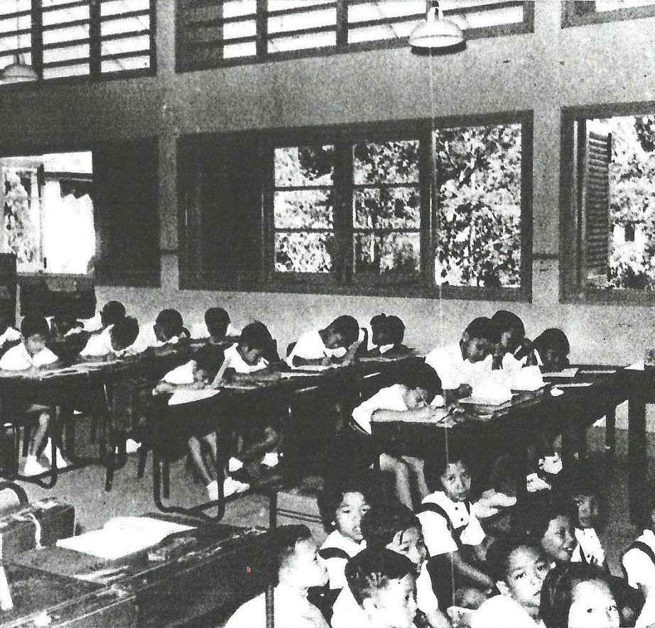
Climate & Building Considerations
Basic principles of climatic building design applied to each climate zone are based upon:
Solar orientation – the need to exclude or admit solar radiation for cooling or heating
Shelter or Openness to prevailing winds to aid heating or cooling
Thermal mass of construction which may slow down or speed up heat gains.
Design of openings to encourage (or discourage) natural ventilation
Level of insulation to reduce heat gains or losses.
Singapore Improvement Trust (1957)

Slide 5
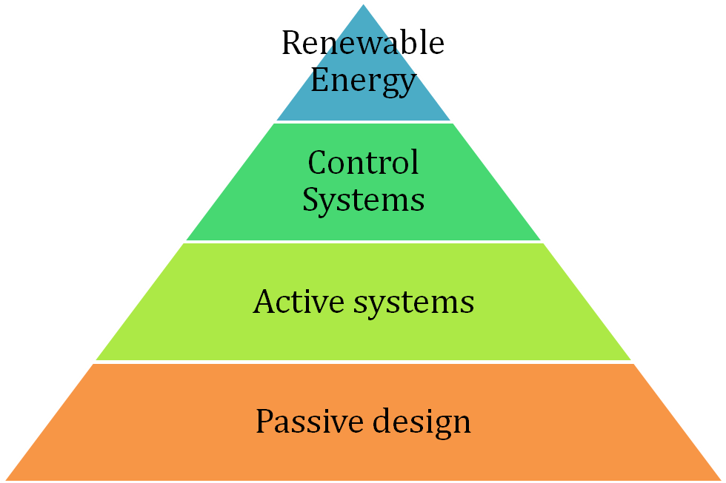
Approach to Green Buildings
1. Passive strategies (Climate positive) – to implement as a first priority!
Natural Ventilation
Behavioural changes
Daylight
Operation and regular maintenance
2. Active Systems – with high efficiency to support or supplement the passive measures. E.g. Energy efficient AC, lighting and low flow water fittings
3. Renewable Systems

Slide 6
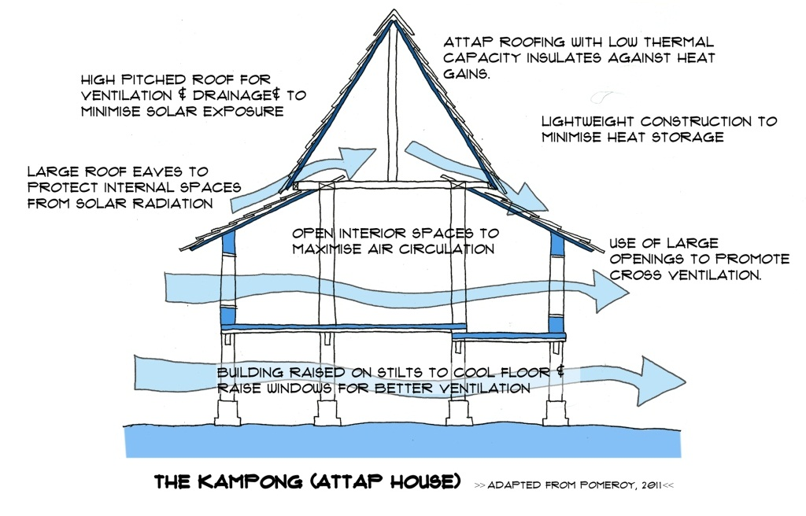
Vernacular Features – Summary
Notes:
From the last lesson we saw how the people of past in the region developed their housing and buildings to be responsive to the environment. These are summarised above. In this lesson we shall look at the solar design issues for buildings in Singapore. In the following Lesson we will be looking at natural ventilation.

Slide 7
Approach to Tropical buildings:
Aim is to reduce internal temperatures, maximise ventilation rates to increase the effectiveness of sweat evaporation, and provide protection from sun, rain and insects.
Use of large doors and windows to promote cross-ventilation,
Open planning and wide, free spaces between buildings,
Raising building on stilts to cool floor and raise windows for better ventilation,
Orientation determined by prevailing breezes,
Large overhangs to protect from internal spaces from solar radiation,
Use of sliding screens to protect from storms and insects at night,
Use of low thermal mass materials to minimise heat storage,
Use of highly insulating materials in roof.

Slide 8
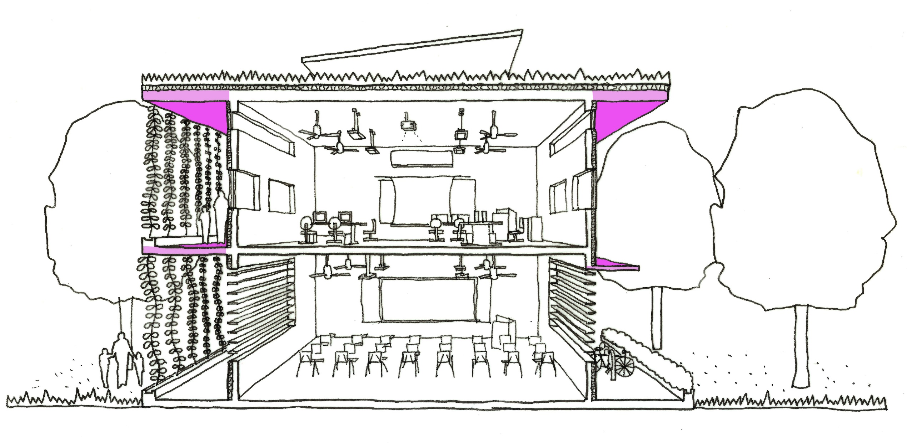
2. Passive Solar Design
Benjamin Towell (2014)

Slide 9
Approach to Tropical buildings:
Aim is to reduce internal temperatures, maximise ventilation rates to increase the effectiveness of sweat evaporation, and provide protection from sun, rain and insects.
Use of large doors and windows to promote cross-ventilation,
Open planning and wide, free spaces between buildings,
Raising building on stilts to cool floor and raise windows for better ventilation,
Orientation determined by prevailing breezes,
Large overhangs to protect from internal spaces from solar radiation,
Use of sliding screens to protect from storms and insects at night,
Use of low thermal mass materials to minimise heat storage,
Use of highly insulating materials in roof.

Slide 10
The Position of the Sun
Poor climatic design considerations of the sun often cause many buildings to overheat, even in temperate climates! The power of the sun should be understood and respected in which the free energy of the sun is used to power the building, provide good day lighting but not allowed to interfere with the comfort of the building’s occupants.
Good solar design requires knowledge of:
Solar position in relation to the building at different times of the year
The solar intensity
Shade given by existing buildings, vegetation of topographical features
The requirements for controlling the heat gain from direct solar radiation (through windows) and conduction (through walls, roofs and windows).
Notes:
The Position of the Sun:
The position of the sun varies constantly throughout the day and year, knowing the position of the sun at a particular time of the day or year is important in determining potential solar access to a building or overshadowing and also for the dimensioning of protective features such as shading devices. For these purposes it is usual to work on three sun-paths March 21st and September 23rd (Equinox), June 21st (summer solstice) and December 21st (winter solstice). The path of the sun is described by two angles, solar altitude (angle between the horizontal plane and the sun beams) and solar azimuth (angle between the projection of the sunbeams on the horizontal plane and the south, to the east positive, to the west negative).

Slide 11
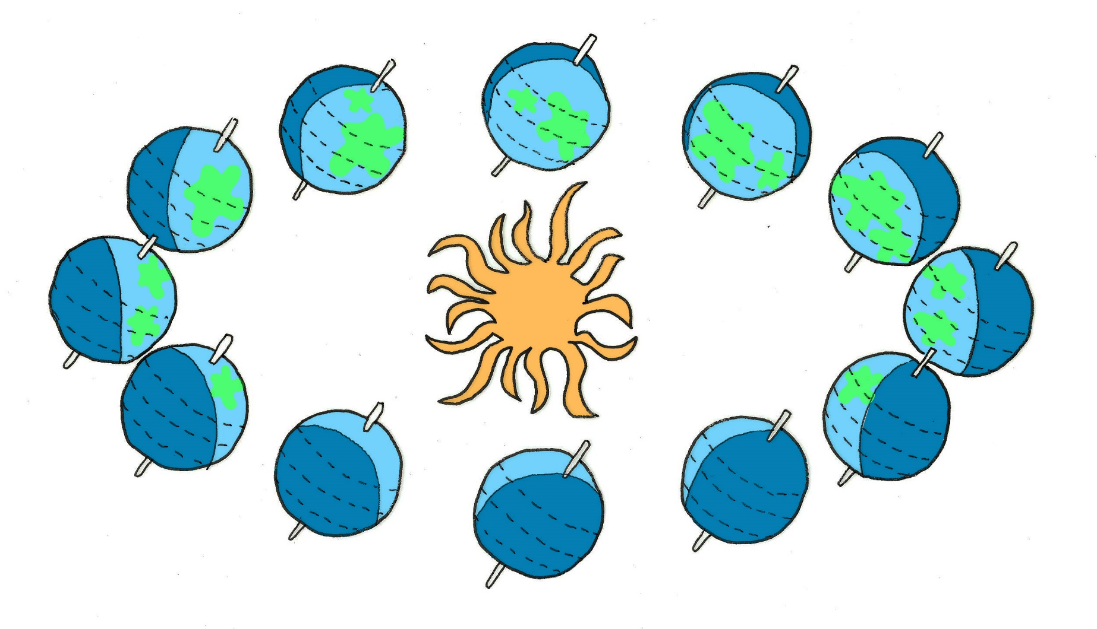
The Position of the Sun
March
June
December
September
Notes:
From March to September the Northern Hemisphere has more daylight than the souther hemisphere, this is due to the earth rotating on an axis that is angled away from perpendicular to its orbit. This means that at different times of the year the sun is stronger in dfferent areas due to the sun angle created by the orbit and the earths axis.

Slide 12
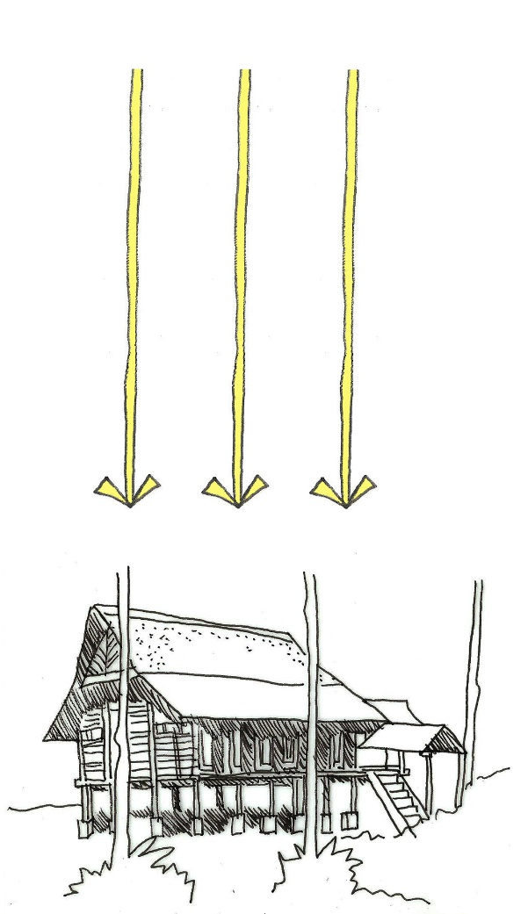
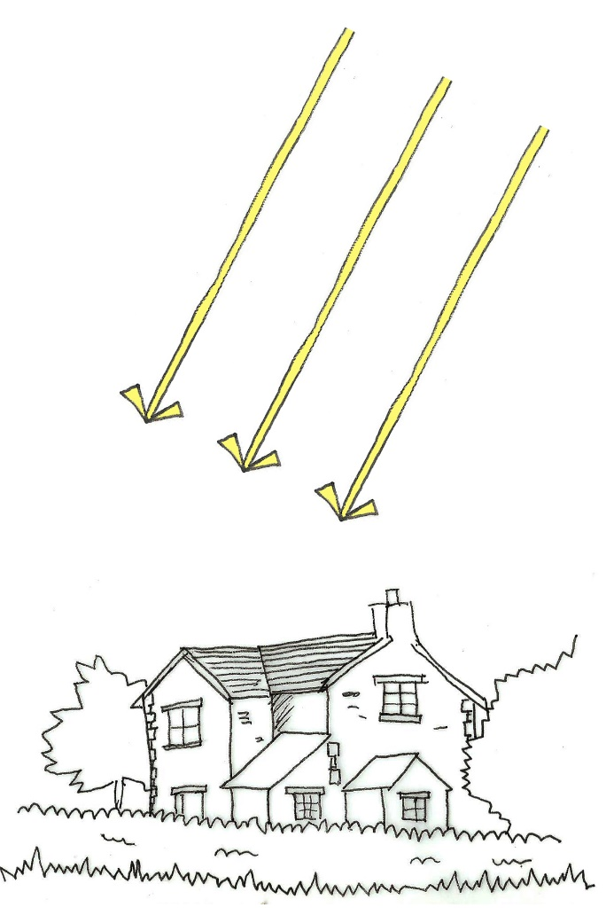
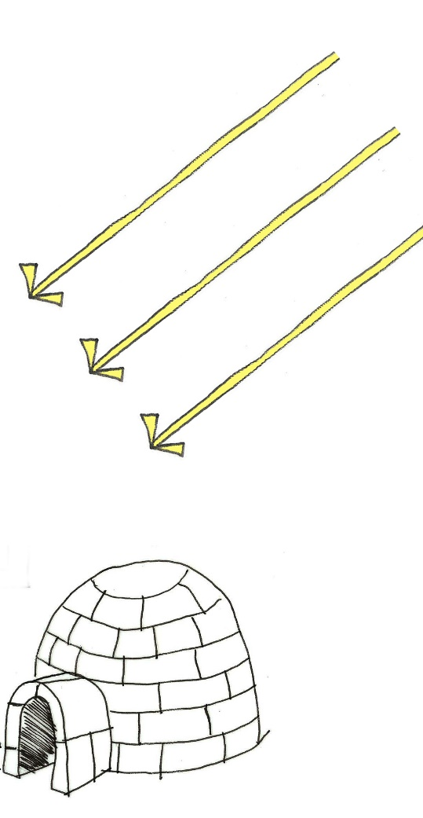
The Position of the Sun
Solar radiation
1 unit
1 unit
1 unit
1.4 units
2 units
1 unit
Tropics
Temperate
Polar
Notes:
The Position of the Sun:
The tropical region has a very high sun angle for most of the day - the sun rises in the east and sets in the west. The sun not only provides the light we use to see and the plants to grow during the day, it also provides warmth. Due to the strength of the sun in the tropics it is considerably warmer than places nearer the 2 Poles.

Slide 13
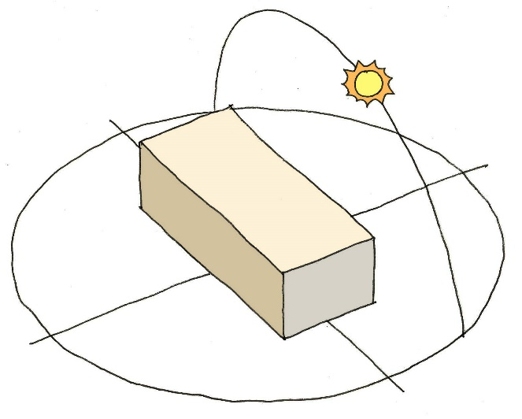
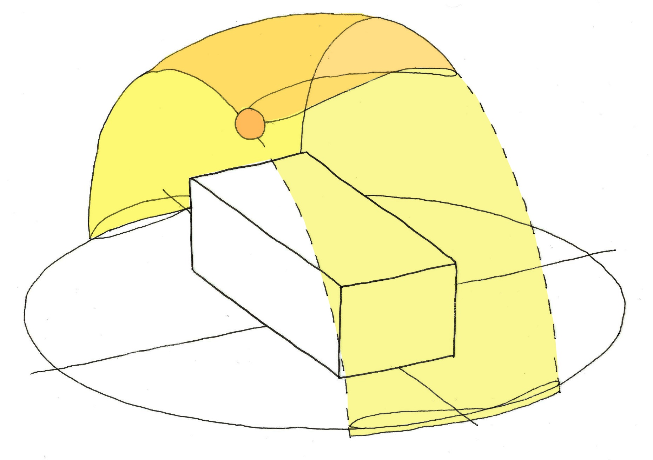
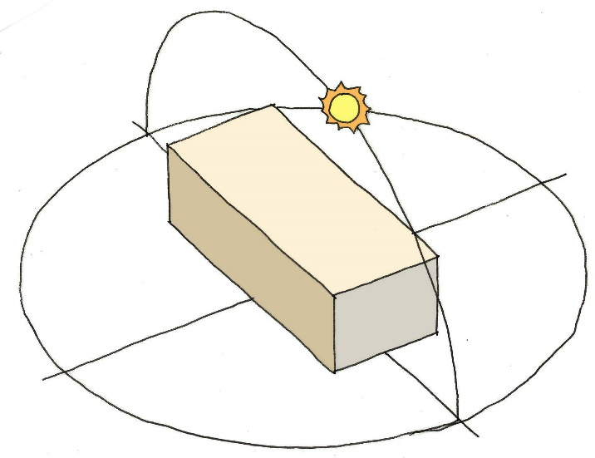
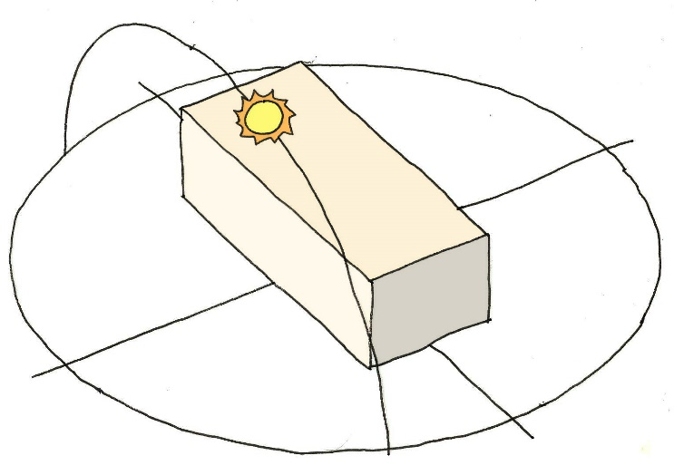
The Position of the Sun
June 21st
Summer Sun
March 21st & September 23rd
Winter Sun
N
December 21st
S
Summer Sun
Winter Sun
E
Notes:
The Position of the Sun:
The position of the sun varies constantly throughout the day and year, knowing the position of the sun at a particular time of the day or year is important in determining potential solar access to a building or overshadowing and also for the dimensioning of protective features such as shading devices. For these purposes it is usual to work on three sun-paths March 21st and September 23rd (Equinox), June 21st (summer solstice) and December 21st (winter solstice). The path of the sun is described by two angles, solar altitude (angle between the horizontal plane and the sun beams) and solar azimuth (angle between the projection of the sunbeams on the horizontal plane and the south, to the east positive, to the west negative).

Slide 14
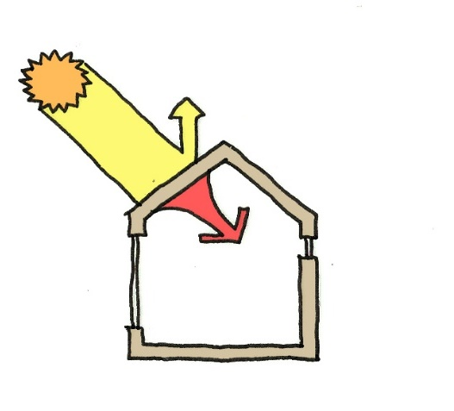
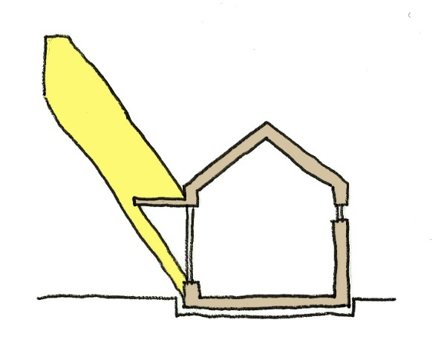
Solar Heat Gains
Heat enters a building in 3 ways:
Conduction through Walls & Roof. This is where insulation is very important as is the choice of materials. Some materials heat up quickly and loose their heat quickly, others store the heat and radiate this into the building over time.
Conduction through windows. Glazing usually has higher conductivity than solid walls so more heat can be conducted into the building.
Radiation (direct and diffused) through windows. This typically accounts for more than 70% of the heat gain through the building envelope.
With radiation in the tropics being so critical to heat gain, reducing this is a first priority!
Conduction through the building fabric – reduce this with the se of insulative building materials
To reduce radiation through windows, shading devices can be used.

Slide 15
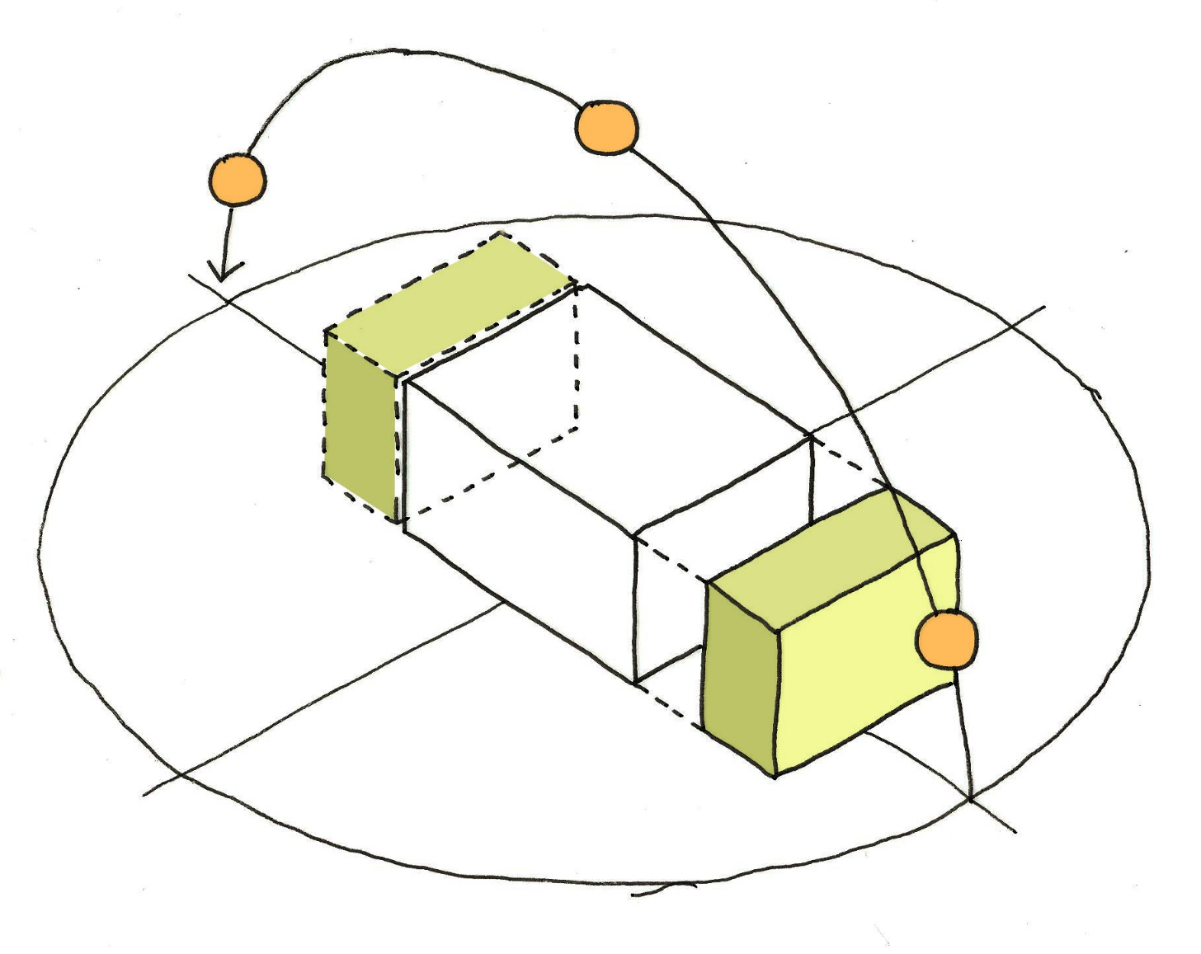
Orientation
To mitigate solar heat gains:
Orientation North and South – reduce the amount of the building facing east and west.
Solar shading to windows (external shading is the most effective)
Insulated walls and roof
Green walls and green roofs (the use of plants)
W
N
S
E
Notes:
Orientation of Buildings:
The key factor in affecting solar gain within a building is orientation. In Singapore due to the high sun angles the north and south facades receive a great deal less direct solar radiation than the eat façade in the mornings and the west in the afternoons and evenings. Due to the solar intensity of the tropics buildings do well to orientate themselves to the north and South, with the eat and west insulated or containing service cores (less frequently occupied spaces due to the higher heat gains in these spaces. See the blocks shaded in green

Slide 16
Solar Shading

Slide 17
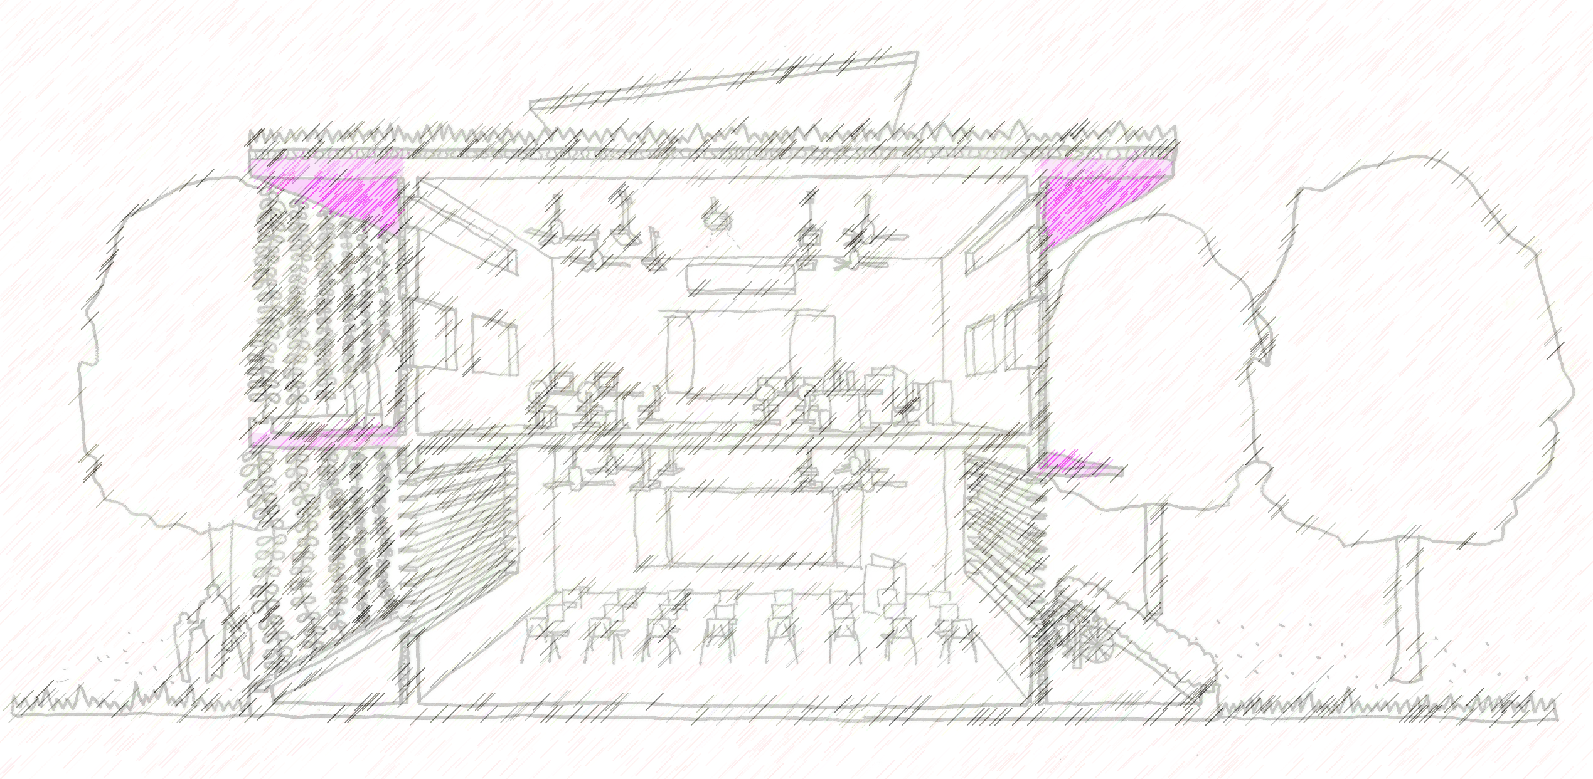
Solar Shading
Design for solar shading for the windows (shutters, external blinds a distance away)
Reduces the solar heat gain into the room and improves the thermal comfort for occupants near the windows / openings. Horizontal overhangs can also act to prevent rain from entering the windows, thus high level windows can be left open to allow the cool air into the room

Slide 18
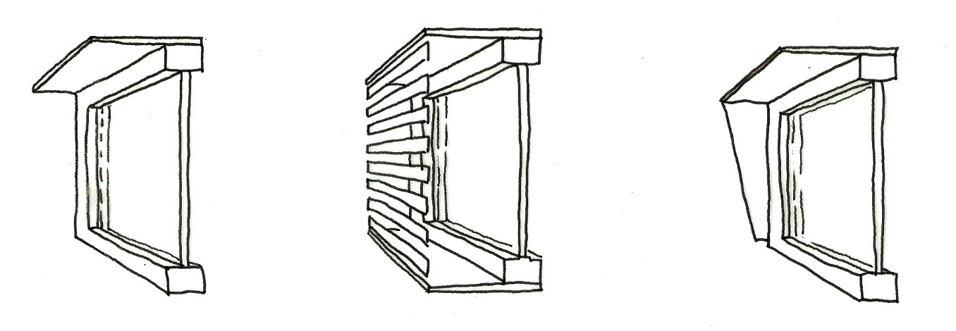
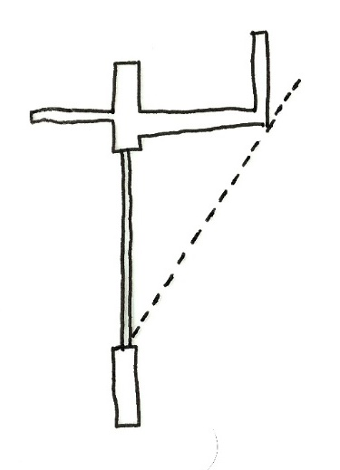
Shading Devices
Shading devices are used to reduce the direct solar radiation from any opening or glazed area. This is one of the most effective ways of reducing the heat gain through the façade after the orientation and amount of glazing has been optimised.
Horizontal Overhang:
Effective in Singapore due to high sun angle. Apply to North & South Facades
Vertical Sun-screen:
Effective for East & West Facades, issues for daylight & views
Horizontal & Vertical Overhang:
Effective for North East, North West, South East and South West windows
Projection
Sun’s ray
Shade
Window
External Blind:
Adaptive for personal use. External use thus blocks radiation when needed. Can be opened for views & daylight
Awning:
Adaptive for personal use.
Shutters:
Adaptive for personal use. Act like a solid wall when closed.
Vertical Fins
Effectiveness based on projection length and frequency

Slide 19
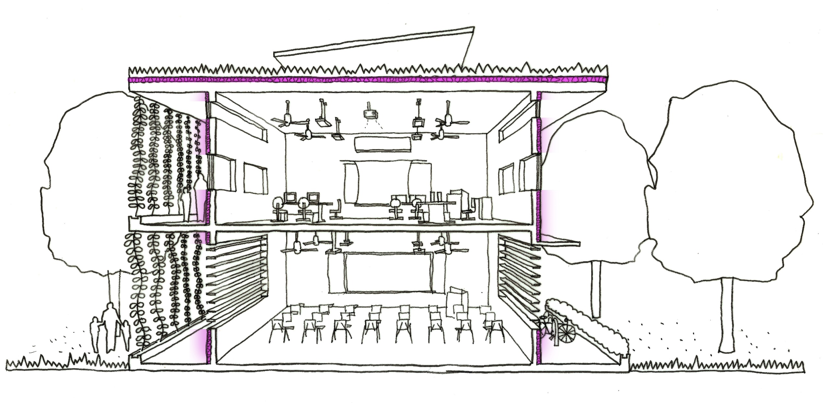
Insulation

Slide 20
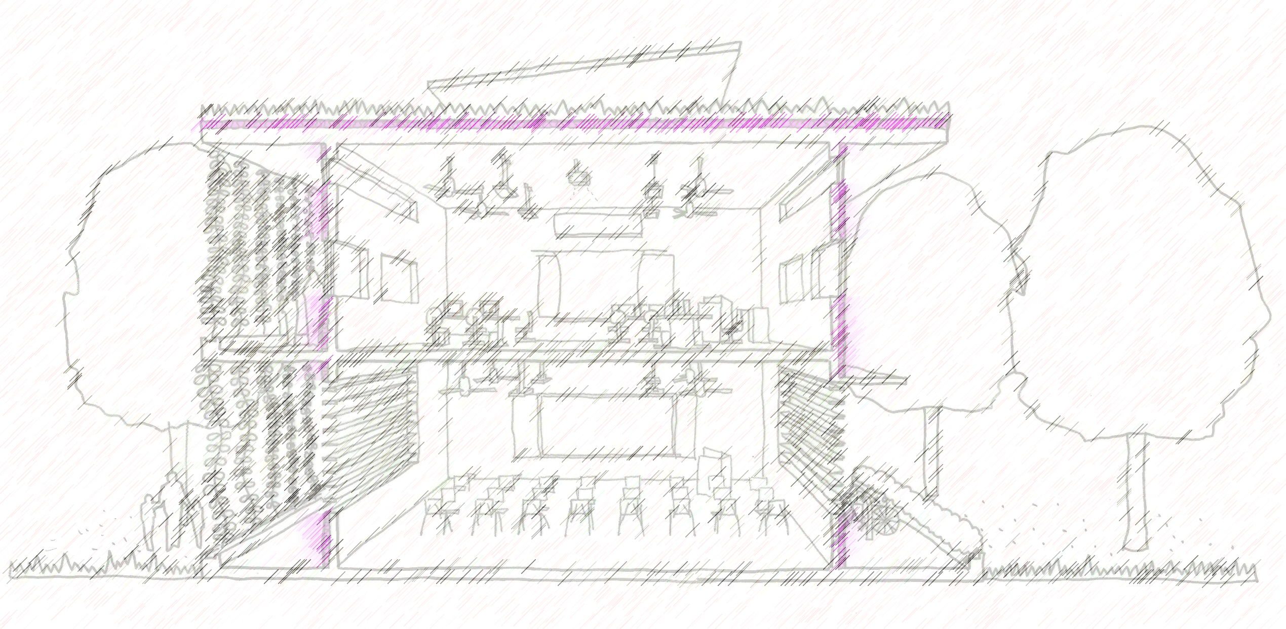
Insulation
Thermal properties of the facade & Roof. Reduce the transmitted heat from the facade through the use of insulation on the external face to reduce the thermal transmission through the façade. The use of Cool Paints on exposed east and west facades can be considered to reduce the heat absorbed by the façade.

Slide 21
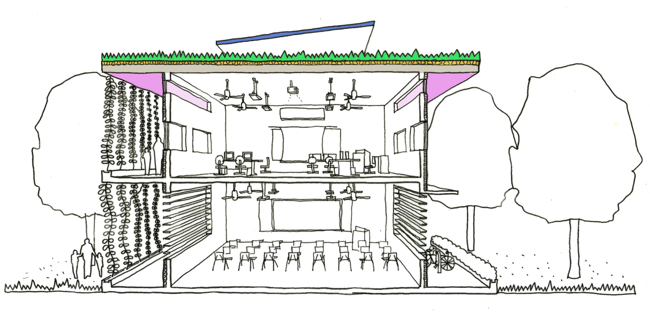
Roof

Slide 22
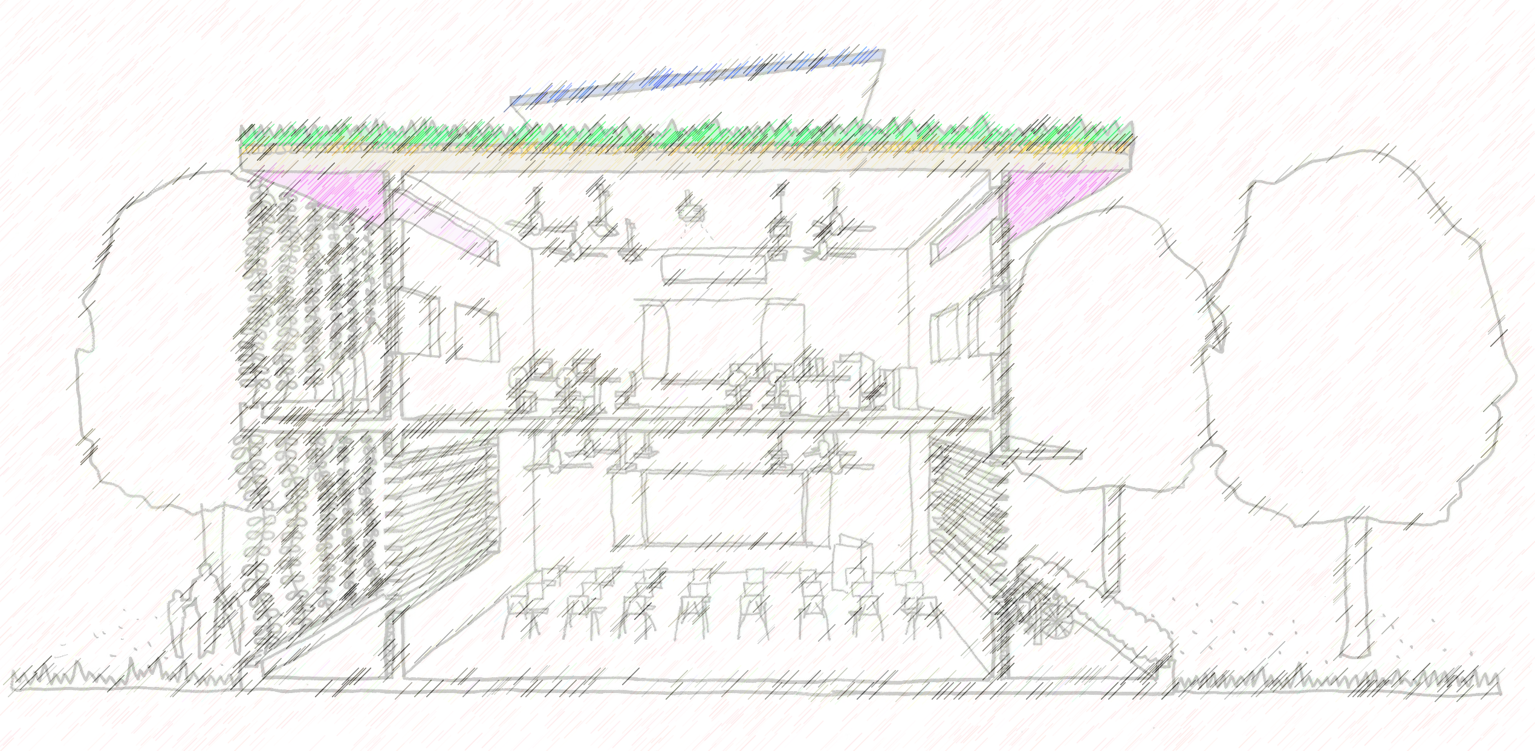
Roof
Overhang – acts as a shading device – protects the façade from solar heat gains during the middle of the day. Use of Green Roof or insulation or Shading strategies (such as the use of PV panels, or indeed a 2nd layer with an air gap) to reduce the heat gain into the school.

