Slide 1
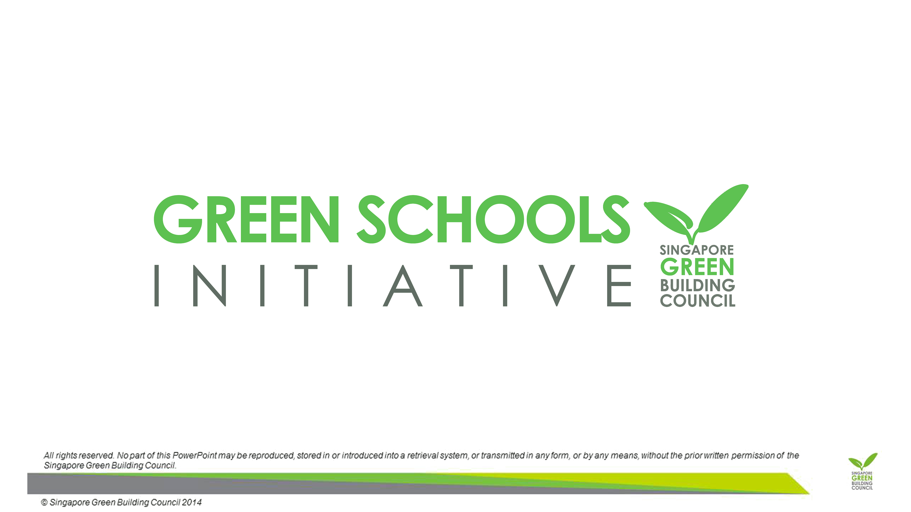

Slide 2
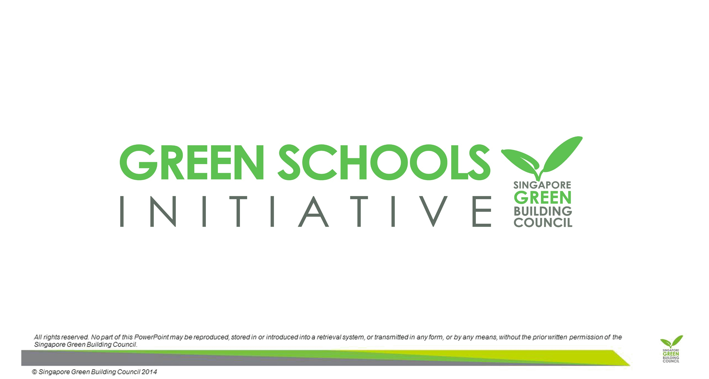
Course Objectives
To identify a green building as one that is energy-efficient, water-efficient, consumes fewer resources and has a reduced environmental impact
To identify the key consumers of energy in a building and the strategies that can be adopted to reduce the energy consumption
To be familiar with the Energy Efficiency Index (EEI) and how it serves as a benchmark to compare buildings with similar characteristics
To understand the role of Green Mark in recognising green buildings in Singapore

Slide 3
Course Outline
The course is broken up into 10 lessons of 30 to 45 minutes each. The general content shall include:
Module 1: Basic Principles of Tropical Building Design
Module 2: Energy Consumption
Module 3: Resource Management
Module 4: Outdoor Thermal Environment
Module 5: Singapore’s Approach to Green Buildings

Slide 4
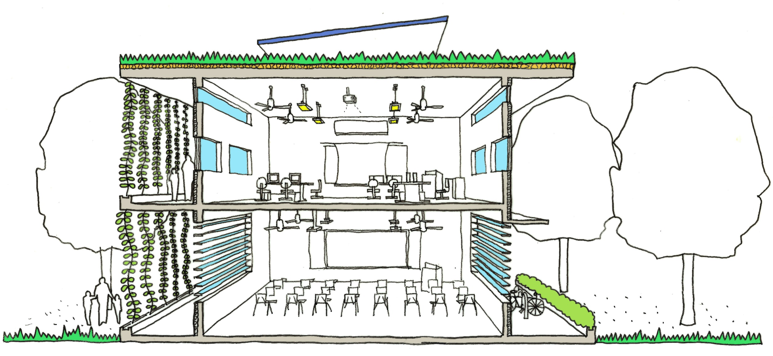
1. Green Buildings in the Tropics
Benjamin Towell (2014)

Slide 5
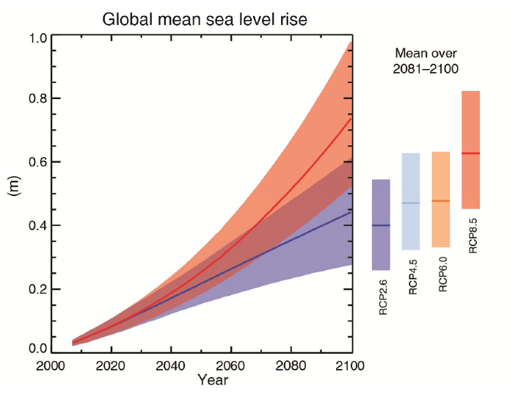
Why the Topic?
The climate is changing and our activity is the cause
Our resources are dwindling
Our consumption is increasing in spite of this.
We need to work together to reduce our impacts.
Global average Surface Temperature Change (ºC)
The graphs from the UN climate pane’s 2013 report showing the best case and worst case scenarios for the climate projection of the earth. The report details the physical evidence for climate change and states with 95% confidence that humans are the “dominant cause”. (IPCC WG1 AR5, 2013)
Notes:
The climate is changing, and this effect is being enhanced through human activities. This is no longer refutable; the shrinking of the polar ice caps, the changing wind patterns in Singapore and the extreme events in other countries.
Without mediation there will be increasingly devastating patterns of extreme weather events – from droughts, floods, typhoons, hurricanes and warmer weather.
Our global resources are becoming increasingly depleted with our disposable culture of material goods.
The physical environment – the forms of buildings, the use of buildings and the organisation of our physical environment have a huge contribution to our environmental footprint.

Slide 6
Why the Topic?
Warming of the climate system is unequivocal, and since the 1950s, many of the observed changes are unprecedented over decades to millennia. The atmosphere and ocean have warmed, the amounts of snow and ice have diminished, sea level has risen, and the concentrations of greenhouse gases have increased.
(Extract from Working Group I Contribution to the IPCC Fifth Assessment Report Climate Change 2013: The Physical Science Basis Summary for Policymakers – by the UN)
Each of the last three decades has been successively warmer at the Earth’s surface than any preceding decade since 1850. In the Northern Hemisphere, 1983–2012 was likely the warmest 30-year period of the last 1400 years (medium confidence).
(Extract from Working Group I Contribution to the IPCC Fifth Assessment Report Climate Change 2013: The Physical Science Basis Summary for Policymakers – by the UN)

Slide 7
Why the Topic?
Global Building Consumption
(Kishnani, 2010)
The built environment globally and locally consumes vast quantities of resources during their construction and over their life. With limited resources and the impacts of climate change being felt globally there needs to be collective action to mitigate this.
No other sector of industry uses more materials and energy, produces more waste and contributes less to material recycling than the building industry (Hegger et al, 2008)
3%
18%
43%
31%
5%

Slide 8
Impact on Singapore
Rising sea levels – greater land constraints.
Increase in flash floods
Hotter dryer periods
Change in wind direction and speed
A less liveable environment
Predicted Reserves of Fossil Fuels
Oil | 30 years
Natural Gas | 50 years
Coal | 190 years
Table Adapted from Vale, B&R (1991)

Slide 9
What is Sustainable Development?
Discuss what the term SUSTAINABILITY or SUSTAINABLE means to you.

Slide 10
What is Sustainable Development?
Bruntland Report
  Development that meets the needs of the present without compromising the ability of future generations to meet their own needs
  (World Commission on Environment and Development 1987).
Caring for the Earth
  Improving the quality of life while living within the carrying capacity of supporting ecosystems
  (IUCN/UNDP/WWF 1991)

Slide 11
What is Sustainable Development?
1. How we live well with the environment:
  Responsible use of the worlds resources
  Working with the climate (do we need air conditioning, what's wrong with being warm???)
  Responsible material consumption.
2. How we live well with each other
  Sharing spaces and places
  Community initiatives and tolerance
  Working together

Slide 12
The Tropics & Singapore
Discussion:
1. What characterises our climate (describe the weather).
2. How does this affect building design?

Slide 13
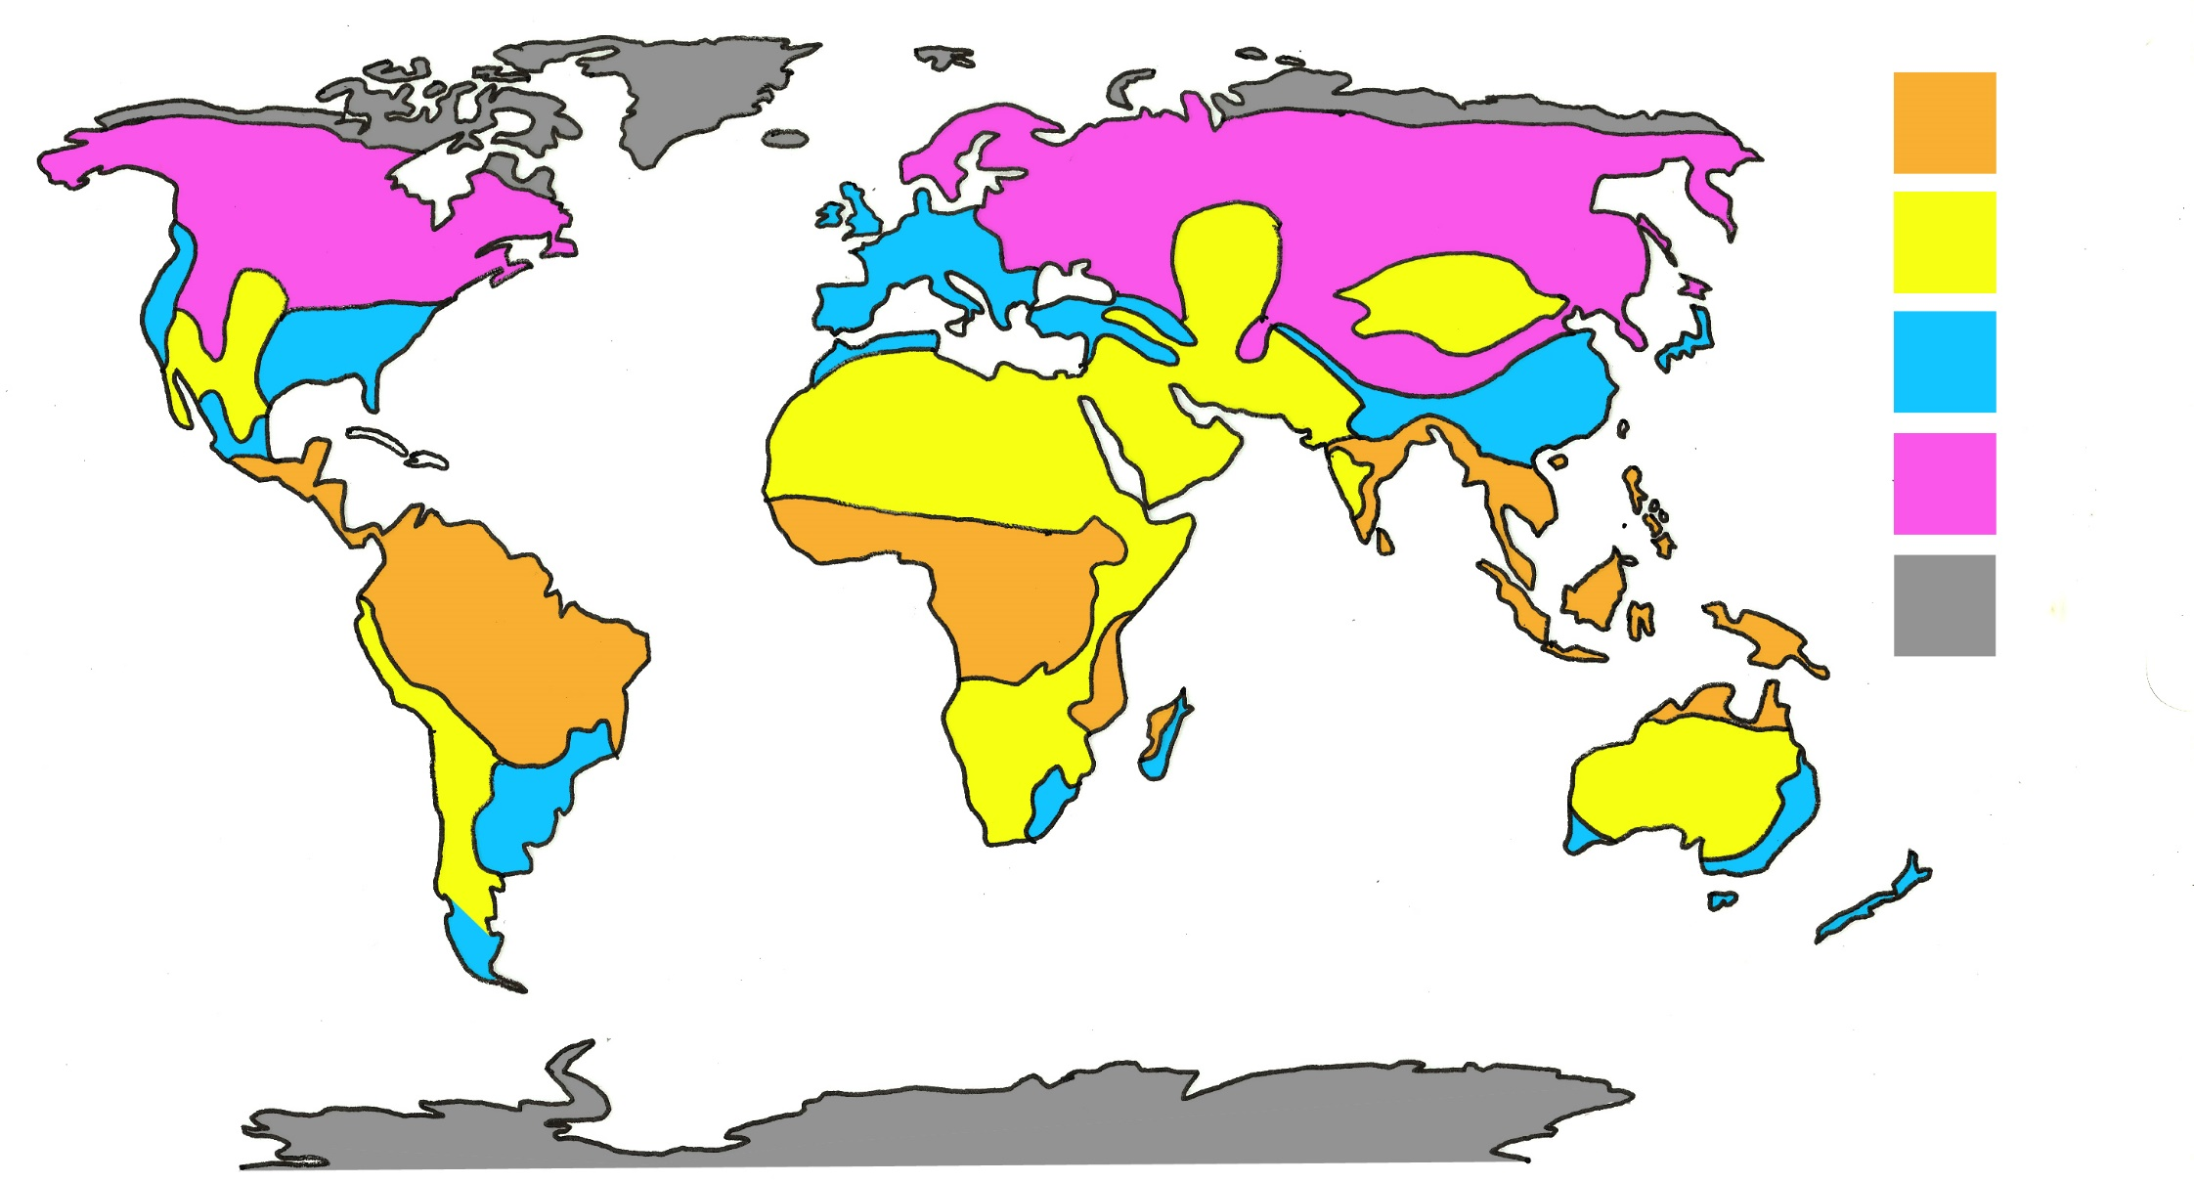
The Tropics & Singapore
Köppen climate classification – The 5 climate groups
Tropical
Dry / Arid
Temperate
Cool / Snow
Polar
Adapted from Chen & Chen (2013)

Slide 14


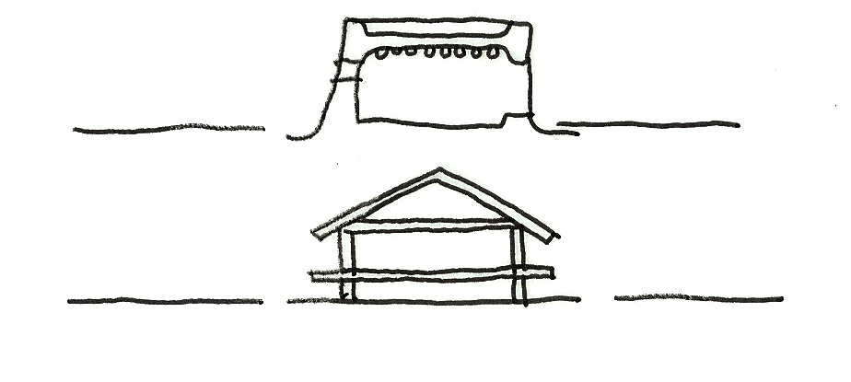
How did we design for the climate in past?
Many of the strategies that address sustainable design are not new or complex. Each region in the past developed local building styles that addressed the climatic conditions in a sensitive manner (their vernacular architecture).
The climatic vernacular produced buildings that had low energy consumption, used local materials, were sensitive to sites (light footprints); creative use of limited resources, and a response to climate for natural comfort.
Cool – roofs have low pitch to allow dry snow to act as insulation
Temperate – walls are more protective than roof, which has medium pitch for rain run off
Dry – usually characterised by flat roofs with minimal surface area and made of heavyweight construction such as clay
Tropical – roofs more important than walls (which were often omitted). A high pitch roof allows both drainage and ventilation

Slide 15
How did we design for the climate in past?
The following images show the vernacular approach to the tropical environment. See how many green features you can spot as these will be explored in the next lesson in more detail.

Slide 16
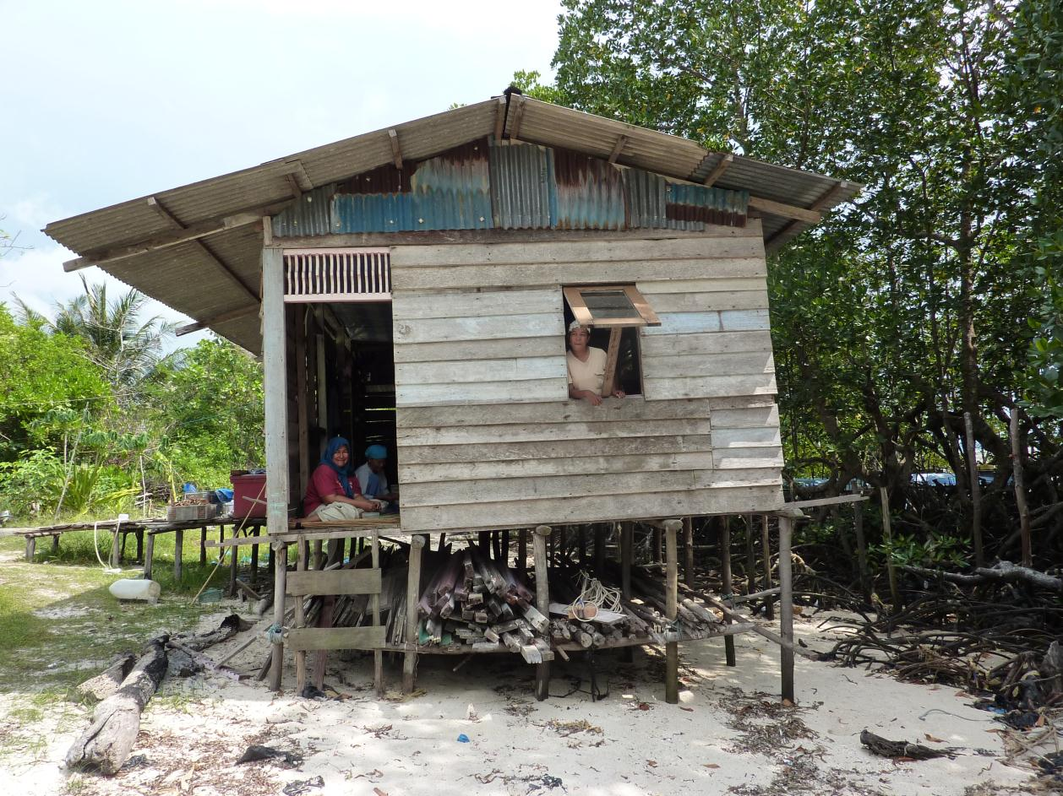
How did we design for the climate in past?
Benjamin Towell (2014)
Notes:
Roof overhangs, local materials, lots of ventilation and shading

Slide 17
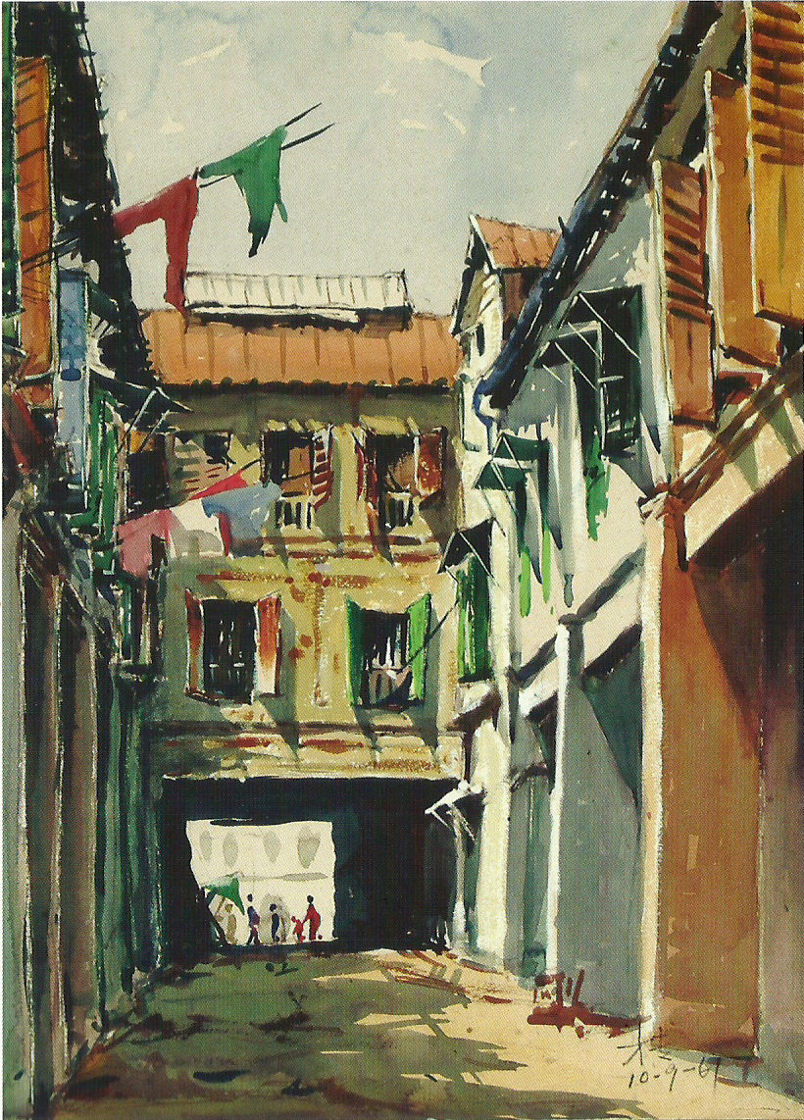
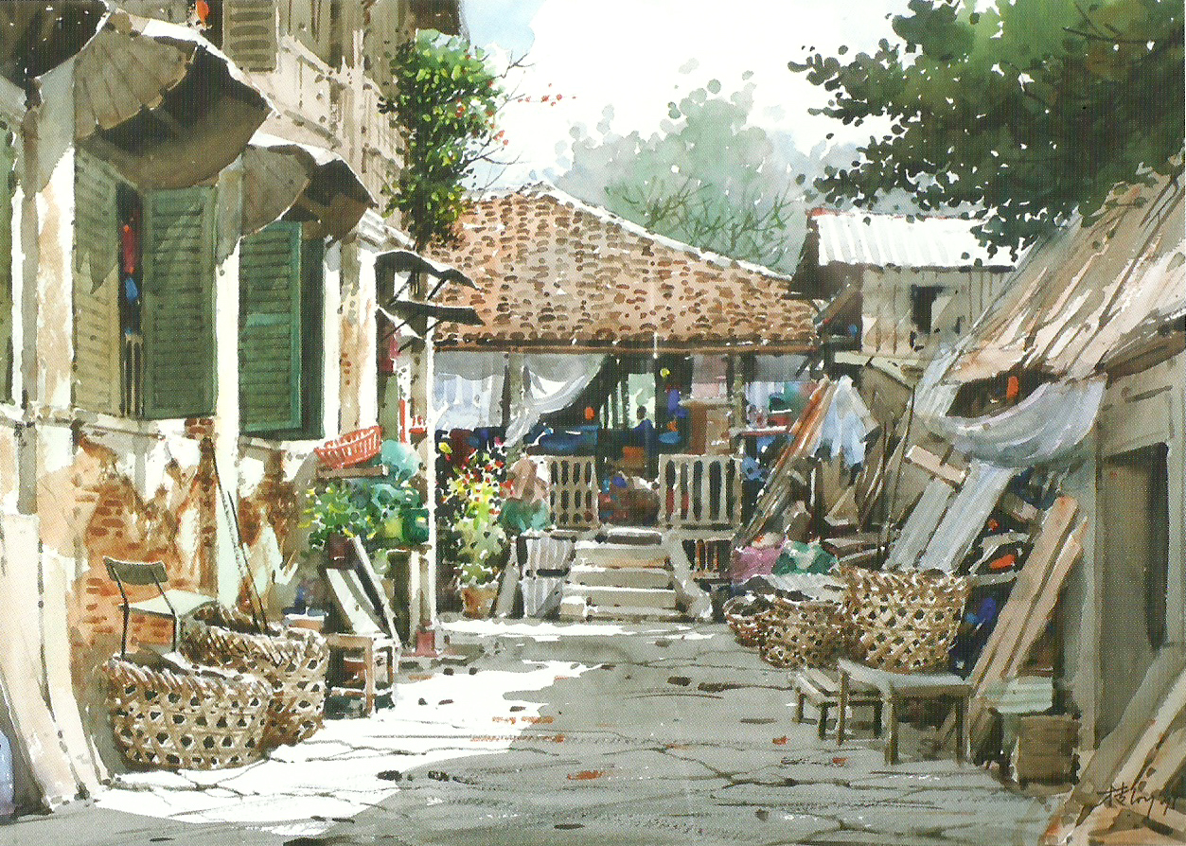
How did we design for the climate in past?
Loy Chye Chuan (Artist)
Notes:
Façade treatement for shading (shutters) which were lovred to allow for ventilation whilst protecting from the sun and rain. Notice the awnings on the painting on the right.

Slide 18
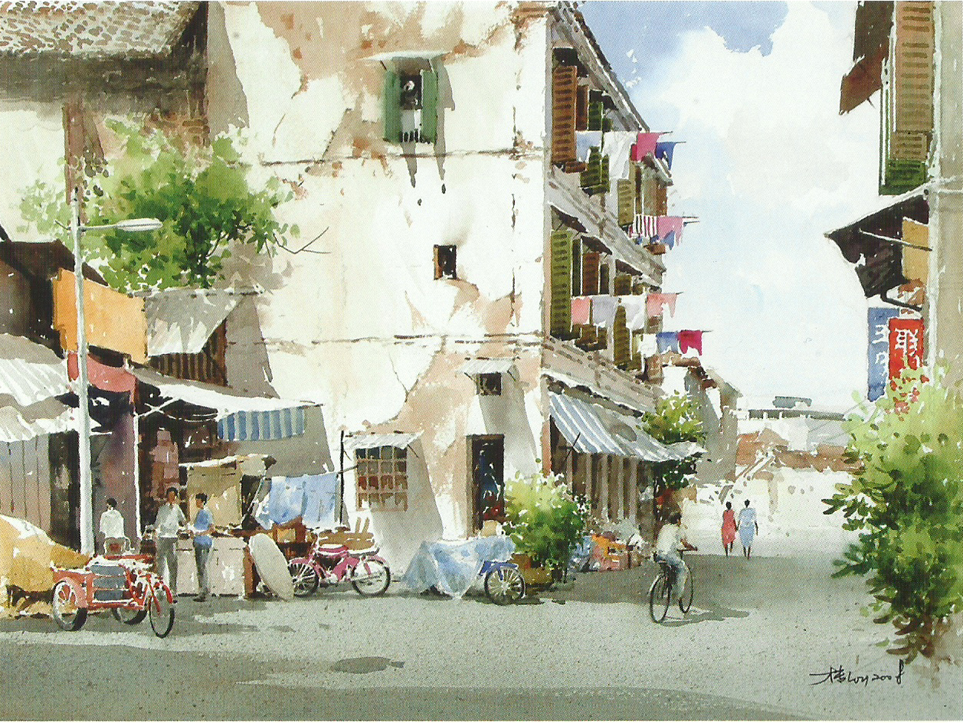
How did we design for the climate in past?
Loy Chye Chuan (Artist)
Notes:
Shutters and shading devices, not too many glazed areas for excessive heat to enter. Not the quiet streets for cyclist and pedestrians to move

Slide 19
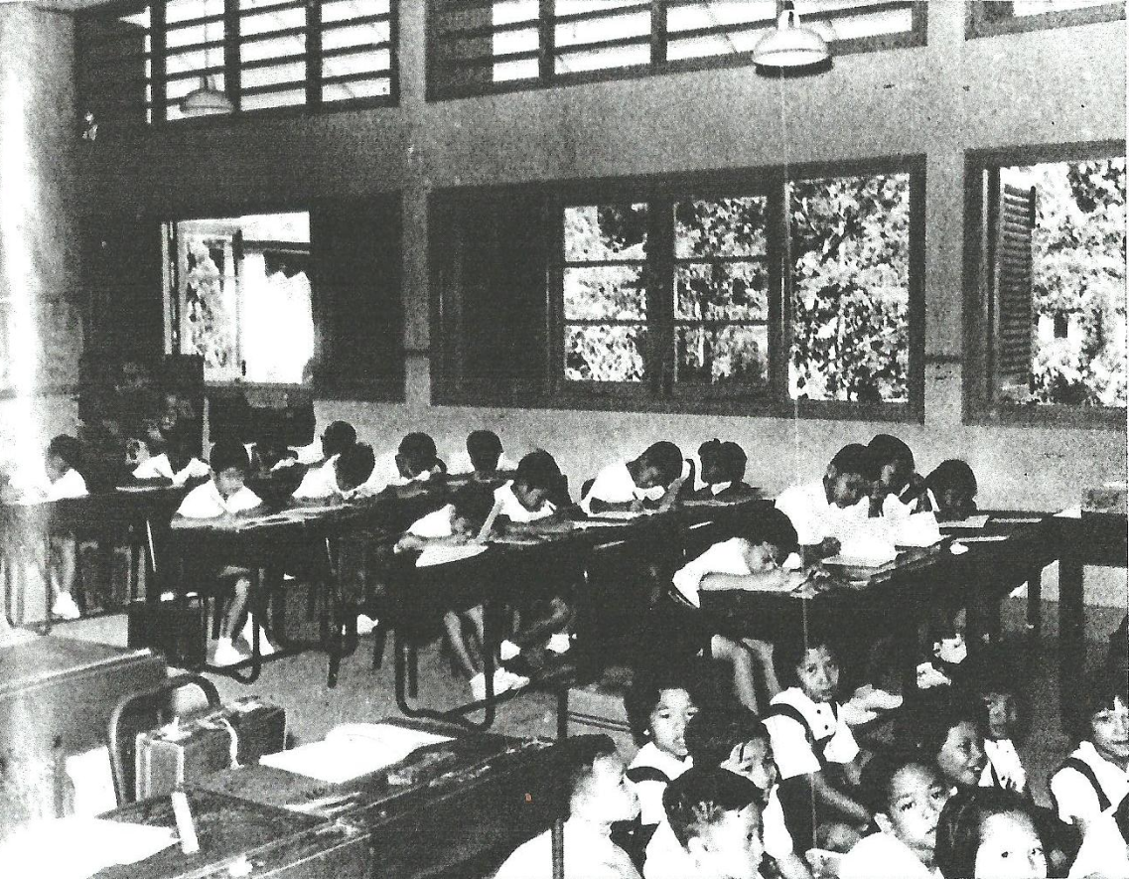
How did we design for the climate in past?
Singapore Improvement Trust (1957)
Notes:
High ceilings high openings good for daylight penetration and ventilation. Louvred shutters lower levels to block excessive solar gain. Good openings for ventilation.

Slide 20
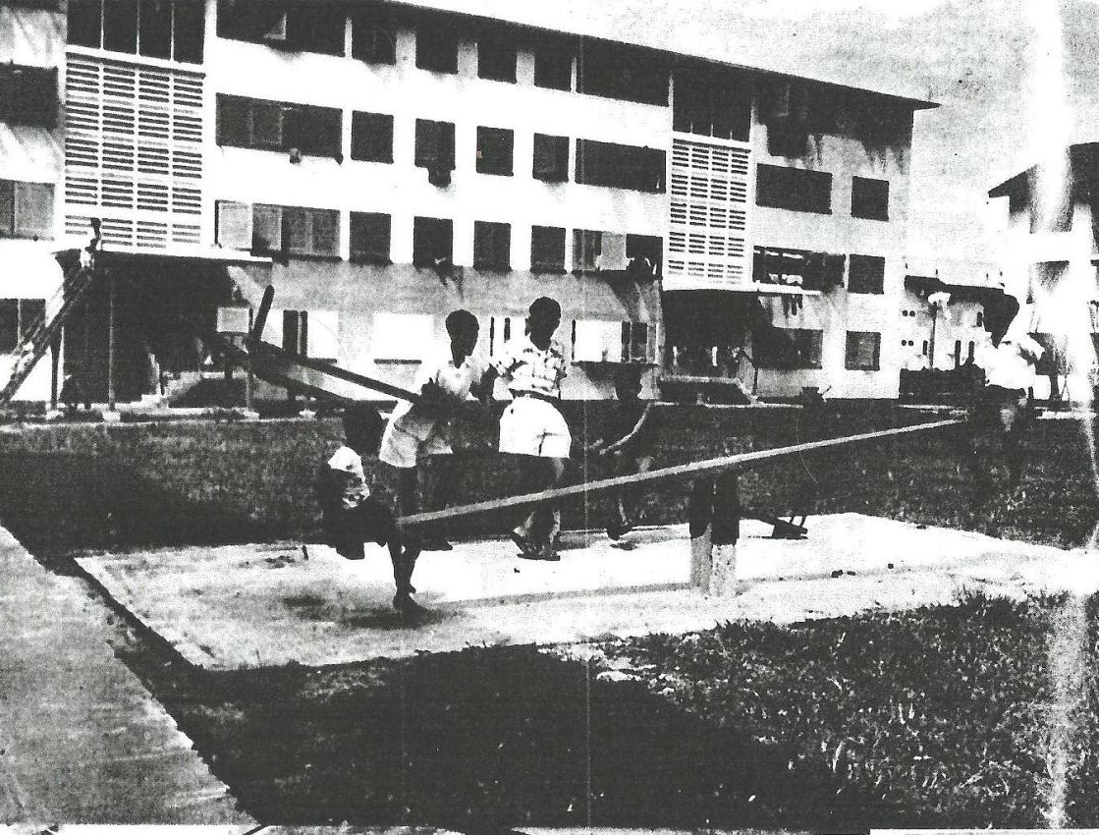
How did we design for the climate in past?
Singapore Improvement Trust (1957)
Notes:
Note the ventilation holes in the structure to encourage natural ventilation yet maintain shade.

Slide 21
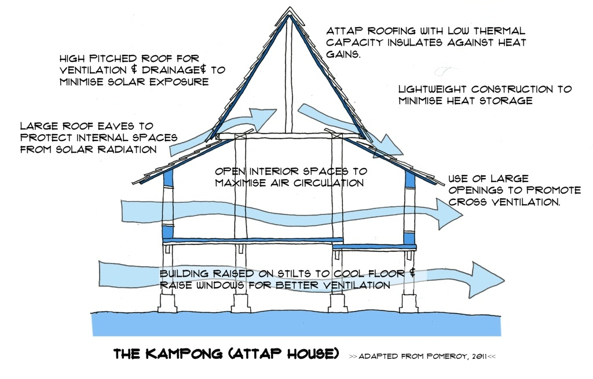
Vernacular Features – Summary
Notes:
Why the vernacular is important – we should look back and understand how to adapt this for the future.
1. Increased Authenticity and Identity: Cultural Sustainability
There is considerable disenchantment with the 'International Style' which has led to many cities losing their distinctive character and becoming more like each other. There is an increasing emphasis and interest in regionally distinct and culturally valid design which is based on fundamental concepts (including spatial relationships) much beyond the superficial ideas of style and surface image (Frampton, 1985). These movements recognise that a culturally valid response must be CONTEXT (ie PLACE) derived: the context is climatic, cultural, social and economic. It also suggests that responses can be more effectively made by the people within the place, with a greater recognition of local traditions, knowledge and skill and less reliance on imported experts and ideas. This is precisely what VERNACULAR architecture does so naturally.
2. Ecological Sensitivity: Environmental Sustainability
From many perspectives we can see that the traditional, holistic ways of building are much more SUSTAINABLE, indeed they have demonstrated their sustainability for centuries (in contrast to 20 th century ideas which way well be short lived). Low energy consumption, use of local materials, sensitivity to sites (light footprints); ingenious, creative use of resources, response to micro-climate etc. Such issues are higher up the agenda today so there is much we can learn.

